Slide 1
Procedural details from the SPYRAL HTN OFF-MED Trial of Renal Denervation for Uncontrolled Hypertension
Dr. Felix Mahfoud
Klinik für Innere Medizin III, Universitätsklinikum des Saarlandes, Homburg/Saar, Germany
and
Felix Mahfoud,¹ David Kandzari,² Michael Böhm,¹ Michael Weber,³ Kazuomi Kario,⁴ Martin Fahy,⁵ and Raymond Townsend⁶ on behalf of the SPYRAL HTN-OFF MED Trial Investigators
¹Klinik für Innere Medizin III, Universitätsklinikum des Saarlandes, Universität des Saarlandes, Homburg/Saar, Germany; ²Piedmont Heart Institute, Atlanta, GA, USA; ³SUNY Downstate College of Medicine, Brooklyn, NY, USA; ⁴Jichi Medical University School of Medicine, Tochigi, Japan; ⁵Medtronic PLC, Santa Rosa, CA, USA; ⁶Perelman School of Medicine, University of Pennsylvania, Philadelphia, PA, USA

Slide 2
SPYRAL HTN Clinical Program
Background
Two new randomized prospective sham controlled trials have demonstrated significant blood pressure reduction in uncontrolled hypertensive patients in both the presence and absence of concomitant pharmacologic therapy:
SPYRAL HTN-OFF MED
SPYRAL HTN-ON MED
Anatomical eligibility criteria were less restrictive in the SPYRAL HTN trials, allowing therapy in smaller vessels and accessory arteries.
We examined the association of anatomical and procedural determinants with blood pressure changes to determine whether these variables can help identify the most eligible procedural candidates.

Slide 3
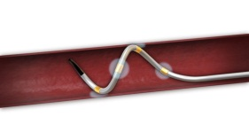
SPYRAL HTN Clinical Program
Advances of SPYRAL HTN Compared to SYMPLICITY HTN-3
Medications
Patients
Procedure
SYMPLICITY HTN-3
5.1 prescribed anti-HTN drugs at randomization
No drug adherence testing
Resistant hypertension patients (OSBP 180±16)
No diastolic cutoff
Mono-electrode, sequential ablation system
Mostly inexperienced operators without proctoring
Main artery RDN only
Ablations per pt: 11.2 ± 2.8
SPYRAL HTN
No anti-HTN drugs at time of randomization
Drug adherence testing by serum and urine
Moderate hypertension patients (OSBP 162±7)
Excluding ISH patients (ODBP 101±7)
Four-electrode, simultaneous ablation system
Highly experienced operators with proctoring
Main + branches RDN
Ablations/pt: 43.8 ± 13.1

Slide 4
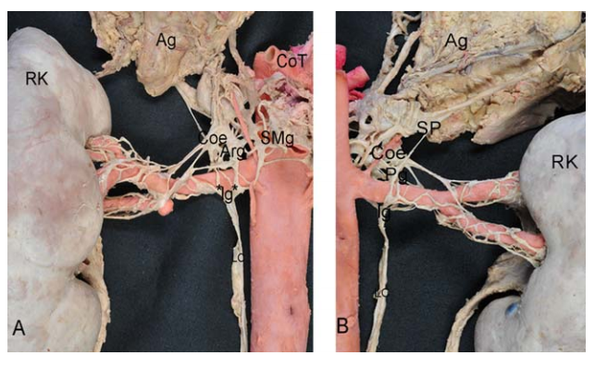
Renal Nerve Anatomy
Renal nerves generally originate from the aorta and arborise towards the kidney.
Nerve fibers do not completely converge on the renal artery until beyond the main bifurcation.
Mompeo et al. Clin Anat. 2016 Jul;29(5):660-4.

Slide 5
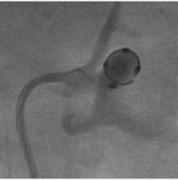
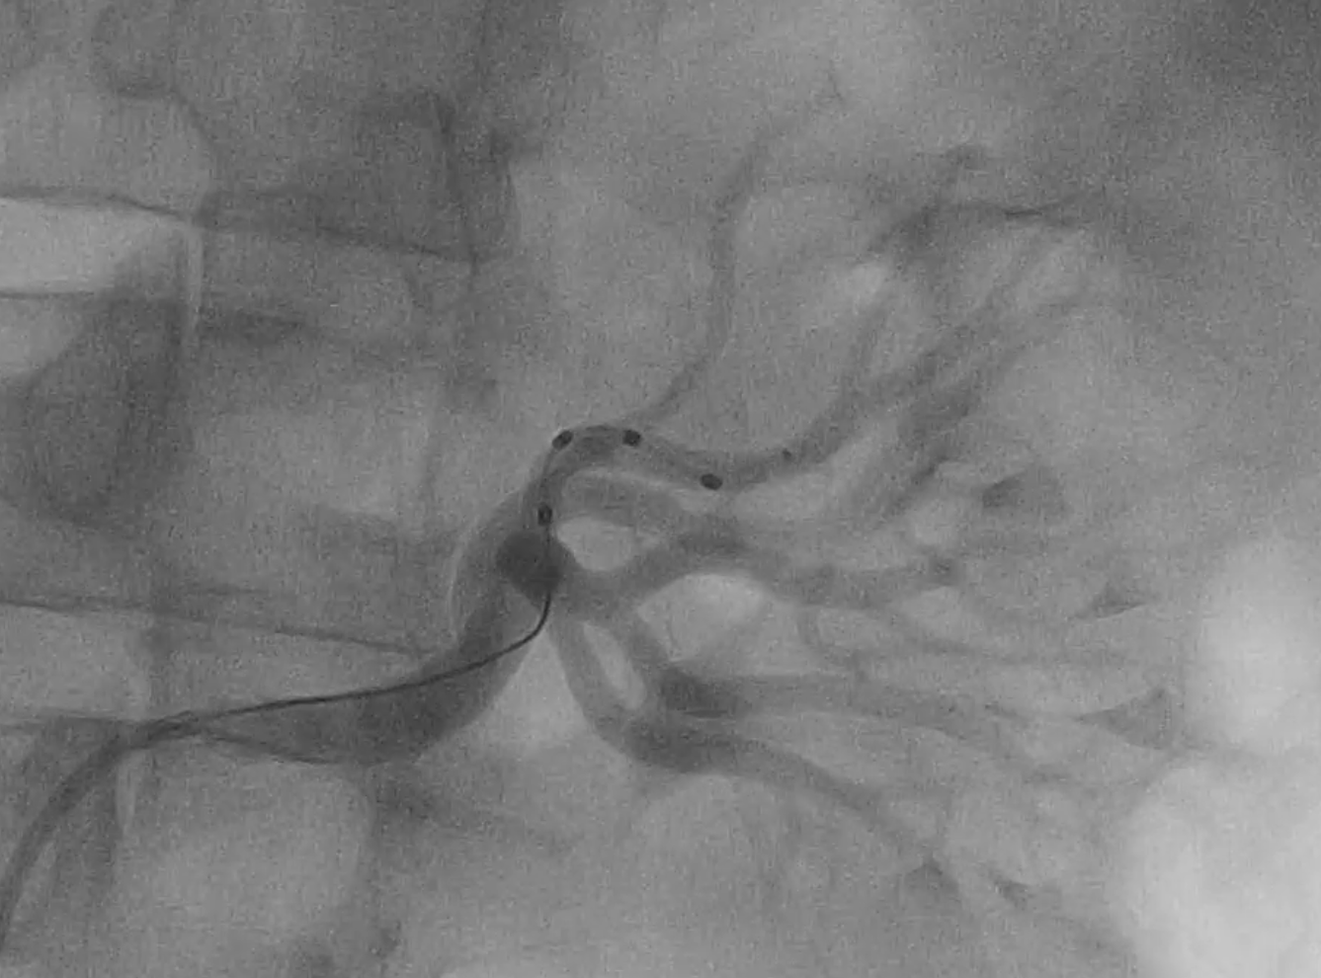
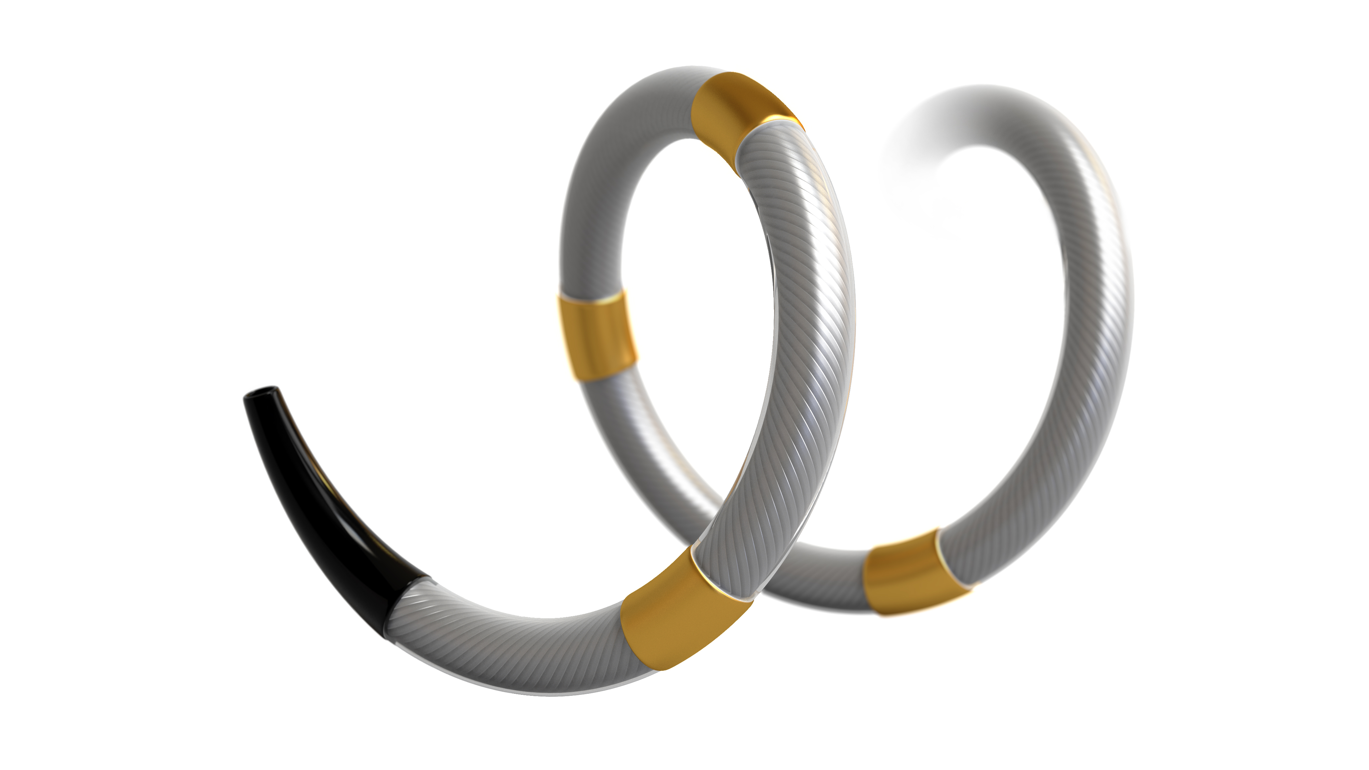
SPYRAL HTN Clinical Program
Study Device: Symplicity Spyral™ Catheter
Multi-electrode catheter with quadrantic vessel contact for simultaneous ablation in up to 4 electrodes
60-second simultaneous energy delivery
Vessel diameter range: 3 – 8 mm
Flexible catheter allows branch treatment
6F guiding catheter compatible

Slide 6
SPYRAL HTN – OFF MED
Study Design
Randomized, sham-controlled, (patient and assessor) blinded, proof-of-concept trial
25 sites in Germany, UK, Austria, Greece, Japan, Australia and USA
SCREENING
ENROLLMENT
Inclusion criteria:
Office SBP ≥150 to <180
Patient is either drug naïve or permitting discontinuation of antihypertensive medications
Sham Control + Medications
every 2 weeks
3M
6M
12-36M
3-4 weeks¹
1-2
weeks¹
Drug titration
until OSBP<140
Unblinding and optional crossover to RDN
VISIT 1
VISIT 2
R
Office SBP
SBP≥150 to <180
DBP ≥90
Drug naïve or stop meds
2-week
safety check²
Drug testing
Office BP
SBP≥150 to <180
DBP ≥90
Witnessed drug intake
24-hr ABPM
SBP ≥140 to <170
Renal Denervation + Medications
every 2 weeks
3M
6M
12-36M
Office BP
Drug testing³
Office BP
Witnessed drug intake⁴
24-hr ABPM
Screen failure if OSBP ≥180
¹ According to scheduling ² Only for patients discontinuing anti-hypertensive medications ³ Drug testing not done at 24 and 36 months ⁴ If prescribed to achieve OSBP <140
Clinicaltrials.gov NCT02439749
Kandzari D, et al. Am Heart J. 2016;171:82-91.

Slide 7
SPYRAL HTN-OFF MED
Anatomic Eligibility
Main renal arterial vessel diameter greater than 3mm and less than 8mm in each kidney
Anatomy allows for simultaneous quadrantic radio frequency ablations in the main renal artery or in all branch vessels greater than 3mm and less than 8mm
No exclusion for main vessels < 20mm
No exclusion for presence accessory vessels

Slide 8
SPYRAL HTN – OFF MED
Patient Baseline Characteristics
Mean ± SD or % | RDN (N = 38) | Sham Control (N = 42)
Age (years) | 56 ± 10 | 53 ± 12
Male | 68 | 74
BMI (kg/m²) | 30± 5 | 30±5
Diabetes (type 2) | 2.6 | 7.1
Current smoker | 11 | 24
Obstructive sleep apnea | 7.9 | 7.1
Peripheral artery disease | 2.6 | 0
Coronary artery disease† | 0 | 4.8
Stroke and transient ischemic attack† | 2.6 | 0
Myocardial infarction / acute coronary syndrome† | 0 | 2.4
† Events occurred > 3 months before randomization
P = NS for differences in all baseline characteristics

Slide 9
SPYRAL HTN – OFF MED
Baseline Blood Pressure
Mean ± SD | RDN | Sham Control
Office measurements | N = 38 | N = 42
Office SBP (mm Hg) | 162.0 ± 7.6 | 161.4 ± 6.4
Office DBP (mm Hg) | 99.9 ± 6.8 | 101.5 ± 7.5
Office heart rate (bpm) | 71.1 ± 11.0 | 73.4 ± 9.8
24-hour measurements | N = 37 | N = 42
Mean 24-hour SBP (mm Hg) | 153.4 ± 9.0 | 151.6 ± 7.4
Mean 24-hour DBP (mm Hg) | 99.1 ± 7.7 | 98.7 ± 8.2
Mean 24-hour heart rate (bpm) | 72.3 ± 10.9 | 75.5 ± 11.5
P = NS for differences in all baseline characteristics

Slide 10
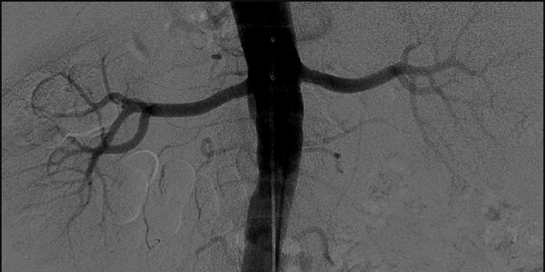
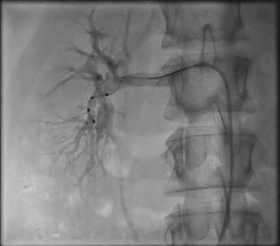
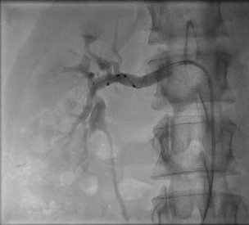
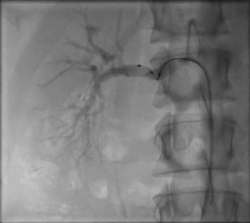
SPYRAL HTN Clinical Program
Study Procedure & Imaging Requirements
Plan to treat main renal artery and any branch and/or accessory with diameter 3-8 mm located outside the kidney parenchyma
Protocol required intensive imaging documentation:
Before or after each ablation to verify position of energy delivery: cine with contrast
After ablation of each vessel to confirm and record the condition entire vessel: cine with contrast

Slide 11
SPYRAL HTN – OFF MED
RDN Procedural Details – Main Vessel
Right Kidney
Length
Mean | 31.9 ± 14.8
Proximal Mid Distal | 9.0 ± 6.1 9.6 ± 5.5 8.6 ± 5.1
Total length treated | 27.0 ± 15.3
Diameter
Mean | 5.4 ± 1.0
Proximal Mid Distal | 5.5 ± 1.0 5.2 ± 0.9 5.1 ± 1.0
Left Kidney
Length
Mean | 28.8 ± 12.3
Proximal Mid Distal | 7.7 ± 5.0 9.4 ± 4.4 8.2 ± 4.3
Total length treated | 24.9 ± 12.5
Diameter
Mean | 5.1 ± 1.1
Proximal Mid Distal | 5.2 ± 1.2 5.0 ± 1.1 4.9 ± 1.1
Main vessel
Per patient
Multiple main vessels | 21.1% (8/38)
Main vessels treated | 2.2 ± 0.5
Main vessel ablations | 17.9 ± 10.5
Measurements in mm (mean ± SD)

Slide 12
SPYRAL HTN – OFF MED
Renal Denervation Procedural Details
Right Kidney
Total no. branches | 6.4 ± 2.6
Branches length
Mean length per branch | 19.7 ± 11.1
Total branch length | 125.0 ± 50.8
Total treated length | 16.4 ± 9.8
Branches diameter
Mean diameter | 3.7 ± 0.8
Left Kidney
Total no. branches | 5.9 ± 2.8
Branches length
Mean length per branch | 19.4 ± 10.3
Total branch length | 105.5 ± 47.2
Total treated length | 14.3 ± 7.7
Branches diameter
Mean diameter | 3.6 ± 0.9
Branches
Per patient
Total no. branches | 12.3 ± 4.8
Branches treated | 5.2 ± 2.5
Branch ablations | 25.9 ± 12.8
Measurements in mm (mean ± SD)

Slide 13
SPYRAL HTN – OFF MED
Procedural Details
SPYRAL HTN – OFF MED Mean ± SD | RDN (N = 38) | Sham Control (N = 42)
Total number of ablations per patient | 43.8 ± 13.1 | NA
Treatment time (min) | 57.1 ± 19.7 | NA
Contrast volume used (cc) | 251.0 ± 99.4 | 83.3 ± 38.5
Real World Experience: Global SYMPLICITY Registry
GSR Mean ± SD | Spyral™ Patients (N=351)
Total number of ablations per patient | 21.4 ± 11.21
Treatment time (min) | 32.5 ± 23.1
Contrast volume used (cc) | 117.5 ± 79.9

Slide 14
SPYRAL HTN – OFF MED
Procedural Details
SPYRAL HTN – OFF MED Mean ± SD | RDN (N = 38) | Sham Control (N = 42)
Total number of ablations per patient | 43.8 ± 13.1 | NA
Treatment time (min) | 57.1 ± 19.7 | NA
Contrast volume used (cc) | 251.0 ± 99.4 | 83.3 ± 38.5
Serum creatinine change (baseline – discharge, mg/dL) | -0.00 ± 0.15 | -0.01 ± 0.08 †
eGFR change (baseline – discharge, ml/min/1.73 m²) | 2.43 ± 9.66 | 0.05 ± 9.63 †
†P = NS
Real World Experience: Global SYMPLICITY Registry
GSR Mean ± SD | Spyral™ Patients (N=351)
Total number of ablations per patient | 21.4 ± 11.21
Treatment time (min) | 32.5 ± 23.1
Contrast volume used (cc) | 117.5 ± 79.9

Slide 15
SPYRAL HTN – OFF MED
Renal Function
No differences in renal function at any time point
P = NS at all timepoints

Slide 16
SPYRAL HTN – OFF MED
Blood Pressure Change from Baseline to 3 Months
24-hr SBP
24-hr DBP
Office SBP
Office DBP
Baseline BP (mmHg)
154
152
100
99
162
161
100
101
n=35
n=36
n=35
n=36
n=37
n=41
n=37
n=41
Δ -5.0 mmHg
(-9.9, -0.2)
P=0.04
Δ -4.4 mmHg
(-7.2, -1.6)
P=0.002
Δ -4.9 mmHg
(-8.5, -1.4)
P=0.008
Δ -7.7 mmHg
(-14.0, -1.5)
P=0.02

Slide 17
SPYRAL HTN – OFF MED
Accessory Arteries – Blood Pressure Change to 3 Months
Patient with
Accessory Arteries
Patient without
Accessory Arteries
n=7
n=28
Δ -2.5 mmHg
P = 0.58

Slide 18
SPYRAL HTN – OFF MED
Number of Ablations (Tertiles): Blood Pressure Change at 3 Months
Office Systolic BP
24-hr Systolic BP
Ablations
<38
38-48
≥49
<38
38-48
≥49
Baseline BP (mmHg)
165
161
160
157
154
150
n=13
n=10
n=14
n=12
n=9
n=14
± 6.0
± 13.8
± 9.7
± 14.7
± 16.0
± 16.3
P = 0.69
P = 0.98
Notes:
T01a_eff_ITT_off_ANG_ABL

Slide 19
SPYRAL HTN – OFF MED
Main Vessel Diameter (Tertiles): Blood Pressure Change at 3 Months
Office Systolic BP
24-hr Systolic BP
RVD (mm)
<4.87
4.87–5.64
≥5.64
< 4.87
4.87–5.64
≥ 5.64
Baseline BP (mmHg)
162
164
161
153
156
151
n=11
n=13
n=13
n=11
n=12
n=12
± 14.2
± 7.0
± 9.0
± 14.7
± 18.9
± 14.1
P = 0.94
P = 0.87
Notes:
T01a_eff_ITT_off_ANG_RVD

Slide 20
SPYRAL HTN – OFF MED
Main Vessel Treated Length (Tertiles): Blood Pressure Change at 3 Months
Office Systolic BP
24-hr Systolic BP
Treated Length
<44.2
44.2–58.8
≥58.8
< 44.2
44.2–58.8
≥ 58.8
Baseline BP (mmHg)
161
163
162
152
154
154
n=12
n=12
n=13
n=11
n=11
n=13
± 7.3
± 13.2
± 10.2
± 11.2
± 19.2
± 16.4
P = 0.88
P = 0.66
Notes:
T01a_eff_ITT_off_ANG_RVD

Slide 21
SPYRAL HTN – OFF MED
Safety Results at 3 Months
% | RDN (n = 38) | Sham Control (n = 42)
Death | 0 | 0
New myocardial infarction | 0 | 0
Major bleeding (TIMI¹) | 0 | 0
New onset end stage renal disease | 0 | 0
Serum creatinine elevation >50% | 0 | 0
Significant embolic event resulting in end-organ damage | 0 | 0
Vascular complications | 0 | 0
Dissections | 0 | 0
Perforations | 0 | 0
Hospitalization for hypertensive crisis/emergency | 0 | 0
New stroke | 0 | 0
¹TIMI definition: intracranial hemorrhage, ≥5g/dl decrease in hemoglobin concentration, a ≥15% absolute decrease in hematocrit, or death due to bleeding within 7 days of the procedure

Slide 22
SPYRAL HTN – OFF MED
Implications for Clinical Practice
Renal anatomy is heterogeneous
Multiple main vessels (accessories) were common (21%)
Multiple branch vessels (>2) vessels are common
Imaging requirements from study protocol are not reflective of real world experience
GSR showed significantly less contrast & treatment time
Complete treatment of the main and branch vessels with the Symplicity Spyral is feasible and no acute adverse events were reported

Slide 23
SPYRAL HTN – OFF MED
Conclusions
Clinically meaningful blood pressure reductions were observed compared to sham-control at 3 months in uncontrolled hypertensive patients in the absence of anti-hypertensive medications
No major safety events were reported despite a more complete procedure that extended into renal artery branch vessels
Clinical trial procedure times and contrast volumes may not reflect real world clinical experience due to strict protocol requirements
Post hoc analyses of anatomic procedural variables did not reveal any significant differences in BP response to renal denervation between subjects. However analyses were limited by small sample size and, possibly, the rigid protocol requirements for the denervation procedure

