Slide 1
C. Michael Gibson, MS, MD on behalf of the PIONEER Investigators
An OPen-label, Randomized, Controlled, Multicenter Study ExplorIng TwO TreatmeNt StratEgiEs of Rivaroxaban and a Dose-Adjusted Oral Vitamin K Antagonist Treatment Strategy in Subjects With Atrial Fibrillation Who Undergo Percutaneous Coronary Intervention PIONEER AF-PCI
Gibson et al. AHA 2016

Slide 2
Disclosure
Dr. Gibson has received research grant support and consulting fees in the past from all major manufacturers of antiplatelets and antithrombins
This is an educational lecture and is not intended to be an inducement to use any drug or drug in a fashion that is inconsistent with the drug or device label. Rivaroxaban is not approved for use in acute coronary syndromes in the US, but is so in many other countries
The slides were prepared by C. Michael Gibson, M.S., M.D. and / or were under the editorial control of C. Michael Gibson, M.S., M.D.
Gibson et al. AHA 2016

Slide 3
Conflict of Interest Statement
Present Research/Grant Funding
Angel Medical Corporation
Bayer Corp.
CSL, Inc.
Ikaria, Inc.
Janssen Pharmaceuticals
Johnson & Johnson Corporation
Portola Pharmaceuticals
Stealth Peptides, Inc.
St. Jude Medical
Peer to Peer Communications
Eli Lilly and Company
The Medicines Company
Royalties as a Contributor
UpToDate in Cardiovascular Medicine
Spouse:
Employee of Boston Clin Res Institute with equity
Consultant
(all with moderate support)
Amarin Pharama
Amgen
Boston Clinical Research Institute
Cardiovascular Research Foundation
CSL Behring
Eli Lilly and Company
Gilead
Novo Nordisk
Pfizer
Pharma Mar
Roche Diagnostics
St. Francis Hospital
St. Jude Medical
The Medicines Company
Web MD
Consultant (with $0.00 monies received by Dr. Gibson)
Bayer Corporation
Janssen Pharmaceuticals
Johnson & Johnson Corporation
Ortho McNeil
Gibson et al. AHA 2016

Slide 4
Epidemiology and AF and PCI
AF and CAD often occur together because of the strong association of both conditions with aging and overlapping risk factors
@ 1 Billion people in US and Europe
@ 20 Million with AF (1-2% of population)^{1,2}
@ 16 Million anticoagulation indicated (80%) ^{1,2}
@ 4.8 Million have CAD as well (20%-45%) ^{1,2}
@ 1- 2 Million potential revasc (20%-25%) ^{3,4}
24.9% of patients with AF enrolled in ARISTOTLE had prior PCI⁴
1. The AFFIRM Investigators. Am Heart J 2002;143:991–1001; 2. Carpodanno D et al, Circ Cardiovasc Interv 2014;7:113–124; 3. Kralev S et al, PLoS One 2011;6:e24964; 4. Bahit MC et al, Int J Cardiol 2013;170:215–220
Gibson et al. AHA 2016

Slide 5
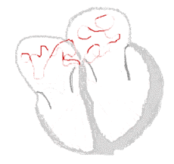
The Optimal Management of Atrial
Fibrillation and ACS Differ
Atrial Fibrillation (ACTIVE W)¹: The combination of aspirin and clopidogrel is not as effective as warfarin in patients with AF¹
However
Stenting (STARS)²: The combination of aspirin and a thienopyridine is more effective than warfarin in patients with coronary stents ²
1. Lancet 2006 Jun 10;367(9526):1903-12. 2. N Eng J Med 1998 Dec 3;339(23):1665-71.
Gibson et al. AHA 2016

Slide 6
Dose of Rivaroxaban Varies in ACS & Atrial Fibrillation Patients
ACS/
Stenting
Atrial
Fibrillation
Stent
+
Afib
DAPT +
2.5 mg BID Riva
Riva 20 mg QD
4 Fold Difference in Riva Dose Between ACS and AF
Schmitt J et al Atrial fibrillation in acute myocardial infarction: a systematic review of the incidence, clinical features and prognostic implications. Eur Heart J 2009;30:1038–1045.
Gibson et al. AHA 2016

Slide 7
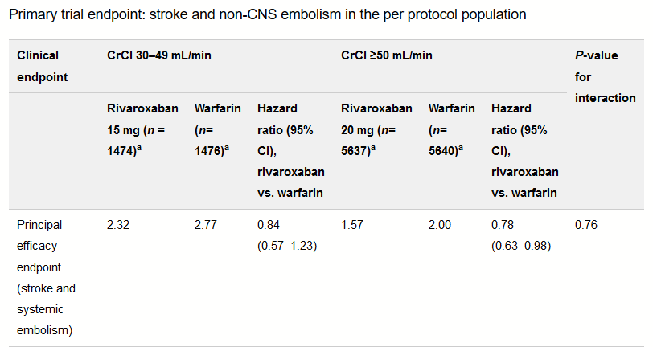
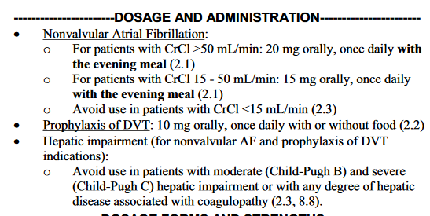
ROCKET Trial Data Regarding 15 mg Rivaroxaban Dose and FDA Label
Fox et al EHJ DOI: http://dx.doi.org/10.1093/eurheartj/ehr342 2387-2394 First published online: 28 August 2011
http://www.accessdata.fda.gov/drugsatfda_docs/label/2011/202439s001lbl.pdf
Gibson et al. AHA 2016

Slide 8
Ｊ-ＲＯＣＫＥＴ ＡＦ: Primary Efficacy Endpoint
(%)
7
Event Rate (%/year) | Rivaroxaban | Warfarin
Stroke or Systemic Embolism | 1.26 | 2.61
6
Cumulative Event Rate
Warfarin
5
Hazard Ratio (95% CI): 0.49 (0.24-1.00)
P =0.050 (two-sided test)#
4
3
Rivaroxaban 15 mg
2
1
0
0
100
200
300
400
500
600
700
800
900
Days from Randomization
No. of Patients
Rivaroxaban | 637 | 593 | 563 | 542 | 443 | 313 | 217 | 156 | 48 | 0
Warfarin | 637 | 581 | 547 | 517 | 406 | 285 | 212 | 154 | 48 | 0
CI, confidence interval.
Per-protocol, on-treatment population
Analysis method: Cox proportional hazard model
Gibson et al. AHA 2016
Hori M et al. Circ J 2012; 76: 2104-2111
Notes:
8
Now, let’s look at the Primary Efficacy Endpoint in the J-ROCKET AF trial.
- The endpoint event rates were 1.26% per year in the rivaroxaban group and 2.61% per year in the warfarin group, indicating an obvious trend toward decrease in event rate in the rivaroxaban group.
- However, since the sample size of the J-ROCKET AF trial was one-tenth of that of the global study, the difference was not statistically significant enough to prove the superiority of rivaroxaban.

Slide 9
Is ASA Necessary In Triple Therapy?
The WOEST trial
Modest-scale, open-label WOEST study (N=573) compared safety outcomes with triple therapy (VKA + clopidogrel + ASA) vs dual therapy (VKA + clopidogrel) 69% of WOEST patients had AF, included prosthetic heart valves
Safety outcomes
Efficacy outcomes
VKA + clopidogrel (dual therapy) (n=279)
VKA + clopidogrel + ASA (triple therapy) (n=284)
*
*
Power
23% CV Death
13.7%
30.6%
*
*p<0.05.
** All-cause death (CV & non-CV death p = 0.207 & 0.069)
Dewilde WJ et al, Lancet 2013;381:1107–1115
Gibson et al. AHA 2016

Slide 10
Patients With Atrial Fibrillation Undergoing Coronary Stent Placement: PIONEER AF-PCI
End of treatment 12 months
R
A
N
D
O
M
I
Z
E
Rivaroxaban 15 mg qd* Clopidogrel 75 mg qd†
2100 patients with NVAF
Coronary stenting
No prior stroke/TIA, GI bleeding, Hb<10, CrCl<30
WOEST Like
1,6, or 12 months
≤72 hours
After
Sheath
removal
Pre randomization MD Choice
Rivaroxaban 2.5 mg bid Clopidogrel 75 mg qd†
Aspirin 75-100 mg qd‡
Rivaroxaban 15mg QD
Aspirin 75-100 mg qd
ATLAS Like
1,6, or 12 months
Pre randomization MD Choice
Triple
Therapy
VKA∆ (target INR 2.0-3.0) Clopidogrel 75 mg qd†
Aspirin 75-100 mg qd
VKA∆(target INR 2.0-3.0) Aspirin 75-100 mg qd
Primary endpoint: TIMI major + minor + bleeding requiring medical attention
Secondary endpoint: CV death, MI, and stroke (Ischemic, Hemorrhagic, or Uncertain Origin)
*Rivaroxaban dosed at 10 mg once daily in patients with CrCl of 30 to <50 mL/min.
†Alternative P2Y₁₂ inhibitors: 10 mg once-daily prasugrel or 90 mg twice-daily ticagrelor.
‡Low-dose aspirin (75-100 mg/d). ∆ Open label VKA
Gibson et al. AHA 2016

Slide 11
Trial Organization
Trial Leadership:
Chairman: C. Michael Gibson, Co-Chairman: Keith Fox
Executive Committee
Christoph Bode, Marc Cohen, Johnathan Halperin, Steen Husted, Gregory YH Lip, Roxana Mehran, Eric Peterson, Freek Verheugt
Clinical Operations
PERFUSE Study Group, Boston; Johnson & Johnson Global Clinical Operations; Parexel
Statistics
PERFUSE Study Group, Megan Yee, Purva Jain, Serge Korjian, Yazan Daaboul
Clinical Events Committee
DCRI: Robert Harrison, MD (Chair), Joni O’Briant (Project Leader)
Data Safety Monitoring Board
Joseph Alpert (Chair, Cardiologist), John Easton (Neurologist), Douglas Weaver (Cardiologist), Alan Fisher (Statistician)
Sponsors: Johnson & Johnson and Bayer Health Care
J&J: Paul Burton, Peter Wildgoose, Mary Birmingham, Juliana Ianus, CV Damaraju
Bayer: Martin van Eickels
Gibson et al. AHA 2016

Slide 12
National Lead Investigators
GERMANY (295) |  | ARGENTINA (82) |  | SWEDEN (47) |  | AUSTRALIA (15)
S. Schellong |  | S. Macin |  | O. Fröbert |  | W. van Gaal
RUSSIA (265) |  | ITALY (72) |  | TURKEY (43) |  | MEXICO (13)
M. Ruda |  | D. Ardissino |  | H. Kultursay |  | C. Martinez
BULGARIA (221) |  | NETHERLANDS (68) |  | BRAZIL (41) |  | DENMARK (12)
J. Jorgova |  | J. Cornel |  | D. Precoma |  | T. Larsen
POLAND (218) |  | CANADA (66) |  | CZECH REPUBLIC (40) |  | MALAYSIA (11)
M. Tendera |  | R. Welsh |  | P. Widimsky |  | W. Azman
UNITED STATES (151) |  | UKRAINE (60) |  | KOREA, REPUBLIC OF (39) |  | SOUTH AFRICA (5)
CM. Gibson |  | O. Sychov |  | K. Seung |  | J.P. Roux
UNITED KINGDOM (131) |  | BELGIUM (52) |  | TAIWAN (25)
G. Lip |  | C. Beauloye |  | J. Lin
FRANCE (84) |  | ROMANIA (50) |  | CHILE (18)
G. Montalescot |  | D. Vinereanu |  | R. Corbalan
26 Countries 426 Sites
Gibson et al. AHA 2016
Notes:
12

Slide 13
CONSORT Diagram
2236 Patients screened
112 Patients did not meet eligibility criteria
Pre-Randomization
Physician Choice
2124 Patients enrolled in study
338 Stratified to DAPT 1 month
737 Stratified to DAPT 6 months
1049 Stratified to DAPT 12 months
R
ITT
709 Randomized to Group 1 (Riva + P2Y₁₂)
709 Randomized to Group 2 (Riva + DAPT)
706 Randomized to Group 3 (VKA + DAPT)
SAFETY
696 Group 1 (Riva + P2Y₁₂) Received ≥ 1 dose Riva
706 Group 2 (Riva + DAPT)
Received ≥ 1 dose Riva
697 Group 3 (VKA + DAPT) Received ≥ 1 dose VKA
146 Premature discontinuation
20 Deaths
0 Lost to follow up
3 Withdrawal of consent
123 Other reasons
149 Premature discontinuation
22 Deaths
0 Lost to follow up
3 Withdrawal of consent
124 Other reasons
205 Premature discontinuation
22 Deaths
0 Lost to follow up
3 Withdrawal of consent
180 Other reasons
Gibson et al. AHA 2016

Slide 14
Pre-Randomization Choice of Duration of DAPT & Thienopyridine: PIONEER AF-PCI
XARELTO® 15 mg qd* Clopi 95%, Ticag 4%, Prasugrel 1%
WOEST Like
R
A
N
D
O
M
I
Z
E
2100 patients with NVAF
Coronary stenting
No prior stroke/TIA, GI bleeding, Hb<10, CrCl<30
1 mo: 16%
6 mos: 35%
12 mos: 49%
≤ 72 hours
After
Sheath
removal
XARELTO® 2.5 mg bid Clopi 95%, Ticag 4%, Prasugrel 1%
Aspirin 75-100 mg qd‡
XARELTO® 15mg QD
Aspirin 75-100 mg qd
ATLAS Like
1 mo: 16%
6 mos: 35%
12 mos: 49%
VKA (target INR 2.0-3.0) Clopi 95%, Ticag 4%, Prasugrel 1%
Aspirin 75-100 mg qd
VKA (target INR 2.0-3.0) Aspirin 75-100 mg qd
TTR 65%
Triple
Therapy
Gibson et al. AHA 2016

Slide 15
Baseline Characteristics
 | Riva + P2Y₁₂ (N=709) | Riva + DAPT (N=709) | VKA + DAPT (N=706)
Age, mean ± SD | 70.4 ± 9.1 | 70.0 ± 9.1 | 69.9 ± 8.7
Sex, female, n (%) | 181 (25.5%) | 174 (24.5%) | 188 (26.6%)
Diabetes Mellitus, n (%) | 204 (28.8%) | 199 (28.1%) | 221 (31.1%)
Type of Index Event, n (%)
NSTEMI | 130 (18.5%) | 129 (18.4%) | 123 (17.8%)
STEMI | 86 (12.3%) | 97 (13.8%) | 74 (10.7%)
Unstable Angina | 145 (20.7%) | 148 (21.1%) | 164 (23.7%)
Stable Angina | 340 (48.5%) | 329 (46.8%) | 330 (47.8%)
Drug-eluting stent, n (%) | 464 (65.4%) | 471 (66.8%) | 468 (66.5%)
Type of Atrial Fibrillation, n (%)
Persistent | 146 (20.6%) | 146 (20.6%) | 149 (21.1%)
Permanent | 262 (37.0%) | 238 (33.6%) | 243 (34.5%)
Paroxysmal | 300 (42.4%) | 325 (45.8%) | 313 (44.4%)
Gibson et al. AHA 2016
Notes:
* p < 0.05

Slide 16
Proportion of Time in Therapeutic Range (TTR) by Region for the VKA Subjects
Overall TTR for INR of 2.0 to 3.0: 65.0%
8.9
10.0
7.0
10.3
7.9
8.2
3.9
4.5
3.7
4.4
3.3
4.1
TTR
65.0
60.7
64.4
64.4
66.6
63.6
9.6
9.0
8.1
9.2
9.9
10.4
12.7
15.9
16.9
10.5
13.1
14.2
N=651
N=60
N=43
N=237
N=276
N=35
Excluding the First 14 days of Exposure.
Proportion calculated within each subject firstly and then average across subjects within each region.
Gibson et al. AHA 2016

Slide 17
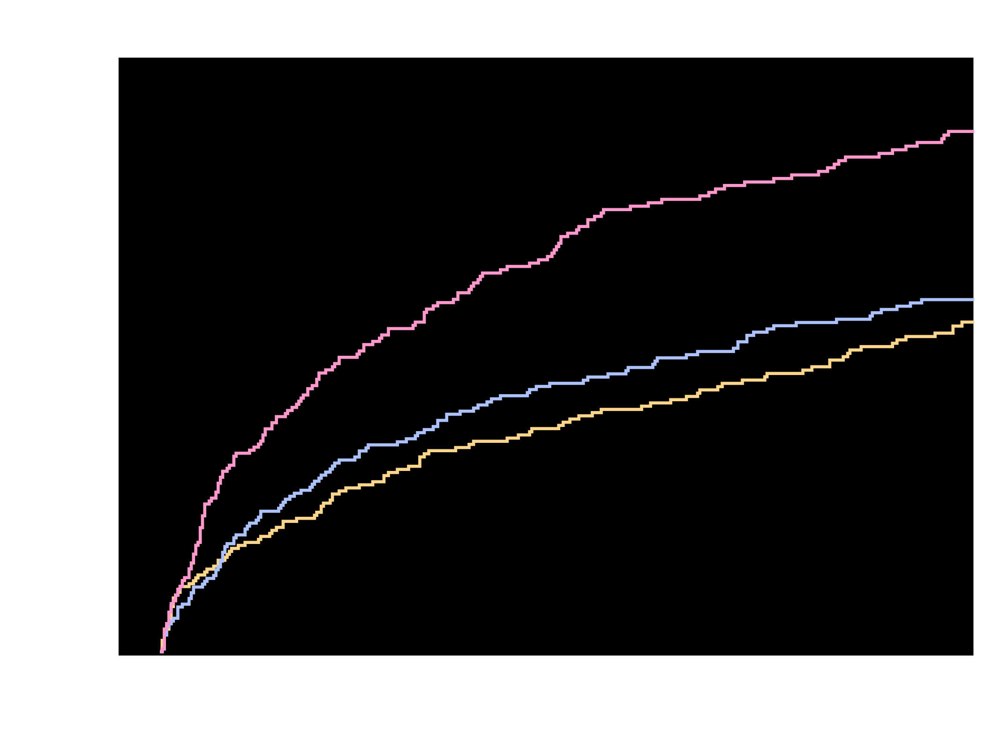
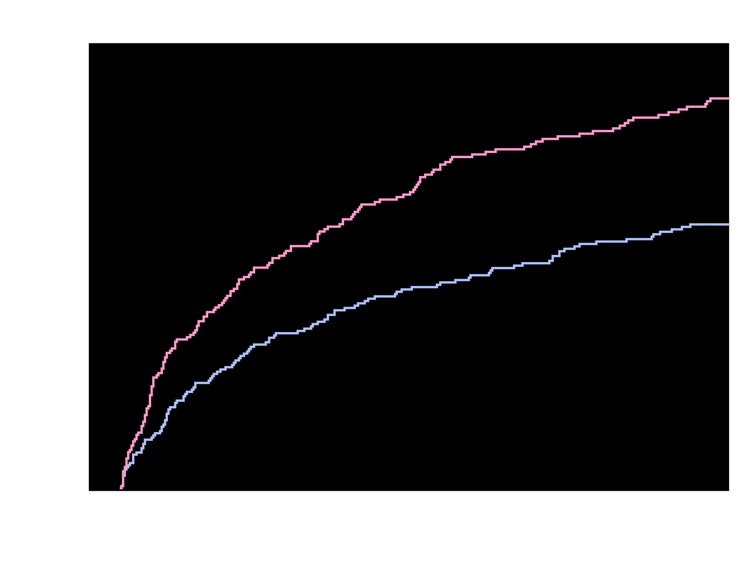
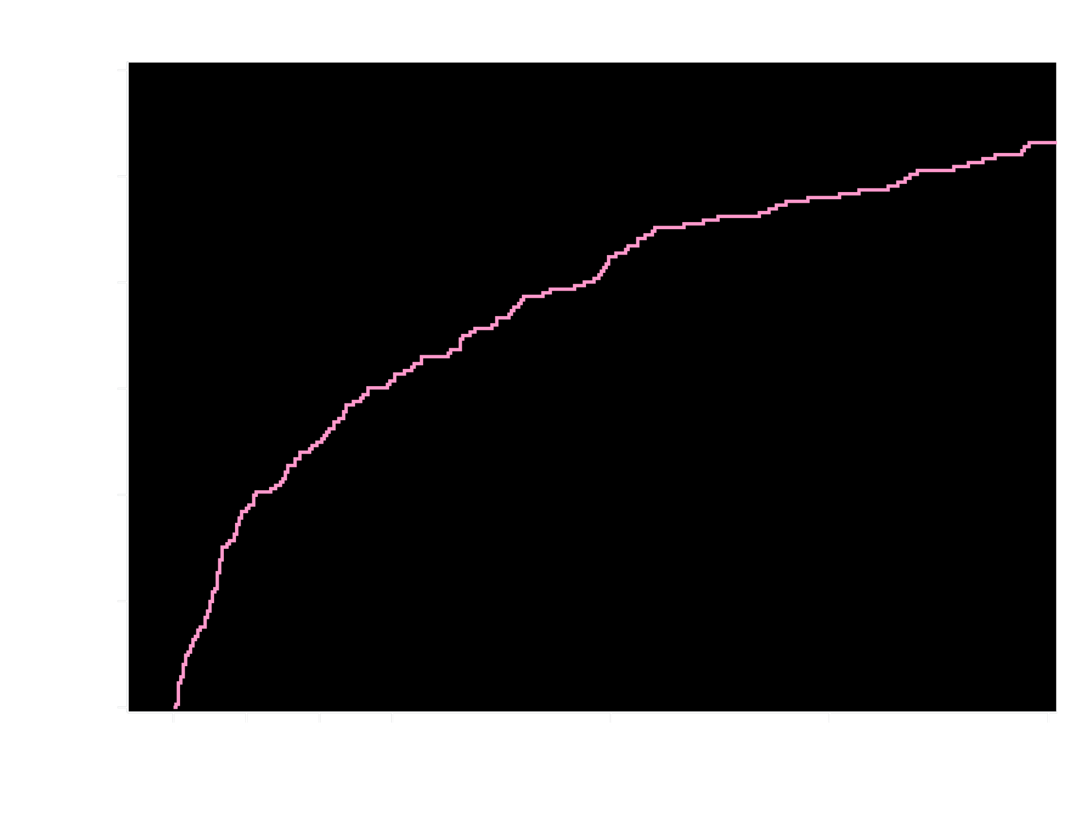
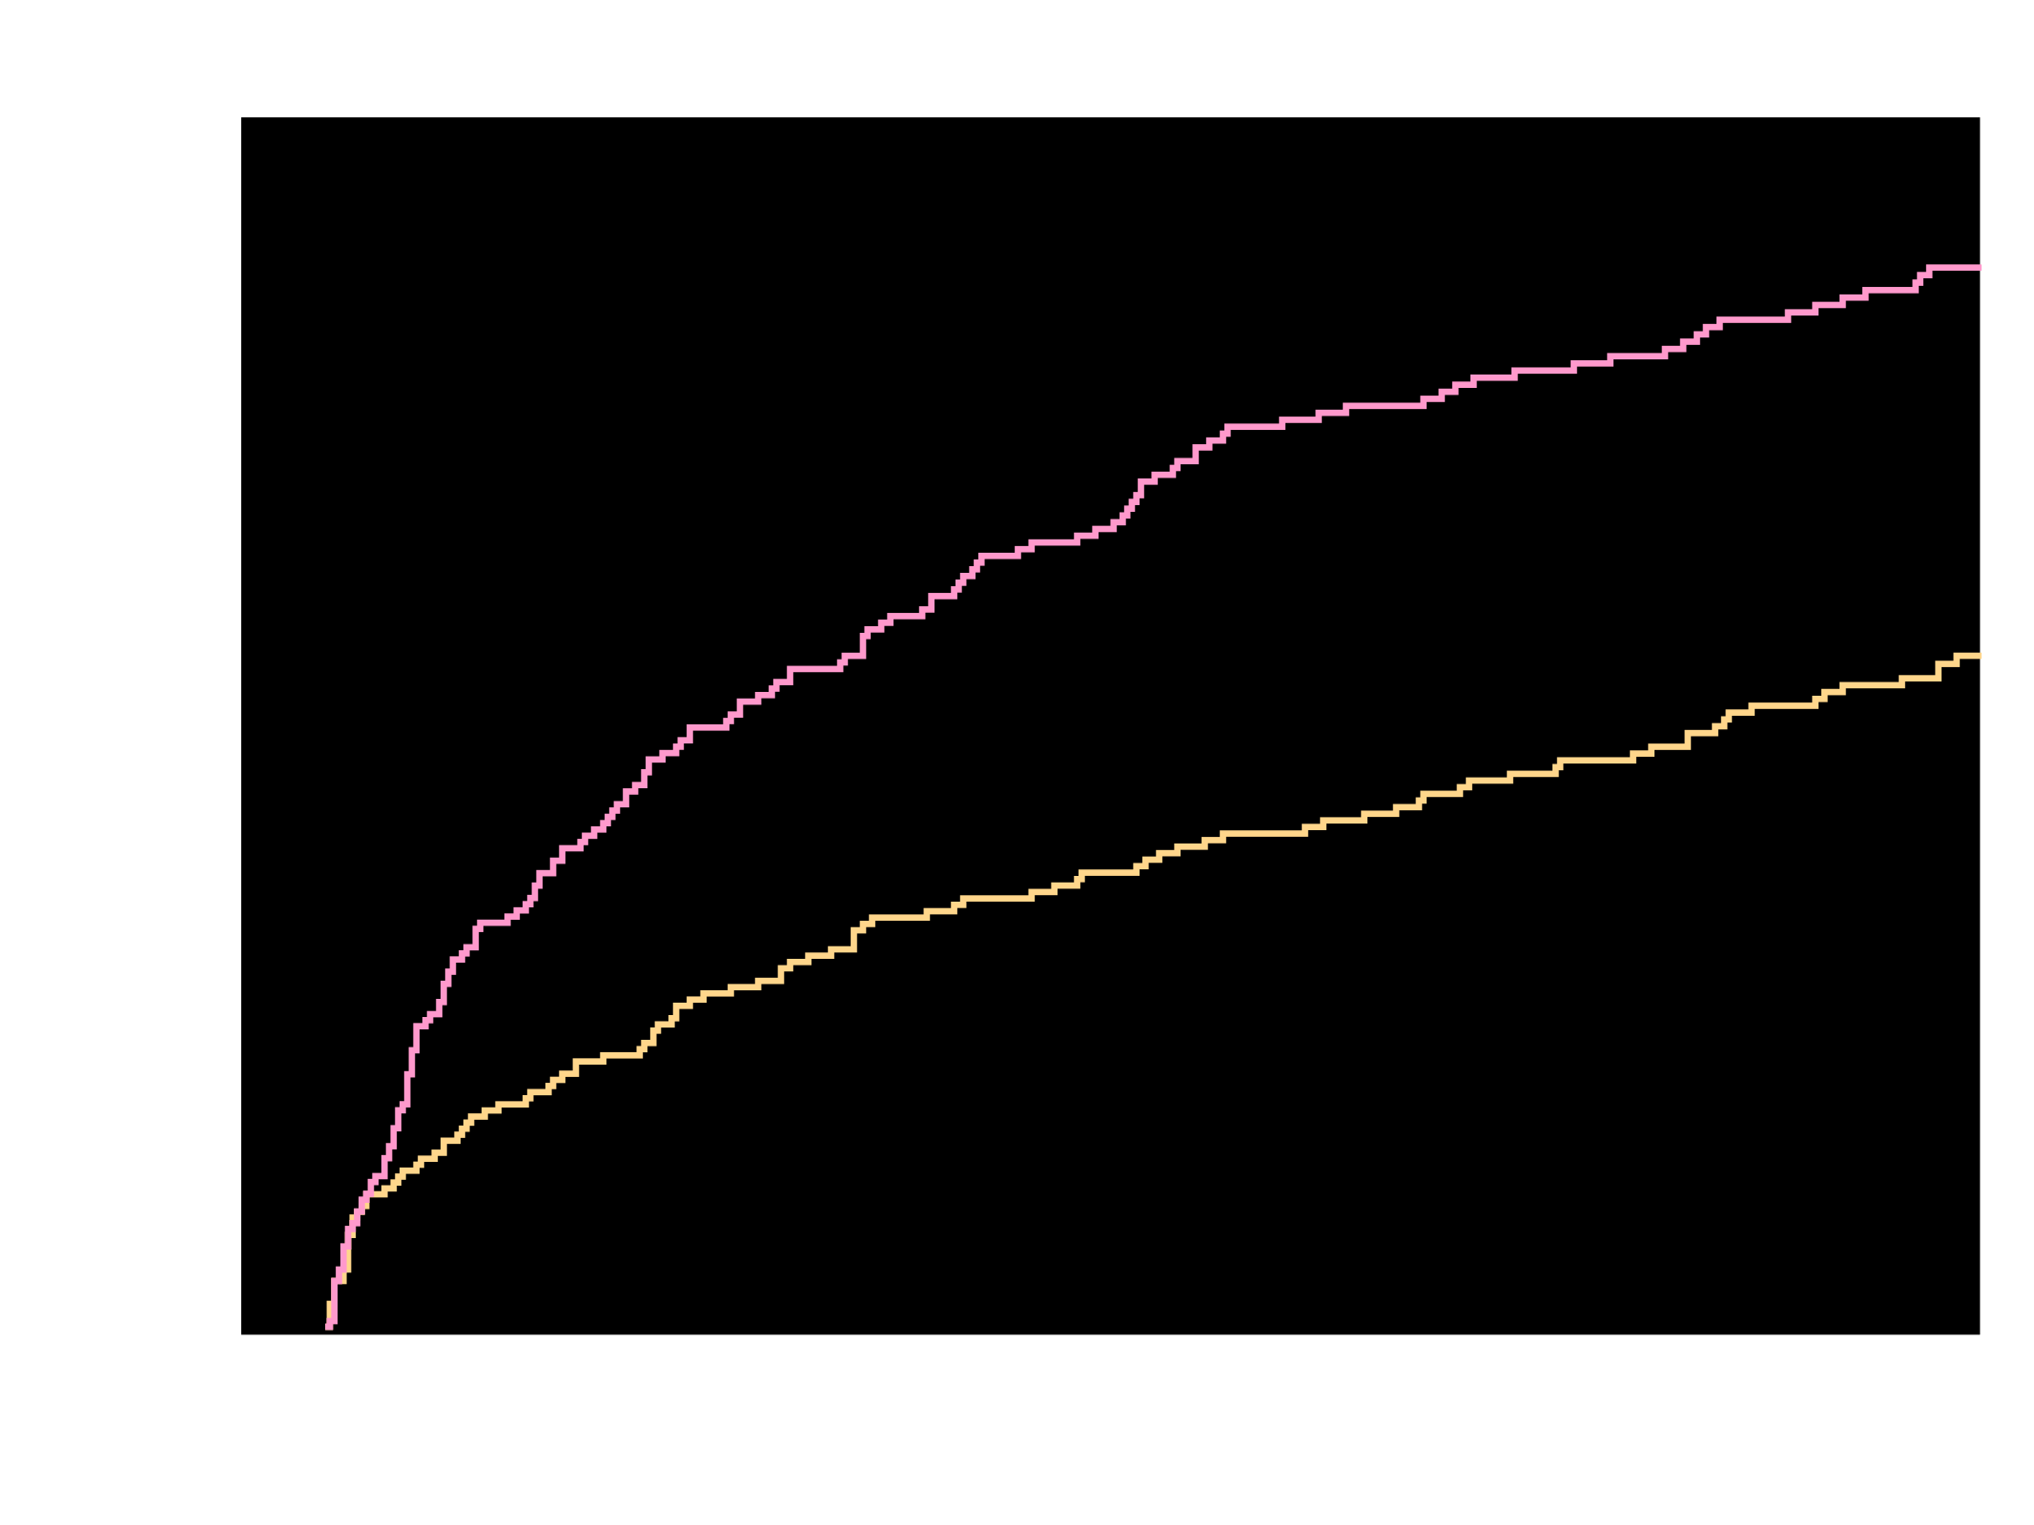
Kaplan-Meier Estimates of First Occurrence
of Clinically Significant Bleeding Events
TIMI Major, TIMI Minor, or Bleeding Requiring Medical Attention (%)
26.7%
p<0.00018
p<0.000013
18.0%
VKA + DAPT
16.8%
VKA + DAPT
VKA + DAPT
VKA + DAPT
Riva + DAPT
Riva + DAPT
Riva + P2Y₁₂
Riva + P2Y₁₂
HR = 0.63 (95% CI 0.50-0.80)
ARR = 8.7
NNT = 12
HR = 0.59 (95% CI 0.47-0.76)
ARR = 9.9
NNT = 11
Riva + P2Y₁₂ v. VKA + DAPT
HR=0.59 (95% CI: 0.47-0.76)
p <0.000013
ARR=9.9
NNT=11
Riva + DAPT v. VKA + DAPT
HR=0.63 (95% CI: 0.50-0.80)
p <0.00018
ARR=8.7
NNT=12
Days
No. at risk
VKA + DAPT
Riva + DAPT
VKA + DAPT
Riva + P2Y₁₂
VKA + DAPT
Riva + P2Y₁₂
Riva + DAPT
VKA + DAPT
697
706
697
696
697
696
706
697
593
636
593
628
593
628
636
593
329
409
329
383
409
329
555
383
329
600
555
606
555
606
600
555
521
579
521
585
521
585
579
521
461
543
461
543
461
543
543
461
426
509
426
510
426
510
509
426
Treatment-emergent period: period starting after the first study drug administration following randomization and ending 2 days after stop of study drug. Clinically significant bleeding is the composite of TIMI major, TIMI minor, and BRMA. Hazard ratios as compared to the VKA group are based on the (stratified, only for Overall, 2.5 mg BID/15 mg QD comparing VKA) Cox proportional hazards model. Log-Rank P-values as compared to VKA group are based on the (stratified, only for Overall, 2.5 mg BID/15 mg QD comparing VKA) two-sided log rank test.
Gibson et al. AHA 2016

Slide 18
Bleeding Endpoints Using TIMI Criteria (Primary Analysis)
 | Kaplan-Meier Estimates |  |  |  | Hazard Ratio (95% CI)
Overall | Riva + P2Y₁₂ (N=696) | Riva + DAPT (N=706) | Comb. Riva (N=1402) | VKA + DAPT (N=697) | Riva + P2Y₁₂ vs. VKA + DAPT | Riva + DAPT vs. VKA + DAPT | Combined vs. VKA + DAPT
Clinically significant bleeding | 109 (16.8%) | 117 (18.0%) | 226 (17.4%) | 167 (26.7%) | 0.59 (0.47-0.76) p<0.001 | 0.63 (0.50-0.80) p<0.001 | 0.61 (0.50-0.75) p<0.001
TIMI Major | 14 (2.1%) | 12 (1.9%) | 26 (2.0%) | 20 (3.3%) | 0.66 (0.33-1.31) p=0.234 | 0.57 (0.28-1.16) p=0.114 | 0.61 (0.34-1.09) p=0.093
TIMI minor | 7 (1.1%) | 7 (1.1%) | 14 (1.1%) | 13 (2.2%) | 0.51 (0.20-1.28) p=0.144 | 0.50 (0.20-1.26) p=0.134 | 0.51 (0.24-1.08) p=0.071
BRMA | 93 (14.6%) | 102 (15.8%) | 195 (15.2%) | 139 (22.6%) | 0.61 (0.47-0.80) p<0.001 | 0.67 (0.52-0.86) p=0.002 | 0.64 (0.51-0.80) p<0.001
Treatment-emergent period: period starting after the first study drug administration following randomization and ending 2 days after stop of study drug. Clinically significant bleeding is the composite of TIMI major, TIMI minor, and BRMA events. A subject could have more than component event. n = number of subjects with events, N = number of subjects at risk, % = KM estimate at the end of study. Hazard ratios as compared to VKA group are based on the (stratified, only for Overall, 2.5 mg BID/15 mg QD comparing VKA) Cox proportional hazards model. Log-Rank p-values as compared to VKA group are based on the (stratified, only for Overall 2.5 mg BID/15 mg QD comparing VKA) two-sided log rank test. BRMA = Bleeding requiring medical attention, TIMI = Thrombolysis in myocardial infarction, CI = confidence interval, DAPT = dual antiplatelet therapy, HR = hazard ratio, VKA = vitamin K antagonist
Gibson et al. AHA 2016

Slide 19
Bleeding Events Using ISTH Scales (Pre-Specified Secondary Analysis)
 | Riva + P2Y₁₂ (N = 696) | Riva + DAPT (N = 706) | Combined Riva (N = 1402) | VKA + DAPT (N = 697) | Group 1 vs Group 3 p-value | Group 2 vs Group 3 p-value | Combined vs Group 3 p-value
ISTH classification
Major bleeding | 27 (3.9%) | 25 (3.5%) | 52 (3.7%) | 48 (6.9%) | 0.013 | 0.005 | 0.001
Hemoglobin drop* | 21 (3.0%) | 19 (2.7%) | 40 (2.9%) | 34 (4.9%) | 0.075 | 0.032 | 0.018
Transfusion† | 15 (2.2%) | 13 (1.8%) | 28 (2.0%) | 15 (2.2%) | 0.997 | 0.677 | 0.813
Critical organ bleeding‡ | 6 (0.9%) | 5 (0.7%) | 11 (0.8%) | 11 (1.6%) | 0.224 | 0.125 | 0.093
Fatal | 2 (0.3%) | 2 (0.3%) | 4 (0.3%) | 5 (0.7%) | 0.452 | 0.285 | 0.167
CRNM bleeding | 90 (12.9%) | 97 (13.7%) | 187 (13.3%) | 130 (18.7%) | 0.003 | 0.013 | 0.001
Minimal bleeding | 123 (17.7%) | 151 (21.4%) | 274 (19.5%) | 163 (23.4%) | 0.008 | 0.369 | 0.041
Treatment-emergent period: period starting after the first study drug administration following randomization and ending 2 days after stop of study drug. ISTH denotes International Society on Thrombosis and Haemostasis,
*Hemoglobin drop = a fall in hemoglobin of 2 g/dL or more.
† Transfusion = a transfusion of 2 or more units of packed red blood cells or whole blood.
‡ Critical organ bleeding are cases where investigator-reported bleeding site is either intracranial, intraspinal, intraocular, pericardial, intra-articular, intramuscular with compartment syndrome or retroperitoneal
Gibson et al. AHA 2016

Slide 20
Bleeding Events Using GUSTO & BARC Scales (Pre-Specified Secondary Analyses)
 | Riva + P2Y₁₂ (N = 696) | Riva + DAPT (N = 706) | Combined Riva (N = 1402) | VKA + DAPT (N = 697) | Group 1 vs Group 3 p-value | Group 2 vs Group 3 p-value | Combined vs Group 3 p-value
GUSTO classification
Severe | 7 (1.0%) | 10 (1.4%) | 17 (1.2%) | 20 (2.9%) | 0.012 | 0.060 | 0.007
Moderate | 13 (1.9%) | 10 (1.4%) | 23 (1.6%) | 9 (1.3%) | 0.388 | 0.839 | 0.539
Mild | 193 (27.7%) | 214 (30.3%) | 407 (29.0%) | 255 (36.6%) | <0.001 | 0.013 | <0.001
BARC classification
Type 0 | 9 (1.3%) | 14 (2.0%) | 23 (1.6%) | 10 (1.4%) | 0.820 | 0.428 | 0.721
Type 1 (minimal) | 125 (18.0%) | 153 (21.7%) | 278 (19.8%) | 167 (24.0%) | 0.006 | 0.307 | 0.029
Type 2 (actionable) | 92 (13.2%) | 91 (12.9%) | 183 (13.1%) | 126 (18.1%) | 0.013 | 0.007 | 0.002
Type 3a | 8 (1.2%) | 7 (1.0%) | 15 (1.1%) | 12 (1.7%) | 0.369 | 0.237 | 0.212
Type 3b (>5g, pressors) | 13 (1.9%) | 16 (2.3%) | 29 (2.1%) | 26 (3.7%) | 0.035 | 0.108 | 0.025
Type 3c | 2 (0.3%) | 5 (0.7%) | 7 (0.5%) | 4 (0.6%) | 0.687 | >0.999 | 0.760
Type 4 | 0 (0.0%) | 0 (0.0%) | 0 (0.0%) | 0 (0.0%) | - | - | -
Type 5a | 1 (0.1%) | 0 (0.0%) | 0 (0.0%) | 1 (0.1%) | >0.999 | 0.497 | .554
Type 5b (Definite Fatal) | 1 (0.1%) | 2 (0.3%) | 3 (0.2%) | 7 (1.0%) | 0.070 | 0.106 | 0.019
BARC denotes Bleeding Academic Research Consortium, GUSTO Global Utilization Of Streptokinase and Tpa For Occluded Arteries Probable fatal bleeding (type 5a) is bleeding that is clinically suspicious as the cause of death, but the bleeding is not directly observed and there is no autopsy or confirmatory imaging. Definite fatal bleeding (type 5b) is bleeding that is directly observed (by either clinical specimen [blood, emesis, stool, etc] or imaging) or confirmed on autopsy. Treatment-emergent period: period starting after the first study drug administration following randomization and ending 2 days after stop of study drug.
Gibson et al. AHA 2016

Slide 21
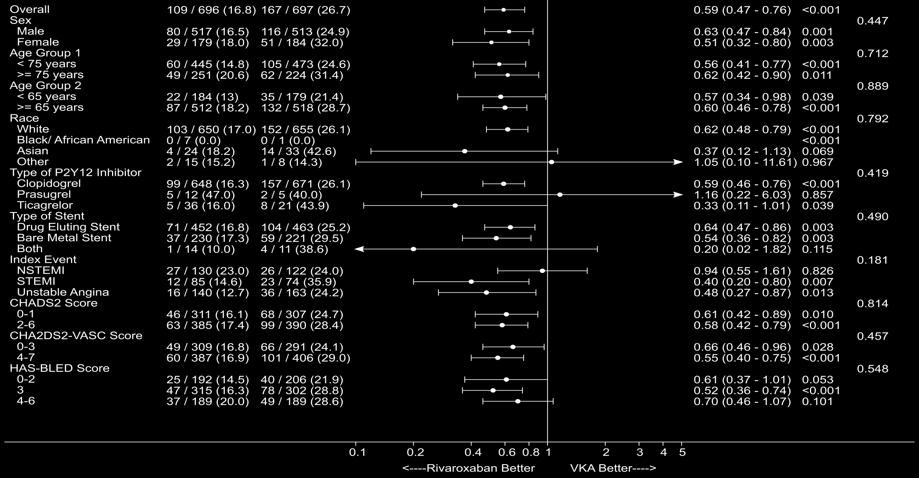
Subgroup Analysis: TIMI Major, TIMI Minor, BRMA Bleeding
Riva
+ P2Y₁₂
VKA + DAPT
TIMI major, TIMI minor, BRMA
HR (95% CI)
p-valueª
p-value^{b}
Treatment-emergent period: period starting after the first study drug administration following randomization and ending 2 days after stop of study drug. n = number of subjects with events, N = number of subjects at risk, % = Kaplan-Meier estimates. Hazard ratios as compared to VKA group are based on the (stratified, only for Overall, 2.5 mg BID/15 mg QD comparing VKA) Cox proportional hazards model. BRMA = Bleeding requiring medical attention, TIMI = Thrombolysis in myocardial infarction.
ª Log-Rank P-values as compared to VKA group are based on the (stratified, only for Overall, 2.5 mg BID/15 mg QD comparing VKA) two-sided log rank test. ^{b} P-Value for quantitative Interaction based on the Cox proportional Hazard joint test.
Gibson et al. AHA 2016

Slide 22
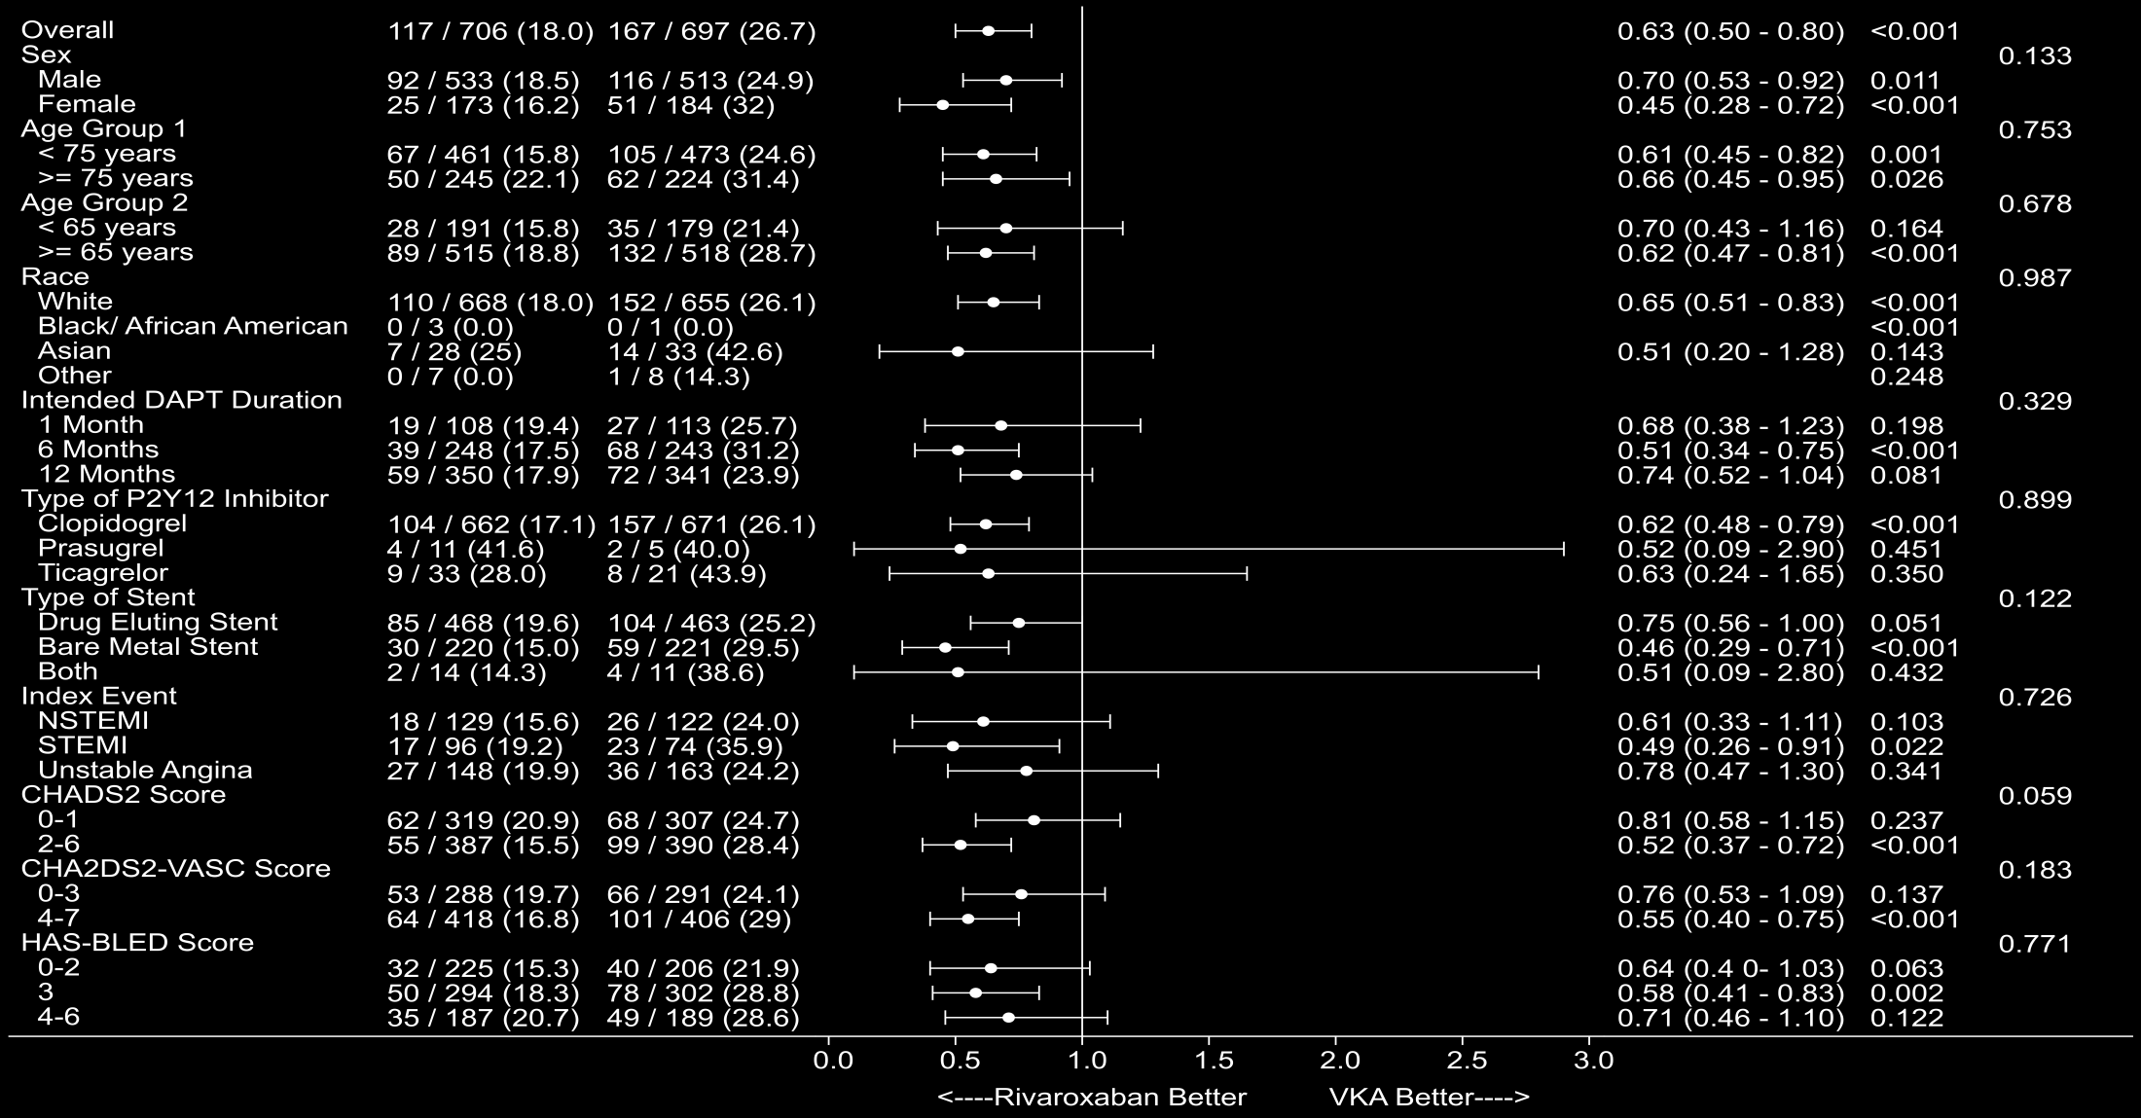
Subgroup Analysis: TIMI Major, TIMI Minor, BRMA Bleeding
Riva +
DAPT
VKA +
DAPT
TIMI Major, TIMI Minor, BRMA
p-value^{b}
HR (95% CI)
p-valueª
Treatment-emergent period: period starting after the first study drug administration following randomization and ending 2 days after stop of study drug. n = number of subjects with events, N = number of subjects at risk, % = Kaplan-Meier estimates. Hazard ratios as compared to VKA group are based on the (stratified, only for Overall, 2.5 mg BID/15 mg QD comparing VKA) Cox proportional hazards model. BRMA = Bleeding requiring medical attention, TIMI = Thrombolysis in myocardial infarction.
ª Log-Rank P-values as compared to VKA group are based on the (stratified, only for Overall, 2.5 mg BID/15 mg QD comparing VKA) two-sided log rank test. ^{b} P-Value for quantitative Interaction based on the Cox proportional Hazard joint test.
Gibson et al. AHA 2016

Slide 23
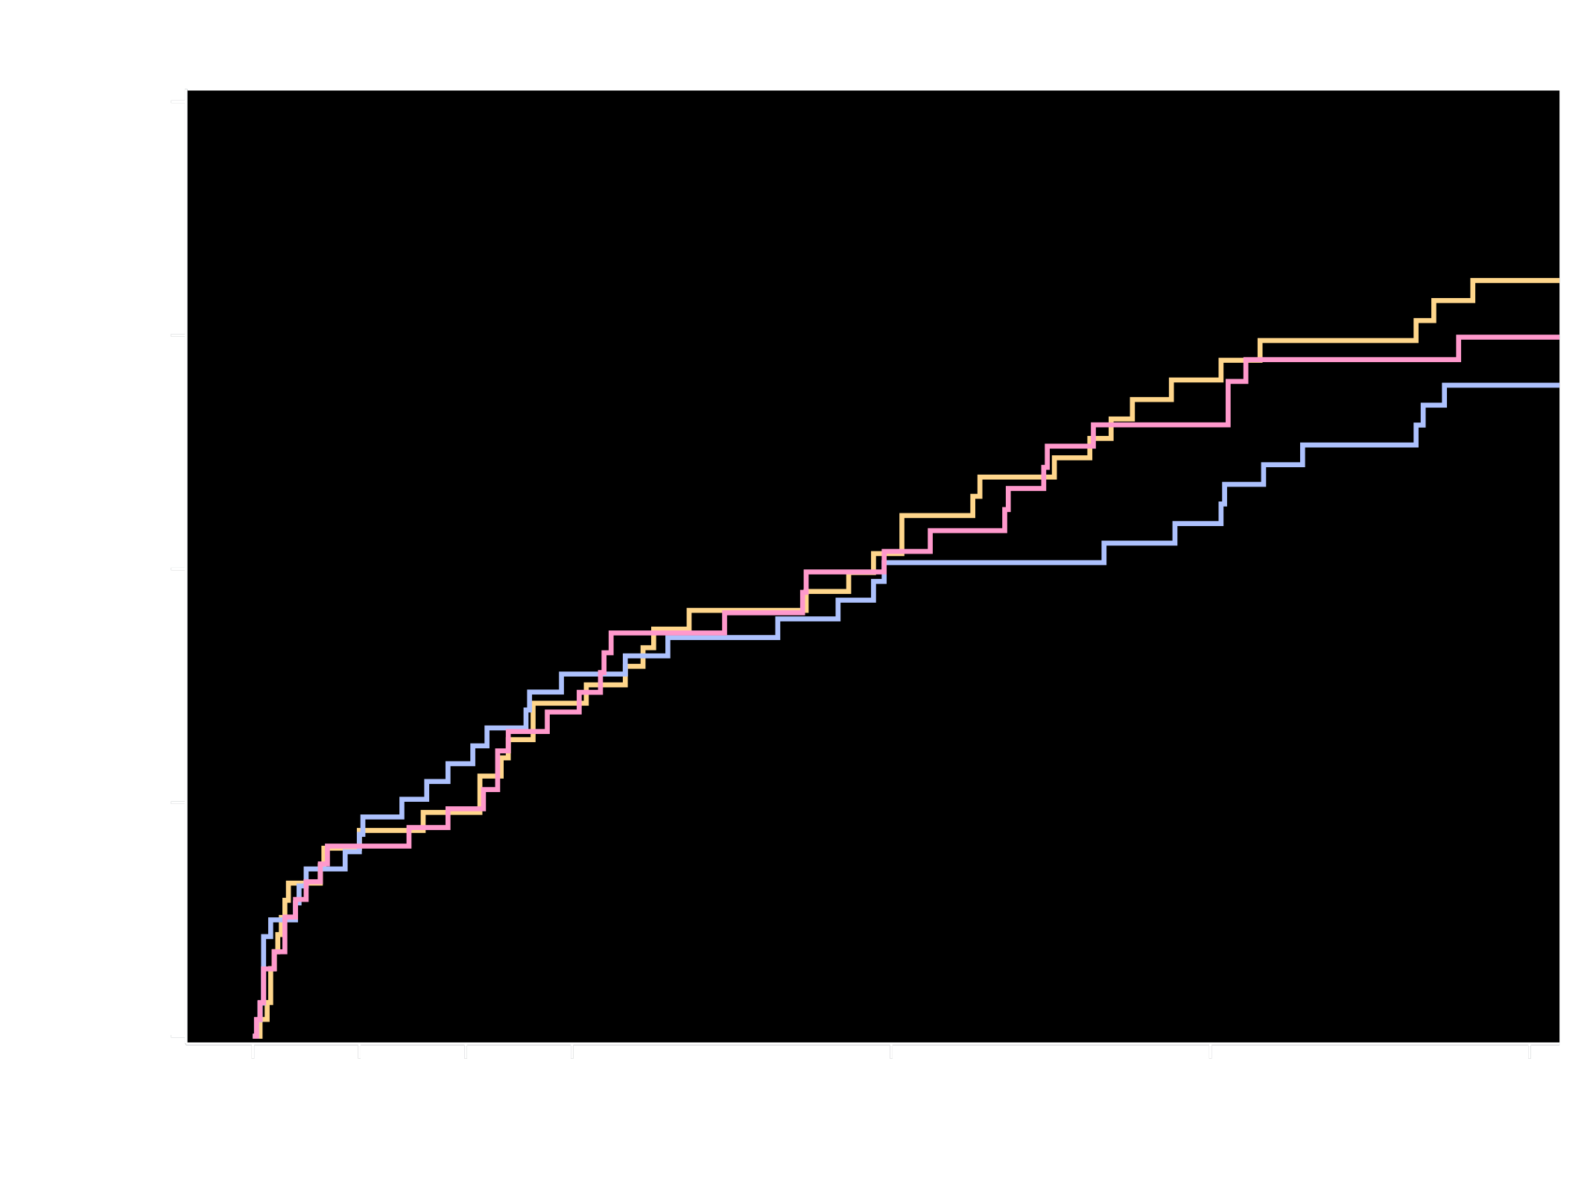
Kaplan-Meier Estimates of First
Occurrence of CV Death, MI or Stroke
Cardiovascular Death, Myocardial Infarction, or Stroke (%)
6.5%
Riva + P2Y₁₂
6.0%
5.6%
Riva + DAPT
VKA + DAPT
Riva + P2Y₁₂ v. VKA + DAPT
HR=1.08 (95% CI: 0.69-1.68)
p=0.750
Riva + DAPT v. VKA + DAPT
HR=0.93 (95% CI: 0.59-1.48)
p=0.765
No. at risk
Days
Riva + P2Y₁₂
Riva + DAPT
VKA + DAPT
694
704
695
648
662
635
633
640
607
621
628
579
590
596
543
562
570
514
430
457
408
Treatment-emergent period: period starting after the first study drug administration following randomization and ending 2 days after stop of study drug.
Composite of adverse CV events is composite of CV death, MI, and stroke. Hazard ratios as compared to VKA group are based on the (stratified, only for the Overall, 2.5 mg BID/15 mg QD comparing VKA) Cox proportional hazards model. Log-Rank P-values as compared to the VKA group are based on the (stratified, only for Overall, 2.5 mg BID/115 mg QD comparing VKA) two-sided log rank test.
6 Subjects were excluded from all efficacy analyses because of violations in Good Clinical Practice guidelines
Gibson et al. AHA 2016

Slide 24
Major Adverse Cardiac Events All Strata
 | Kaplan-Meier Estimates |  |  | Hazard Ratio (95% CI)
Overall | Riva + P2Y₁₂ (N=694) | Riva + DAPT (N=704) | VKA + DAPT (N=695) | Riva + P2Y₁₂ vs. VKA + DAPT | Riva + DAPT vs. VKA + DAPT
Adverse CV Event | 41 (6.5%) | 36 (5.6%) | 36 (6.0%) | 1.08 (0.69-1.68) p=0.750 | 0.93 (0.59-1.48) p=0.765
CV Death | 15 (2.4%) | 14 (2.2%) | 11 (1.9%) | 1.29 (0.59-2.80) p=0.523 | 1.19 (0.54-2.62) p=0.664
MI | 19 (3.0%) | 17 (2.7%) | 21 (3.5%) | 0.86 (0.46-1.59) p=0.625 | 0.75 (0.40-1.42) p=0.374
Stroke | 8 (1.3%) | 10 (1.5%) | 7 (1.2%) | 1.07 (0.39-2.96) p=0.891 | 1.36 (0.52-3.58) p=0.530
Stent Thrombosis | 5 (0.8%) | 6 (0.9%) | 4 (0.7%) | 1.20 (0.32-4.45) p=0.790 | 1.44 (0.40-5.09) p=0.574
Adverse CV Events + Stent Thrombosis | 41 (6.5%) | 36 (5.6%) | 36 (6.0%) | 1.08 (0.69-1.68) P=0.750 | 0.93 (0.59-1.48) p=0.765
Treatment-emergent period: period starting after the first study drug administration following randomization and ending 2 days after stop of study drug. A subject could have more than component event. n = number of subjects with events, N = number of subjects at risk, % = KM estimate at the end of study. Hazard ratios as compared to VKA group are based on the (stratified, only for Overall, 2.5 mg BID/15 mg QD comparing VKA) Cox proportional hazards model. Log-Rank p-values as compared to VKA group are based on the (stratified, only for Overall 2.5 mg BID/15 mg QD comparing VKA) two-sided log rank test. CI = confidence interval, DAPT = dual antiplatelet therapy, HR = hazard ratio, VKA = vitamin K antagonist
6 Subjects were excluded from all efficacy analyses because of violations in Good Clinical Practice guidelines.
Gibson et al. AHA 2016

Slide 25
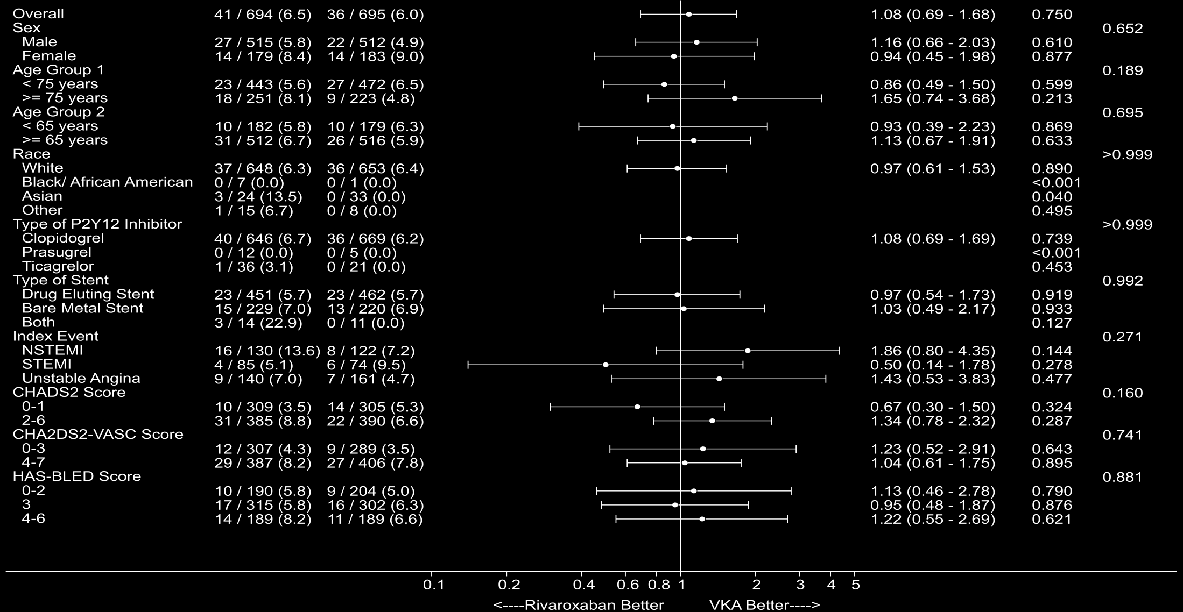
Subgroup Analysis: Major Adverse Cardiac Events
Riva
+ P2Y₁₂
VKA + DAPT
CV Death, MI, Stroke
HR (95% CI)
p-valueª
p-value^{b}
Treatment-emergent period: period starting after the first study drug administration following randomization and ending 2 days after stop of study drug. n = number of subjects with events, N = number of subjects at risk, % = Kaplan-Meier estimates. Hazard ratios as compared to VKA group are based on the (stratified, only for Overall, 2.5 mg BID/15 mg QD comparing VKA) Cox proportional hazards model.
6 subjects from one site were excluded from all efficacy analyses because of violations in Good Clinical Practice guidelines. CV = Cardiovascular, MI = Myocardial Infarction, CI = Confidence Interval, DAPT = Dual Antiplatelet Therapy, HR = Hazard Ratio, VKA = Vitamin K Antagonist. ª Log-Rank P-values as compared to VKA group are based on the (stratified, only for Overall, 2.5 mg BID/15 mg QD comparing VKA) two-sided log rank test. ^{b} P-Value for quantitative Interaction based on the Cox proportional Hazard joint test.
Gibson et al. AHA 2016

Slide 26
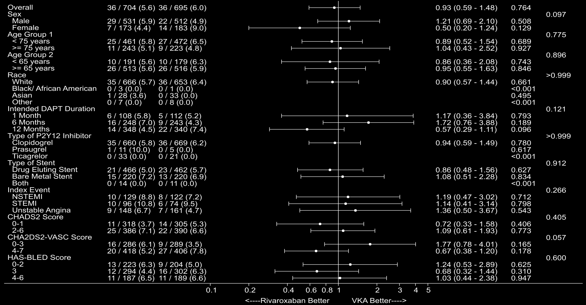
Subgroup Analysis: Major Adverse Cardiac Events
Riva +
DAPT
VKA +
DAPT
CV Death, MI, Stroke
HR (95% CI)
p-valueª
p-value^{b}
Treatment-emergent period: period starting after the first study drug administration following randomization and ending 2 days after stop of study drug. n = number of subjects with events, N = number of subjects at risk, % = Kaplan-Meier estimates. Hazard ratios as compared to VKA group are based on the (stratified, only for Overall, 2.5 mg BID/15 mg QD comparing VKA) Cox proportional hazards model.
6 subjects from one site were excluded from all efficacy analyses because of violations in Good Clinical Practice guidelines. CV = Cardiovascular, MI = Myocardial Infarction, CI = Confidence Interval, DAPT = Dual Antiplatelet Therapy, HR = Hazard Ratio, VKA = Vitamin K Antagonist. ª Log-Rank P-values as compared to VKA group are based on the (stratified, only for Overall, 2.5 mg BID/15 mg QD comparing VKA) two-sided log rank test. ^{b} P-Value for quantitative Interaction based on the Cox proportional Hazard joint test.
Gibson et al. AHA 2016

Slide 27
All Cause Hospitalization for an Adverse Event
Gibson et al. AHA 2016

Slide 28
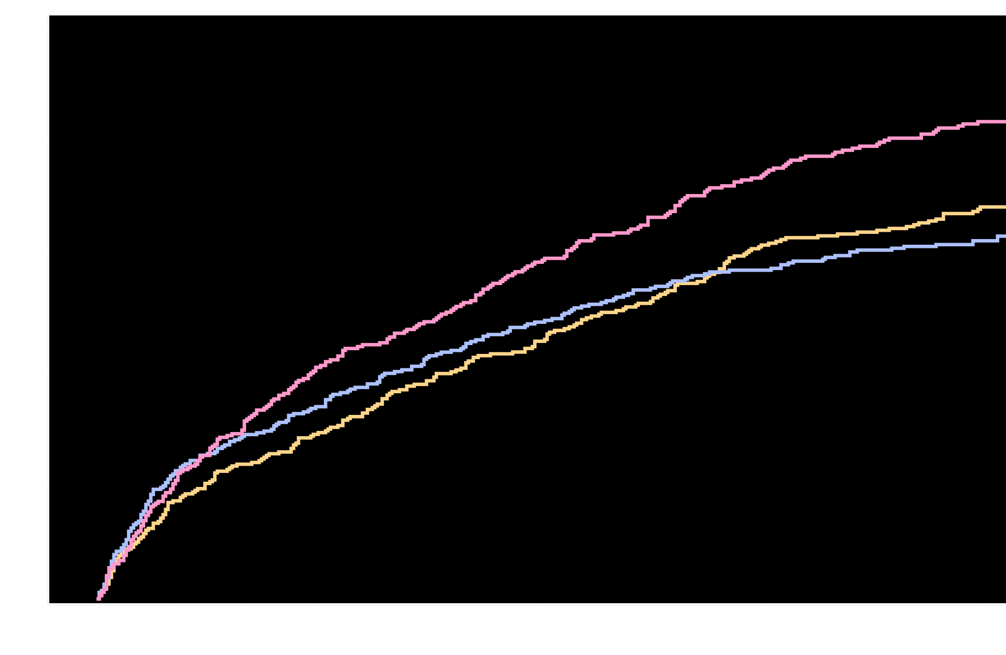
All Cause Hospitalization for an Adverse Event
All Cause Rehospitalization (%)
41.5%
VKA + DAPT
Riva + P2Y₁₂
34.1%
31.2%
Riva + DAPT
Riva + P2Y₁₂ v. VKA + DAPT
HR=0.77 (95% CI: 0.65-0.92)
p=0.005
ARR=7.4
NNT=14
Riva + DAPT v. VKA + DAPT
HR=0.74 (95% CI: 0.61-0.88)
p=0.001
ARR=10.3
NNT=10
No. at risk
Days
Riva + P2Y₁₂
Riva + DAPT
VKA + DAPT
696
706
697
609
607
592
582
570
540
559
548
490
496
493
422
437
454
369
322
367
272
Treatment-emergent period: period starting after the first study drug administration following randomization and ending 2 days after stop of study drug. Rehospitalizations do not include the index event and include the first rehospitalization after the index event. Hazard ratios as compared to the VKA group are based on the Cox proportional hazards model. Log-Rank P-values as compared to VKA group are based on the two-sided log rank test.
Gibson et al. AHA 2016

Slide 29
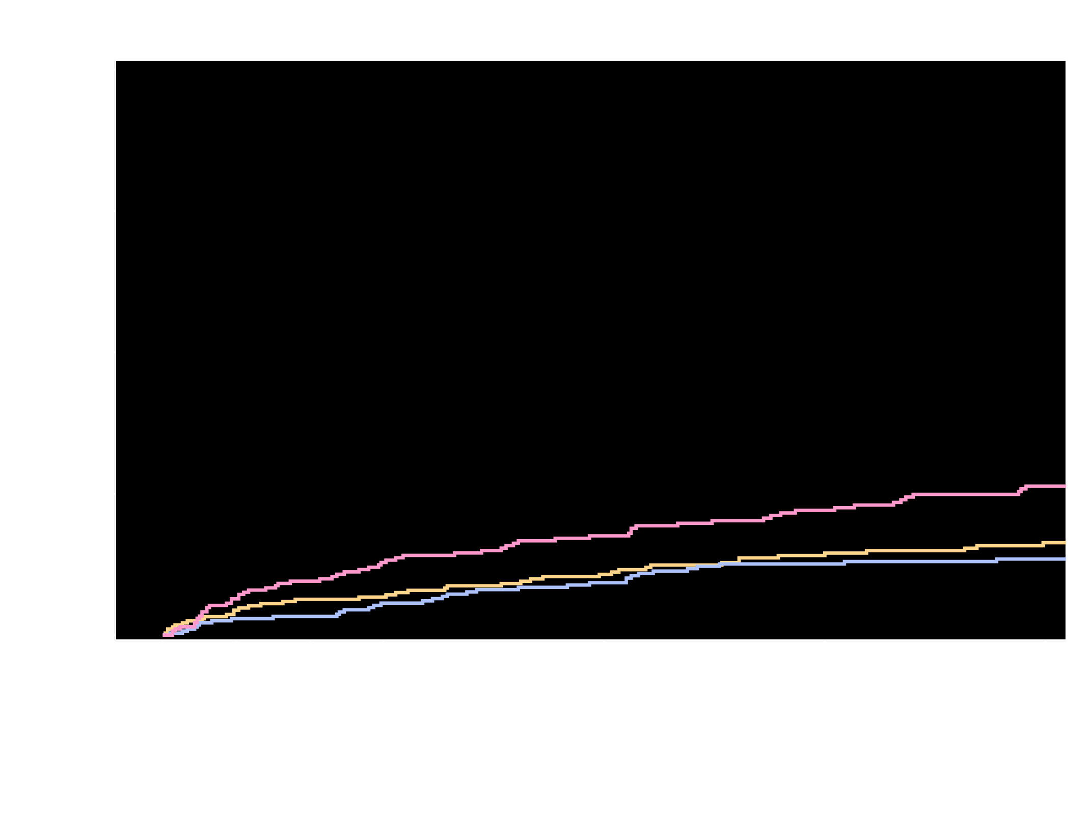
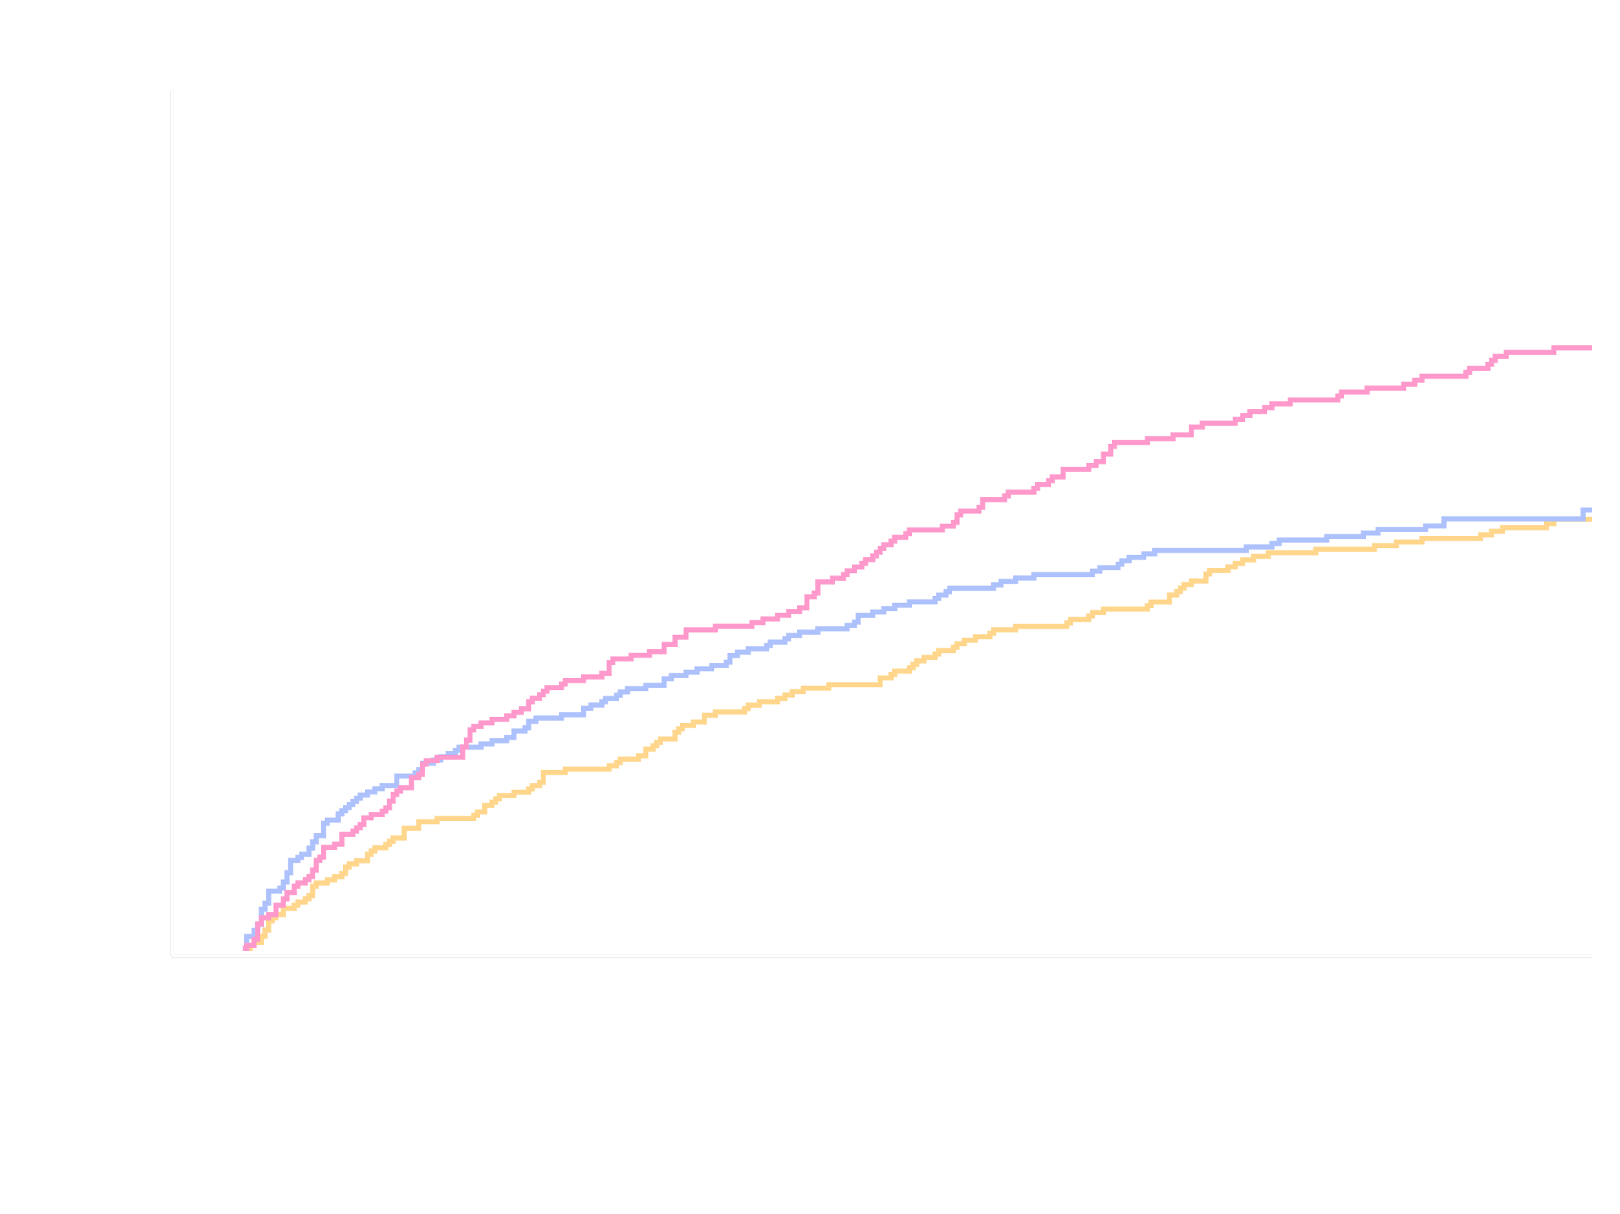
Hospitalization Related to Cardiovascular or Bleeding Event
Cardiovascular
Adverse events leading to hospitalization were classified by consensus panel blinded to treatment group as potentially related to either bleeding, CV or other causes
Riva + P2Y₁₂ v. VKA + DAPT
HR=0.68 (95% CI: 0.54-0.85)
P<0.001
ARR=8.1
NNT=13
Riva + DAPT v. VKA + DAPT
HR=0.73 (95% CI: 0.58-0.91)
p=0.005
ARR=8.1
NNT =13
Rehospitalization (%)
VKA + DAPT
28.4%
Bleeding
Riva + P2Y₁₂ v. VKA + DAPT
HR=0.61 (95% CI: 0.41-0.90)
p=0.012
ARR=4.0
NNT=25
Riva + DAPT v. VKA + DAPT
HR=0.51 (95% CI: 0.34-0.77)
p=0.001
ARR=5.1
NNT=20
Cardio-
vascular
Riva + DAPT
20.3%
20.3%
Riva + P2Y₁₂
10.5%
6.5%
Bleeding
5.4%
No. at risk cardiovascular
Days
No. at risk bleeding
Treatment-emergent period: period starting after the first study drug administration following randomization and ending 2 days after stop of study drug. Rehospitalizations do not include the index event and include the first rehospitalization after the index event. Hazard ratios as compared to the VKA group are based on the Cox proportional hazards model. Log-Rank P-values as compared to VKA group are based on the two-sided log rank test.
Gibson et al. AHA 2016

Slide 30
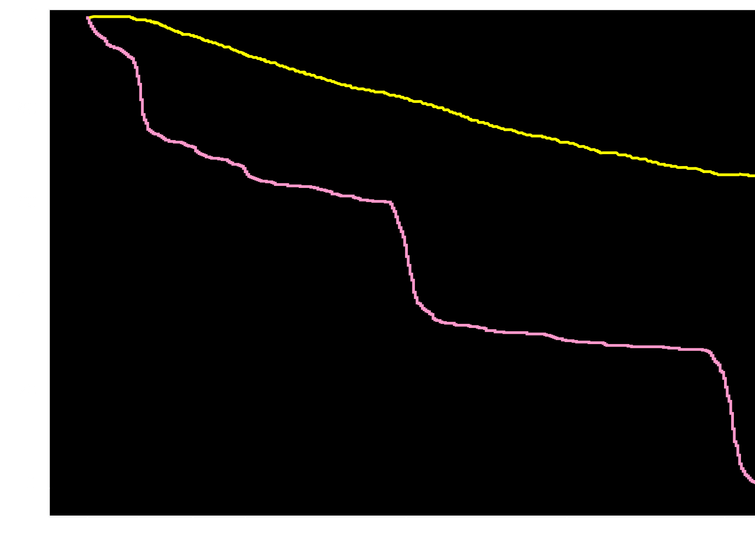
VKA + DAPT Regimen Discontinuation
?
WOEST
69% AF
VKA + DAPT
?
Percent on VKA + DAPT
?
?
?
≈ 66.5%
PIONEER
100% AF
VKA + DAPT
≈ 22.7%
0
30
60
90
180
270
360
Days
Dewilde et al. Lancet 2013 Mar 30;381(9872):1107-15.
Gibson et al. AHA 2016
Notes:
In Pioneer approximately 22.7% of the VKA + DAPT was still on their regimen at one year.
In WOEST we know that at one year 91.2% were on warfarin, 78.9% were on clopidogrel, 66.5% were on aspirin. Therefore, at the maximum 66.5% were on VKA + DAPT

Slide 31
Summary
A strategy of either rivaroxaban 15 mg daily plus a P2Y₁₂ or rivaroxaban 2.5 mg BID + DAPT was associated with a reduction in clinically significant bleeding compared with conventional triple therapy of VKA + DAPT (HR = 0.59 (0.47-0.76), p < 0.001, NNT 11, and HR = 0.63 (0.50-0.80), p <0.001, NNT 12 respectively ).
CV death / MI / stroke were comparable among the groups (Riva 15 mg+ P2Y₁₂ = 6.5%, Riva 2.5 mg+ DAPT = 5.6%, VKA + DAPT = 6.0%) with broad confidence intervals
Rates of all cause death or hospitalization were reduced in the Rivaroxaban arms (Riva 15 mg + P2Y₁₂ = NNT 15, Riva 2.5 + DAPT, NNT =10)
Gibson et al. AHA 2016

Slide 32
CONCLUSION
Among stented AF participants, administration of either rivaroxaban 15 mg daily plus P2Y₁₂ monotherapy for one year or rivaroxaban 2.5 mg BID plus 1, 6, or 12 months of DAPT reduced the risk of clinically significant bleeding as compared with standard of care VKA plus 1, 6, or 12 months of DAPT and yielded comparable efficacy with broad confidence intervals
9.0
Gibson et al. AHA 2016

Slide 33
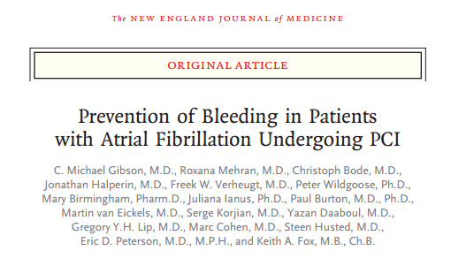
Available Now On Line at www.nejm.org
Gibson et al. AHA 2016

Slide 34
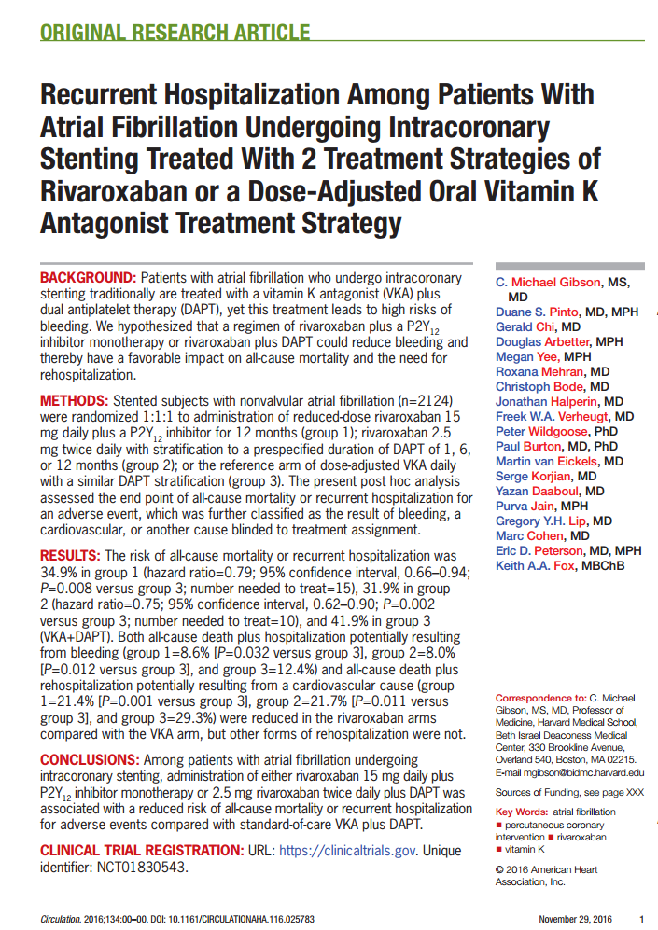
Gibson et al. AHA 2016

Slide 35
Bhatt DL, Circulation. 2016;134:00–00. DOI: 10.1161/CIRCULATIONAHA.116.025923
Gibson et al. AHA 2016

Slide 36
Back up slides

Slide 37
PRIMARY SAFETY ENDPOINT: CLINICALLY SIGNIFICANT BLEEDING
Rivaroxaban + DAPT Bleeding
TIMI Major, TIMI Minor, Bleed Req. Med. Attn.
Fatal Bleeding
Total Daily Dose:
Rivaroxaban 20 mg ----
Rivaroxaban 15 mg ----
Rivaroxaban 10 mg ----
Rivaroxaban 5 mg ----
Placebo ---
?
15
15.3%
12.7%
0.4%
10
10.9%
P=0.018
Clinically Significant Bleeding (%)
6.1%
5
3.3%
0.04%
0
0
Days
180
5 mg
10 mg
20 mg
Gibson CM, AHA 2008
Gibson CM, AHA 2011
STEMI cohort, p=0.044 in all ACS
Slide by C. Michael Gibson, M.S., M.D.

Slide 38
2.5 mg BID Rivaroxaban + DAPT: Reductions in Stent Thrombosis & Death
ATLAS ACS 2
TIMI
51
Stent Thrombosis
2 Yr KM
Cardiovascular Death
2.9%
Placebo
Placebo
HR 0.80
mITT
p=0.038
ITT
p=0.053
2 Yr KM
2.3%
4.1%
3.3%
Estimated Cumulative incidence (%)
Rivaroxaban
(both doses)
Estimated Cumulative incidence (%)
Rivaroxaban
Stent Thrombosis
HR 0.69 mITT p = 0.016
ITT p = 0.008
All cause death#
HR 0.81
mITT p=0.044
ITT p=0.083
0
12
24
0
12
24
Months
Months
ARC Definite / Probable / Possible ST
Slide by C. Michael Gibson, M.S., M.D.
Gibson CM, AHA 2011

Slide 39
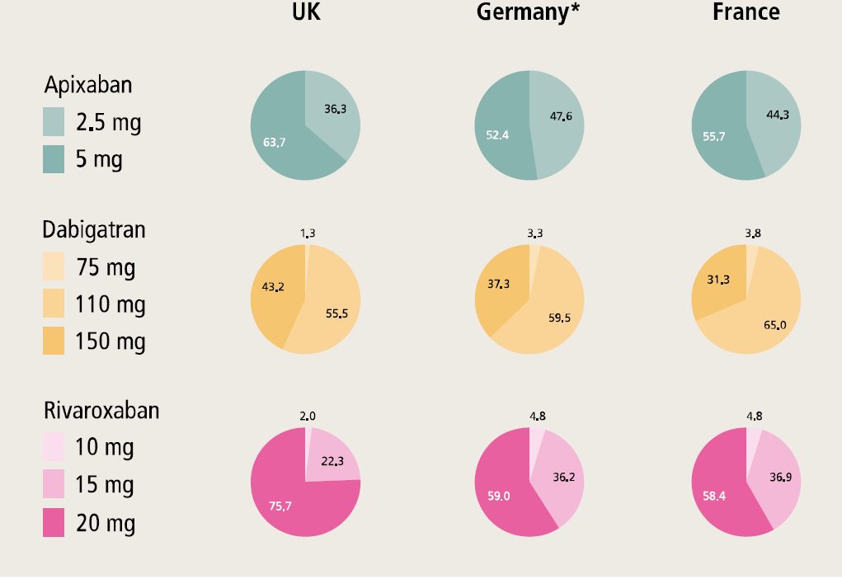
Proportion of Patients Receiving Reduced Dose NOACs
Fay et al; ESC Poster P2597; Aug 2016
Gibson et al. AHA 2016

Slide 40
Danish Registry: Event Rates for Reduced Dose NOAC treatment & Warfarin N=55,644
Peter Brønnum Nielsen, F. Skjøth, M. Søgaard, J.N. Kjældgaard,
G.Y.H. Lip, T.B. Larsen AHA 2016
IPTW rates: No. of events divided by person-years (per 100); 1-year follow-up period
Gibson et al. AHA 2016

Slide 41
Power Calculation Comparing Rehospitalization and MACE Endpoints
≥ 20% Risk Reduction, Two Sided α = 0.05
Recurrent Hospitalization Study |  |  | Main Study
Endpoint | Event Rate | Power | Endpoint | Event Rate | Power
Death or Rehospitalization | 41.9% | 90.0% | Death / MI / stroke | 6.0% | 16.8%
Death or bleeding/cardiovascular rehosp. | 36.4% | 82.8%
More sensitive
Less specific
Greater power
No adjudication
Reflects costs
Less sensitive
More specific
Lower power
Adjudication
Reflects +/- costs
Sample size and power are calculated based on the observed event rate in the VKA arm using the Pearson’s chi-square test. For the power calculation both the treatment and control arms are standardized to 700 subjects.
Gibson et al. AHA 2016

Slide 42
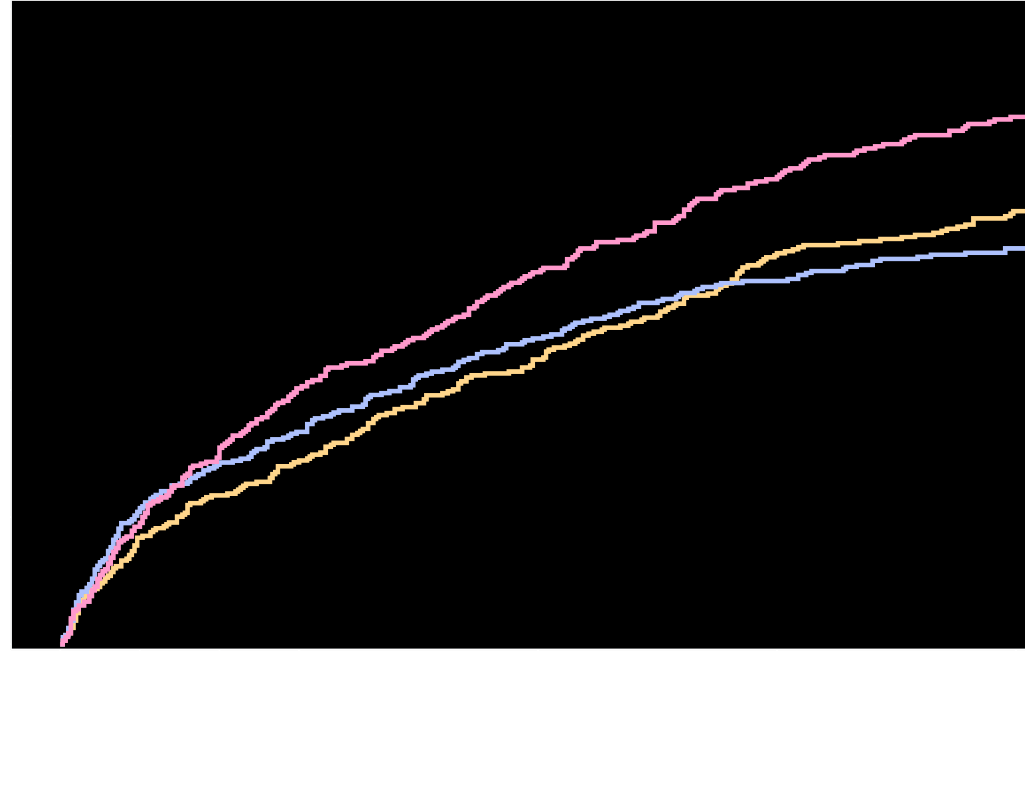
Time to First CV Death, MI, Stroke, Stent Thrombosis or All Cause Recurrent Hospitalization
50
CV Death, MI, Stroke, Stent Thrombosis or All Cause Rehospitalization (%)
42.4%
40
VKA + DAPT
Riva + P2Y₁₂
35.7%
30
32.1%
Riva + DAPT
20
10
Riva + P2Y₁₂ v. VKA + DAPT
HR=0.80 (95% CI: 0.67-0.95)
p=0.010
ARR=6.7
NNT=15
Riva + DAPT v. VKA + DAPT
HR=0.74 (95% CI: 0.62-0.89)
p=0.001
ARR=10.3
NNT=10
0
0
30
60
90
180
270
360
No. at risk
Days
Riva + P2Y₁₂
Riva + DAPT
VKA + DAPT
696
706
697
609
607
592
582
570
540
559
548
490
496
493
422
437
454
369
322
367
272
Treatment-emergent period: period starting after the first study drug administration following randomization and ending 2 days after stop of study drug. Rehospitalizations do not include the index event and include the first rehospitalization after the index event. Hazard ratios as compared to the VKA group are based on the Cox proportional hazards model. Log-Rank P-values as compared to VKA group are based on the two-sided log rank test.
Gibson et al. AHA 2016

