Slide 1
SCAI 2018 Late-Breaking Clinical Science Press Conference

Slide 2

Discrepancy Between Physician Perception And Objective Assessment Of Stroke, Stent thrombosis and Bleeding Risks In Patients With Atrial Fibrillation Undergoing PCI:
Results From The AVIATOR 2 International Registry
Usman Baber, MD, MS
Jaya Chandrasekhar, MBBS
Roxana Mehran, MD, MSCAI, FACC, FAHA, FESC
For the AVIATOR 2 Investigators

Slide 3
Aims
Characterize therapeutic and clinical priorities vis a vis antithrombotic management as perceived by physicians and patients in an AF/PCI cohort
Examine the level of agreement between subjective and empiric assessments of ischemic and bleeding risk
Evaluate the influence of subjective versus empiric risk calculation on use of oral anticoagulation (OAC) among AF patients undergoing PCI
To leverage smartphone app technology to better engage and collect patient-reported data

Slide 4
Study Design
Multicenter, multinational prospective observational study of non-valvular AF PCI patients in 11 international sites.
Antithrombotic choices were at the discretion of treating physician
Patients followed up to one year after PCI
Subjective risk assessment performed via smartphone surveys. Empiric scores calculated using validated algorithms
Primary EP: One-year MACCE
Clinicaltrials.gov identifier: NCT02362659
Chandrasekhar, Mehran et al. Am Heart J 2015;170:1234-42.

Slide 5
Discharge Pharmacotherapy
Antithrombotic
OAC
Antiplatelet

Slide 6
Sample Survey Responses
MD: Which two factors were most important in making your medication selection
Patient: With my heart condition, I am most worried about

Slide 7
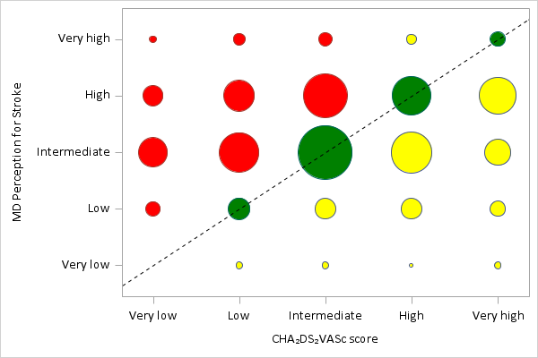
Distribution and Cross-Classification of Ischemic Risk
Subjective Risk Assessment
Empiric Risk Assessment
Among patients with CHA₂DS₂VASC ≥ 3, 58% were considered high or very high risk; 6% were considered very high risk

Slide 8
Use of OAC in Relation to Ischemic Risk
Empiric Assessment
Subjective Assessment
Age, Sex Adjusted Associations for OAC Use According to CHA₂DS₂VASC Score
 | Very Low | Low | Intermediate | High | Very High
aOR (95% CI) | 1.0 (ref) | 2.89 (1.3-6.4) | 3.6 (1.5-8.4) | 5.7 (2.1-15.5) | 2.7 (0.94-7.5)

Slide 9
Summary
Clinical imperatives surrounding antithrombotic therapy are not completely aligned with patient concerns
Clinical perception of ischemic and bleeding risk is poorly aligned with empiric estimates of the same, suggesting overtreatment in low-risk patients and vice versa among higher-risk individuals
Use of OAC is primarily driven by objective assessment of ischemic, not bleeding risk
Longitudinal follow-up will provide further insights on correlation between risk estimation and cardiovascular events

Slide 10


Derivation of a Simple Risk Tool to Predict
30-day Readmissions after
Transcatheter Aortic Valve Replacement
Sahil Khera MD, MPH
Interventional Cardiology
Massachusetts General Hospital
Harvard Medical School

Slide 11
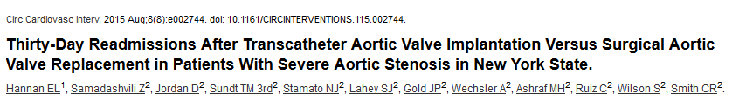
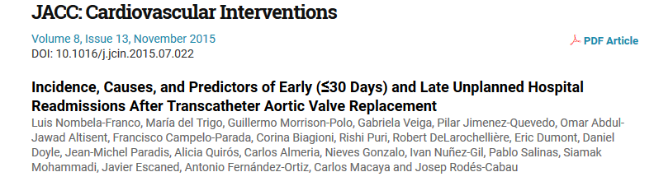
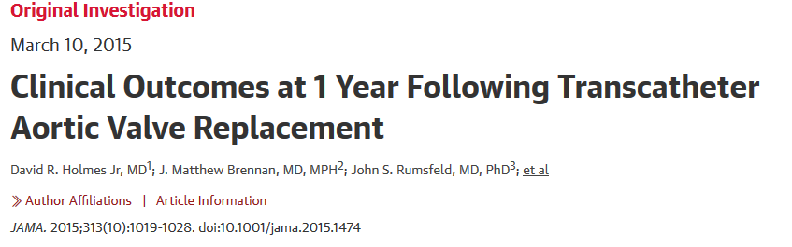
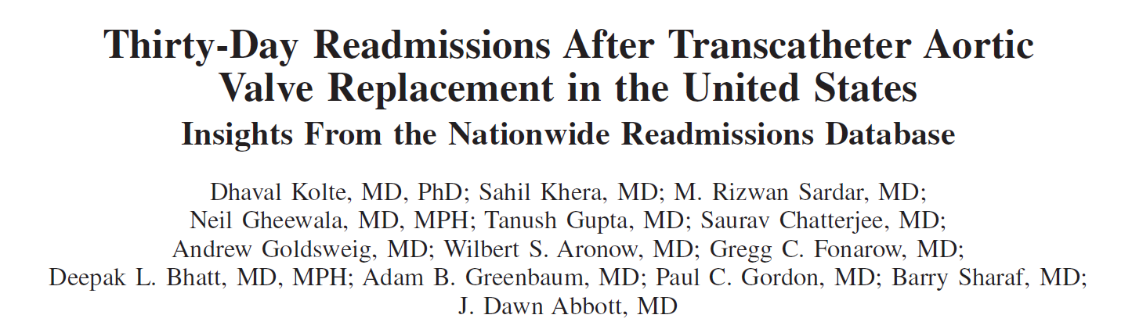
Burden of 30-day Readmissions after TAVR
15-20%

Slide 12
Objective
Devise a simple, easy to use, risk prediction tool for 30-day readmission in patients undergoing transcatheter aortic valve replacement (TAVR)

Slide 13
Patient Selection Grid
14,325,172 (2013)
14,894,613 (2014)
12,927,179 (2015)
Total admissions / Year
4,444 (2013)
7,928 (2014)
10,335 (2015)
Total endovascular TAVR procedures between Jan 2013- Aug 2015
3,868 (2013)
6,889 (2014)
8,968 (2015)
N= 19,725
Included if
LOS > 0 days
Readmit < 30 days
(Duplicate readmissions excluded)
Alive till discharge

Slide 14
Multivariable Logistic Regression*
OR 1.15 (1.06- 1.26)
OR 1.22 (1.13-1.33)
OR 1.24 (1.14-1.34)
OR 1.24 (0.99- 1.54)
OR 1.24 (1.14- 1.35)
OR 2.11 (1.7-2.63)
OR 1.29 (1.14- 1.46)
OR 1.64 (1.50-1.79)
OR 1.21 (1.1- 1.33)
OR 1.57 (1.41- 1.75)
OR 1.81 (1.2- 2.7)
*unweighted data

Slide 15
C-statistic 0.63
Score of >212 corresponds to >30% risk of 30-day readmission

Slide 16
82-year-old woman with COPD, atrial fibrillation, chronic kidney disease undergoes TAVR and develops acute kidney injury post procedure and required an extensive hospital stay (6 days)
Score of >182 corresponds to >25% risk of 30-day readmission

Slide 17
PERSPECTIVE
Percutaneous Revascularization at Piedmont for Chronic Total Occlusions Survey
Procedural, In-Hospital and Long-term Outcomes for Chronic Total Coronary Occlusion Revascularization with the Resolute Zotarolimus-Eluting Stent
David E. Kandzari, MD, FACC, FSCAI,
on behalf of the PERSPECTIVE Trial Investigators
Chief Scientific Officer
Director, Interventional Cardiology
Piedmont Heart Institute
Atlanta, Georgia
david.kandzari@piedmont.org

Slide 18
Disclosure
Within the past 12 months, I or my spouse/partner have had a financial interest/arrangement or affiliation with the organization(s) listed below
Affiliation/Financial Relationship Company
Institutional Grant/Research Support Biotronik, Boston Scientific, Medtronic CardioVascular, Medinol, Orbus Neich
Consulting Fees/Honoraria Biotronik, Boston Scientific Corporation, Medtronic CardioVascular, Cardinal Health
Major Stock Shareholder/Equity None
Royalty Income None
Ownership/Founder None
Intellectual Property Rights None
Other Financial Benefit None

Slide 19
PERSPECTIVE: Trial Design
Symptomatic ischemic heart disease due to CTO in
≥1 coronary artery lesion with TIMI 0/1 flow and estimated ≥3 months duration
No restrictions regarding lesion length, treatment strategy, LVEF or renal function
Prospective Cohort
Enrollment 8/2013 to 3/2016
(N=250)
Single Center study at Piedmont Heart Institute (Atlanta, GA, USA)
Independent QCA analysis and CEC adjudication
Retrospective Cohort
Enrollment 6/2013 to 7/2014
(N=250)
Clinical follow-up
In hospital
6mo
12mo
SAQ and QoL
Primary Endpoints:
  CTO procedural success: final residual angiographic stenosis <50% within treated segment with ≥TIMI 2 antegrade flow
  In-hospital major adverse cardiac events (MACE): death, MI, and repeat target lesion revascularization (TLR)
  1-year MACE among all subjects undergoing attempted CTO revascularization
Key Secondary Endpoints:
  1-year MACE among patients with successful CTO revascularization with R-ZES compared with performance goal
  Procedural and technical success according to strategy and method
  Completeness of revascularization according to residual SYNTAX score
  Adherence to and classification according to Appropriate Use Criteria (AUC)
  Change in angina frequency and QoL (Seattle Angina Questionnaire, EQ-5D) baseline to 1 year
  Frequency of scheduled and PRN anti-anginal medications at index hospitalization, 6 months and 1 year after attempted CTO revascularization

Slide 20
PERSPECTIVE: Baseline Clinical Characteristics
 | Overall (N=500) | R-ZES Group (N=183)
Age (years) | 65 ± 10 | 63 ± 10
Male gender | 409 (81.8) | 146 (79.8)
Diabetes mellitus | 176 (35.2) | 65 (35.5)
Insulin requiring | 50 (10.0) | 22 (13.3)
Hypertension | 452 (90.4) | 159 (86.9)
History of smoking | 305 (61.0) | 102 (59.3)
Prior myocardial infarction | 163 (32.6) | 60 (32.8)
Angina class III/IV* | 174 (70.5) | 111 (79.3)
Heart failure class III/IV | 6 (1.2) | 4 (1.7)
 | Overall (N=500) | R-ZES Group (N=183)
LVEF <40% | 61 (13.5) | 20 (12.3)
Prior percutaneous revascularization | 266 (53.2) | 90 (49.2)
Prior coronary bypass surgery | 149 (29.8) | 49 (26.8)
Clinical indication
Stable angina | 361 (72.2) | 140 (80.9)
Unstable angina/myocardial infarction | 15 (5.7) | 7 (3.8)
Dyspnea | 114 (22.8) | 41 (22.4)
Heart failure/cardiomyopathy | 35 (7.0) | 9 (4.9)
Abnormal noninvasive stress test | 172 (34.4) | 109 (65.3)
Data represented as N (%) or mean ± SD; *Prospective cohort only

Slide 21
PERSPECTIVE: Baseline Angiographic Characteristics
 | Overall (N=500) | R-ZES Group (N=183)
Reference vessel diameter (mm) | 3.0 ± 0.9 | 3.3 ± 0.8
Lesion length (mm) | 81.5 ± 32.7 | 92.6± 36.4
Occlusion length >20 mm | 243 (71.3) | 129 (78.7)
Previous failure | 113 (22.6) | 38 (29.5)
In-stent occlusion | 42 (8.4) | 8 (4.4)
J-CTO score | 2.5 ± 1.1 | 2.6 ± 1.1
SYNTAX score | 14.1 ± 6.6 | 13.5 ± 5.9
 | Overall (N=500) | R-ZES Group (N=183)
Side branch involvement | 135 (28.7) | 45 (33.3)
Reference vessel diameter (mm) | 3.0 ± 0.9 | 3.3 ± 0.8
Lesion length (mm) | 81.5 ± 32.7 | 92.6± 36.4
Occlusion length >20 mm | 243 (71.3) | 129 (78.7)
Previous failure | 113 (22.6) | 38 (29.5)
In-stent occlusion | 42 (8.4) | 8 (4.4)
J-CTO score | 2.5 ± 1.1 | 2.6 ± 1.1
SYNTAX score | 14.1 ± 6.6 | 13.5 ± 5.9
Data represented as N (%) or mean ± SD

Slide 22
PERSPECTIVE: 1 Year Clinical Events
 | Overall (N=488) | R-ZES Group (N=175)
Death | 11 (2.3) | 5 (2.9)
Cardiac Death | 8 (1.6) | 3 (1.7)
Myocardial Infarction
Protocol MI definition (CKMB >10x ULN) | 10 (2.0) | 4 (2.3)
ARC MI definition (CKMB >3x ULN) | 34 (7.0) | 19 (10.9)
Clinically-driven TLR | 10 (2.0) | 3 (1.7)
Stent Thrombosis | 2 (0.4) | 0
MACE
Protocol MI definition | 29 (5.9) | 12 (6.9)
ARC MI definition | 53 (10.9) | 26 (14.9)
TLF
Protocol MI definition | 26 (5.3) | 10 (5.7)
ARC MI definition | 50 (10.2) | 24 (13.7)
Data represented as n (%)

Slide 23
PERSPECTIVE: Primary Endpoint R-ZES Cohort
MACE at 1 Year | R-ZES (n=175) | Upper One-Sided 95% CI | Performance Goal | P-value
Per ARC | 14.9% | 20.0% | 25.2% | 0.001
Pre-specified performance goal
Upper One-Sided
95% CI
0
5
10
15
20
25
30%
MACE defined as all-cause death, MI and TLR.

Slide 24
PERSPECTIVE R-ZES Cohort
SAQ Domains, Baseline to 1 Year
P<0.001
P<0.001
P<0.001
P<0.001
SAQ Mean Scores

Slide 25
PERSPECTIVE R-ZES Cohort: SAQ Angina Frequency Categories
P<0.0001
SAQ Frequency (%)
(n=176)
(n=164)

Slide 26
PERSPECTIVE: Conclusions
In a trial representing contemporary technique and DES, favorable procedural success, health status improvement and late-term clinical outcomes observed in the PERSPECTIVE trial support CTO PCI in a clinically indicated, high lesion complexity patient population
Favorable procedural success was achieved exceeding 90% and with acceptable procedural and in-hospital safety
Despite high lesion complexity and extensive stent length, treatment with R-ZES was associated with low rates of repeat revascularization and ST comparable to outcomes observed in less complex disease and clinical indications
  — Clinically-driven TLR 1.7% and MI 2.3%, no stent thrombosis
  — Significant improvement in both observer- and patient-reported health status
  Overall findings inform the procedural and clinical effectiveness of contemporary CTO PCI in a highly complex patient population with appropriate clinical indication

Slide 27
Length of Stay After Trans-Femoral Transcatheter Aortic Valve Replacement: An analysis of the Society of Thoracic Surgeons/American College of Cardiology
Transcatheter Valve Therapy Registry
Siddharth A Wayangankar MD, MPH, FACC, RPVI
Director of Peripheral Vascular Interventions
Asst Professor of Medicine
University of Florida

Slide 28
Disclosures
Proctor for Medtronic Valve Therapies

Slide 29
Objectives
To analyze prevalence and trends of LOS (DD=length of stay > 72 hours) post TF-TAVR.
To determine independent predictors of length of stay (LOS) post TF-TAVR.
To compare and contrast the trends in 1 year outcomes among early vs. delayed discharge.
To determine the association between LOS post TAVR and 1-year adverse outcomes.
Methods
Registry: STS/ACC TVT Registry
Starting population: All patients underwent TAVR during 11/1/2011 to 9/30/2015. (n= 50, 899)
Inclusion Criteria: Patients were greater than and equal to 18 years when they underwent their first TF-TAVR
Exclusion Criteria:
1) Patient with in-hospital mortality.
2) Patients with aborted or cancelled procedures.
3) Patients who were transferred out or discharged to any facility other than home.
4) Patients with missing in-hospital data
Final Cohort : 24,285

Slide 30
Prevalence and Trends of DD
Incidence | P value (The Cochran-Armitage test) | Pearson coefficients with 95% CI | Spearmen coefficients with 95% CI
DD (delayed discharge) | <0.0001 | -0.064 (-0.074, -0.054) | -0.066 (-0.076, -0.056)

Slide 31
Independent Predictors of LOS
Delayed Discharge
Early discharge
Variable | OR/CI | P Value
Age > 85 | 1.15 (1.08, 1.23) | <0.0001
African American Race | 1.30 (1.11, 1.52) | 0.01
Hispanic | 1.19 (1.05, 1.35) | 0.007
Prior MV procedures | 1.64 (1.36, 1.97) | <0.0001
Diabetes | 1.09 (1.03, 1.15) | 0.003
Home Oxygen | 1.31 (1.19, 1.45) | <0.001
Atrial Fibrillation | 1.17 (1.11, 1.25) | <0.0001
Dialysis | 1.42 (1.22, 1.66) | <0.0001
GFR<30 | 1.60 (1.40, 1.82) | <0.0001
RVSP >60 mm of Hg | 1.37 (1.24, 1.51) | <0.0001
Walk test – >10 seconds/unable | 1.29 (1.20, 1.38) | <0.0001
Self expanding valve | 1.53 (1.40, 1.67) | <0.0001
Variable | OR/CI | P Value
Prior PPM | 0.72 (0.67, 0.79) | <0.0001
Prior ICD | 0.77 (0.67, 0.89) | 0.0003
Prior CABG | 0.88 (0.83, 0.94) | <0.0001
Smoking | 0.86 (0.74, 0.99) | 0.03
Prior MI | 0.90 (0.84, 0.98) | 0.009
Moderate-severe AI | 0.93 (0.87, 0.99) | 0.03
Valve in Valve | 0.68 (0.56, 0.82) | <0.0001
Moderate Sedation | 0.50 (0.43, 0.58) | <0.0001

Slide 32
1-year Outcomes by LOS
Outcomes | Probability (%) & 95%CIs at 1 year |  | P value
 | ED | DD
All-cause mortality | 11.03 (10.16, 11.97) | 15.62 (14.63, 16.68) | <0.0001
Stroke | 1.85 (1.51, 2.27) | 1.95 (1.61,2.37) | 0.5066
MI | 1.75 (1.41, 2.16) | 1.69 (1.36, 2.10) | 0.8569
Bleeding requiring Hospitalization | 13.85 (12.92, 14.85) | 18.40 (17.37, 19.51) | <0.0001
Composite | 22.78 (21.61, 24.0) | 29.43 (28.18, 30.74) | <0.0001

Slide 33
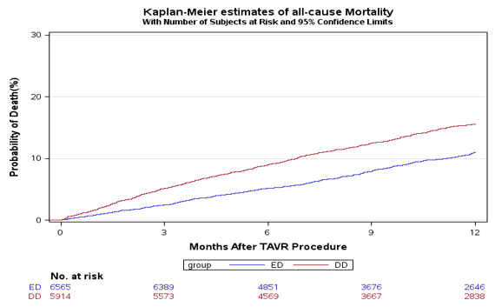
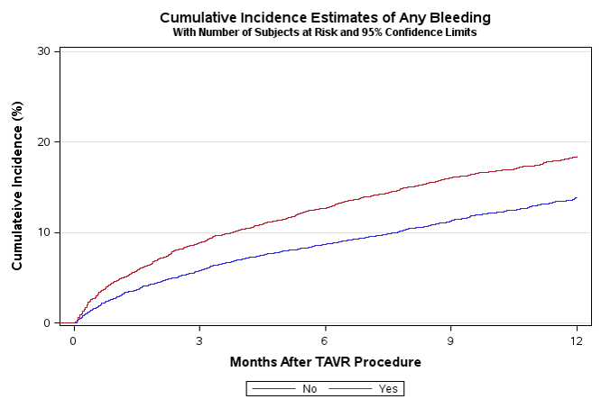
1 Year Outcomes
All-Cause Mortality
Any Bleeding Requiring Hospitalization

Slide 34
Conclusion
First study in medical literature that has described patterns of LOS post-TF-TAVR from a large nation-wide database.
LOS has significantly decreased from 2011 to 2015; and with continued refinement in techniques and patient selection, we anticipate this trend would continue to improve.
Predictors of DD and ED should be used by clinicians, administrators and third party payors to better serve this ever expanding field of percutaneous valve therapies.
Finally, regardless of the presence of procedure related complications, DD is associated with a significant risk of mortality at 1 year.

Slide 35
A Prospective, Single-Arm, Multicenter Trial of Catheter-Directed Mechanical Thrombectomy for Intermediate-Risk Acute Pulmonary Embolism:
The FLARE Study
Thomas Tu, M.D.
On behalf of the FLARE Investigators
National PIs: Kenneth Rosenfield, M.D. and Victor Tapson, M.D.
April 27, 2018
35

Slide 36
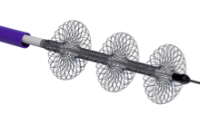
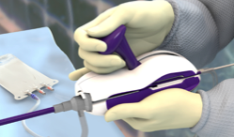

FlowTriever System
Aspiration Guide Catheter (“AGC”)
FlowTriever Device (“FT”)
Retraction Aspirator (“RA”)
Navigates through the right heart and delivers FT device to the pulmonary artery
Large bore catheter maximizes aspiration and collection of thrombus
Deployed out of AGC and into thrombus
Disrupts, engages and moves large volume of thrombus
  Retracts the FT with thrombus into the AGC
  Synchronizes aspiration and retrieval
Disruption, maceration and retrieval of clot
Increased lumen
Rapid flow restoration Reduced PA pressure Reduced RV strain
36

Slide 37
RV/LV Ratio Outcomes
Reduction 0.39
p <0.0001
 | Baseline | 48 Hour | Reduction | p
All Patients (N=106) | 1.53 | 1.15 | 0.39 | p <0.0001
All Paired Patients (N=103) | 1.54 | 1.15 | 0.39 | p <0.0001
Paired Patients w/o Lytic (N=101) | 1.54 | 1.15 | 0.38 | p <0.0001
37

Slide 38
Clinical Outcomes
ICU stay post-procedure, median | 1 day
ICU stay: distribution | 0 = 44 1 = 23 2 = 18 3+ = 21
Days to discharge post-procedure, median | 3 days
# Patients lost-to-follow-up | 2
# Patients any-cause mortality | 1
# MAEs* | 4 (ITT 3.8% , mITT 3.8%)
38

Slide 39
Major Adverse Events
*MAE Subject # | * MAE Description
#0404 | Hemoptysis, hemothorax, pulmonary infarction; lower lobectomy; possible reperfusion injury
#0808 | Worsening PE, surgical embolectomy
#2101 | Cardiogenic shock, acute respiratory insufficiency
#2422 | Patient agitated during procedure despite sedation; respiratory arrest with VFIB and cardioversion

Slide 40
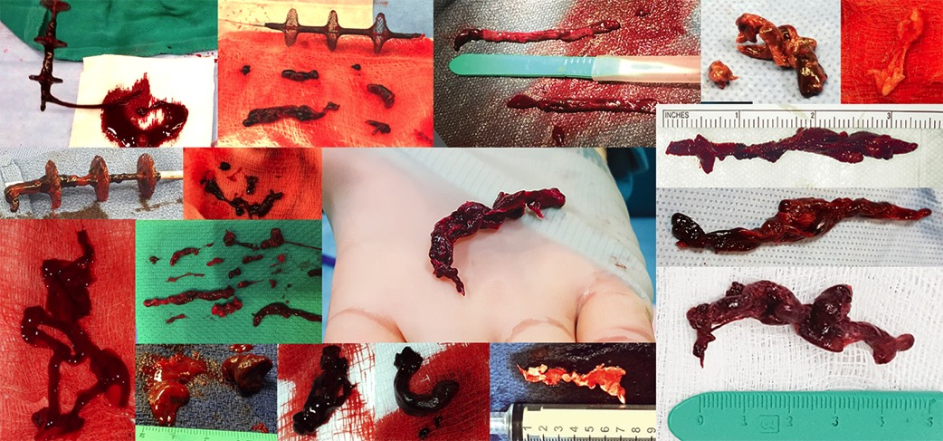
FlowTriever Clot Retrieval Experience, Acute to Chronic
ACUTE CHRONIC
40

Slide 41
FLARE Safety in Context
Study | Major Bleeding | Intracranial Hemorrhage (Fibrinolysis Group)
FLARE | 1/106 (.9%) | 0/106 (0%)
ULTIMA (USAT arm) (Kucher, et al. 2013) | 0/30 (0%) | 0/30 (0%)
PEITHO (tPA arm) (Meyer G, et al. 2014) | 58/506 (11.5%) | 10/506 (2%)
SEATTLE II (Piazza G, et al. 2014) | 17/150 (11.4%) | 0/150 (0%)
41

Slide 42
FLARE Effectiveness in Context
 | N | Treatment | tPA | Reduction in RV/LV Ratio at 48 Hours
FLARE | 104 | FlowTriever mechanical thrombectomy | 0 mg | 0.39 / 25%
SEATTLE II (2015) | 150 | USAT | 24 mg | 0.42 / 24%
ULTIMA (2014)* | 30 | USAT arm | 10-20 mg | 0.29 / 22%
Becattini et al (2010) | 28 | Systemic Thrombolytic | 30-50 mg | 0.31 / 24%
Fasullo et al (2011) | 35 | Systemic Thrombolytic | 100 mg | 0.40 / 27%
Mi et al (2013) | 57 | Systemic Thrombolytic | 50 mg | 0.11 / 8%
*RV/LV Ratio in ULTIMA measured at 24 hours
42

Slide 43
Conclusions
Catheter-directed mechanical thrombectomy using the FlowTriever System, without the use of thrombolytics, is safe and effective in improving RV function in patients with intermediate-risk PE.
Additionally, it has the potential to reduce bleeding complications and reduce total hospital and ICU length of stay.
43

Slide 44
A Prospective, Single-Arm, Multicenter Trial of Catheter-Directed Mechanical Thrombectomy for Intermediate-Risk Acute Pulmonary Embolism:
The FLARE Study
Thomas Tu, M.D.
On behalf of the FLARE Investigators
National PIs: Kenneth Rosenfield, M.D. and Victor Tapson, M.D.
April 27, 2018
44

Slide 45
FlowTriever System
Aspiration Guide Catheter (“AGC”)
FlowTriever Device (“FT”)
Retraction Aspirator (“RA”)
Navigates through the right heart and delivers FT device to the pulmonary artery
Large bore catheter maximizes aspiration and collection of thrombus
Deployed out of AGC and into thrombus
Disrupts, engages and moves large volume of thrombus
  Retracts the FT with thrombus into the AGC
  Synchronizes aspiration and retrieval
Disruption, maceration and retrieval of clot
Increased lumen
Rapid flow restoration Reduced PA pressure Reduced RV strain
45

Slide 46
RV/LV Ratio Outcomes
Reduction 0.39
p <0.0001
 | Baseline | 48 Hour | Reduction | p
All Patients (N=106) | 1.53 | 1.15 | 0.39 | p <0.0001
All Paired Patients (N=103) | 1.54 | 1.15 | 0.39 | p <0.0001
Paired Patients w/o Lytic (N=101) | 1.54 | 1.15 | 0.38 | p <0.0001
46

Slide 47
Clinical Outcomes
ICU stay post-procedure, median | 1 day
ICU stay: distribution | 0 = 44 1 = 23 2 = 18 3+ = 21
Days to discharge post-procedure, median | 3 days
# Patients lost-to-follow-up | 2
# Patients any-cause mortality | 1
# MAEs* | 4 (ITT 3.8% , mITT 3.8%)
47

Slide 48
Major Adverse Events
*MAE Subject # | * MAE Description
#0404 | Hemoptysis, hemothorax, pulmonary infarction; lower lobectomy; possible reperfusion injury
#0808 | Worsening PE, surgical embolectomy
#2101 | Cardiogenic shock, acute respiratory insufficiency
#2422 | Patient agitated during procedure despite sedation; respiratory arrest with VFIB and cardioversion

Slide 49
FlowTriever Clot Retrieval Experience, Acute to Chronic
ACUTE CHRONIC
49

Slide 50
FLARE Safety in Context
Study | Major Bleeding | Intracranial Hemorrhage (Fibrinolysis Group)
FLARE | 1/106 (.9%) | 0/106 (0%)
ULTIMA (USAT arm) (Kucher, et al. 2013) | 0/30 (0%) | 0/30 (0%)
PEITHO (tPA arm) (Meyer G, et al. 2014) | 58/506 (11.5%) | 10/506 (2%)
SEATTLE II (Piazza G, et al. 2014) | 17/150 (11.4%) | 0/150 (0%)
50

Slide 51
FLARE Effectiveness in Context
 | N | Treatment | tPA | Reduction in RV/LV Ratio at 48 Hours
FLARE | 104 | FlowTriever mechanical thrombectomy | 0 mg | 0.39 / 25%
SEATTLE II (2015) | 150 | USAT | 24 mg | 0.42 / 24%
ULTIMA (2014)* | 30 | USAT arm | 10-20 mg | 0.29 / 22%
Becattini et al (2010) | 28 | Systemic Thrombolytic | 30-50 mg | 0.31 / 24%
Fasullo et al (2011) | 35 | Systemic Thrombolytic | 100 mg | 0.40 / 27%
Mi et al (2013) | 57 | Systemic Thrombolytic | 50 mg | 0.11 / 8%
*RV/LV Ratio in ULTIMA measured at 24 hours
51

Slide 52
Conclusions
Catheter-directed mechanical thrombectomy using the FlowTriever System, without the use of thrombolytics, is safe and effective in improving RV function in patients with intermediate-risk PE.
Additionally, it has the potential to reduce bleeding complications and reduce total hospital and ICU length of stay.
52

Slide 53

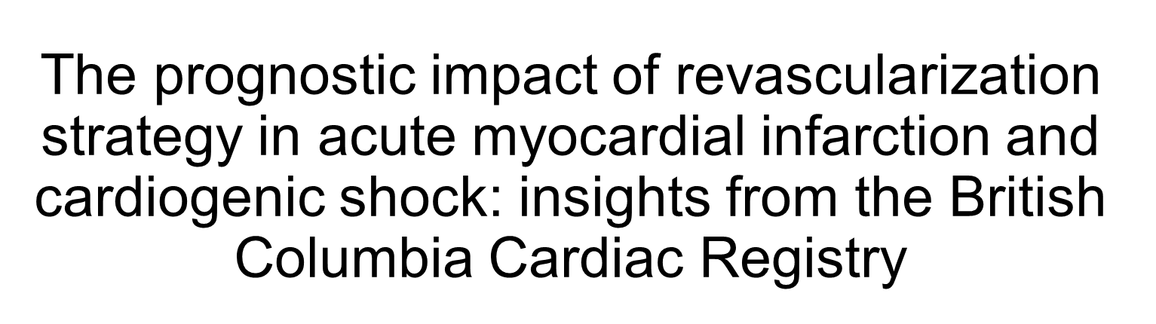
Andrew McNeice^{1,2}, Imad J. Nadra^{1,2}, Simon D. Robinson^{1,2}, Eric Fretz^{1,2}, Lillian Ding³, Anthony Fung⁴, Eve Aymong⁵, Albert W. Chan⁶, Steven Hodge⁷, John Webb⁵, Sanjit Jolly, Shamir Mehta, Anthony Della Siega^{1,2}, David A. Wood⁵, M. Bilal Iqbal^{1,2} on behalf of the British Columbia Cardiac Registry Investigators
1 Victoria Heart Institute Foundation, Victoria, BC, Canada. 2 Royal Jubilee Hospital, Victoria, BC, Canada. 3 Provincial Health Services Authority, Vancouver, BC, Canada. 4 Vancouver General Hospital, Vancouver, BC, Canada. 5 St. Paul's Hospital, Vancouver, BC, Canada. 6 Royal Columbian Hospital, Vancouver, BC, Canada. 7 Kelowna General Hospital, Kelowna, BC, Canada.

Slide 54
Disclosures
None

Slide 55
Background
Up to 80% of patients with cardiogenic shock resulting from an acute myocardial infarction have multivessel disease
Management of non-culprit disease in the acute setting is debated
RCTs have shown improved outcomes with complete revascularization in hemodynamically stable patients with STEMI, primarily driven by reduced repeat revascularization events and no difference in mortality ¹⁻⁵
Until recently, there was no randomized trial data exploring revascularization strategies in patients with cardiogenic shock
1 Wald et al. N Engl J Med 2013;369:1115-23.
2 Gershlick et al. J Am Coll Cardiol 2015;65:963–72.
3 Engstrom et al. Lancet 2015; 386: 665–71.
4 Smits et al. N Engl J Med 2017;376:1234-44.
5 Elgendy et al. J Am Coll Cardiol Intv 2017;10:315–24

Slide 56
Hypothesis and objectives
We hypothesized that contemporary real-world data would be complimentary rather than conflicting with recent randomised controlled data
This retrospective observational study was performed to assess if the results of the CULPRIT-SHOCK trial were similar to real world data in a sample of patients with MVD presenting with AMI complicated by CS from the British Columbia Cardiac registry.

Slide 57
Methods
Comparison of CVI (n=414) versus MVI (n=235) in 649 patients with AMI, CS and MVD enrolled in the British Columbia Cardiac Registry (2008-2014)
End points: All-cause mortality at 30 days and 1 year
Statistical analysis was performed using multivariate models, propensity matching and propensity-score adjusted analyses (to address the issue with reduced sample size due to exclusion of unmatched patients in propensity-matched analyses)
  Patients with LMS disease (>50% stenosis) were excluded from the analysis.
  Cardiogenic shock was defined as a sustained (>30 minutes) episode of systolic blood pressure <90 mm Hg secondary to cardiac dysfunction, and/or the requirement for inotropic or mechanical support to maintain blood pressure and adequate systemic perfusion
  A diseased coronary artery was defined as any epicardial vessel with a stenosis >70%. MVD was defined as stenosis >70% in ≥2 epicardial coronary arteries.

Slide 58
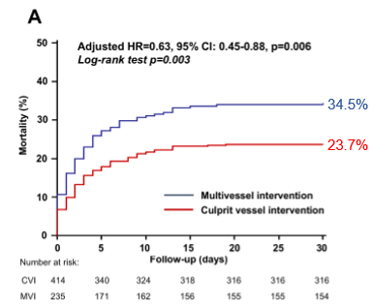
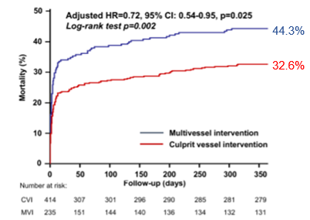
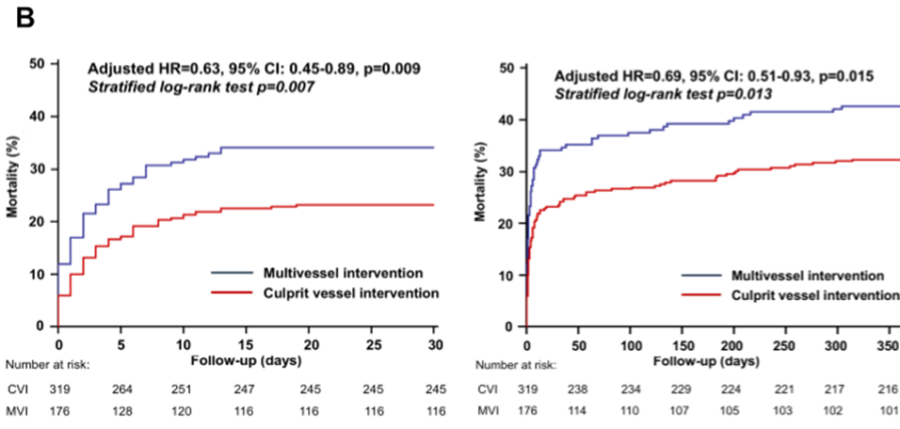
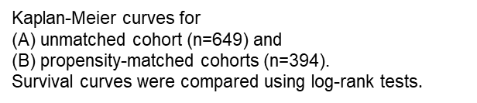
Results

Slide 59
Subgroup analyses in anatomical subsets of non-culprit disease
In the setting of cardiogenic shock, non-culprit PCI may result in an exaggerated acute myocardial injury in the non-infarcted myocardium. Thus, the greater the subtended myocardial territory, the greater the risk associated with non-culprit PCI
Adjusted models for mortality at 1 year referent to PCI of non-culprit disease using (A) standard multivariable-adjusted models; and (B) PSi-adjusted models.
Notes:
Given that cardiogenic shock (acidotic, hypoxic setting) is associated with a systemic inflammatory response and a prothrombotic state, one may hypothesize that non-culprit PCI may result in an exaggerated acute myocardial injury in the non-infarcted myocardium. Thus, the greater the subtended myocardial territory, the greater is the risk associated with non-culprit PCI. The early separation of the Kaplan-Meier curves in our study and in CULPRIT-SHOCK trial would suggest that the negative impact associated with immediate MVI is acute and transient, and occurs early during the period of shock physiology.

Slide 60
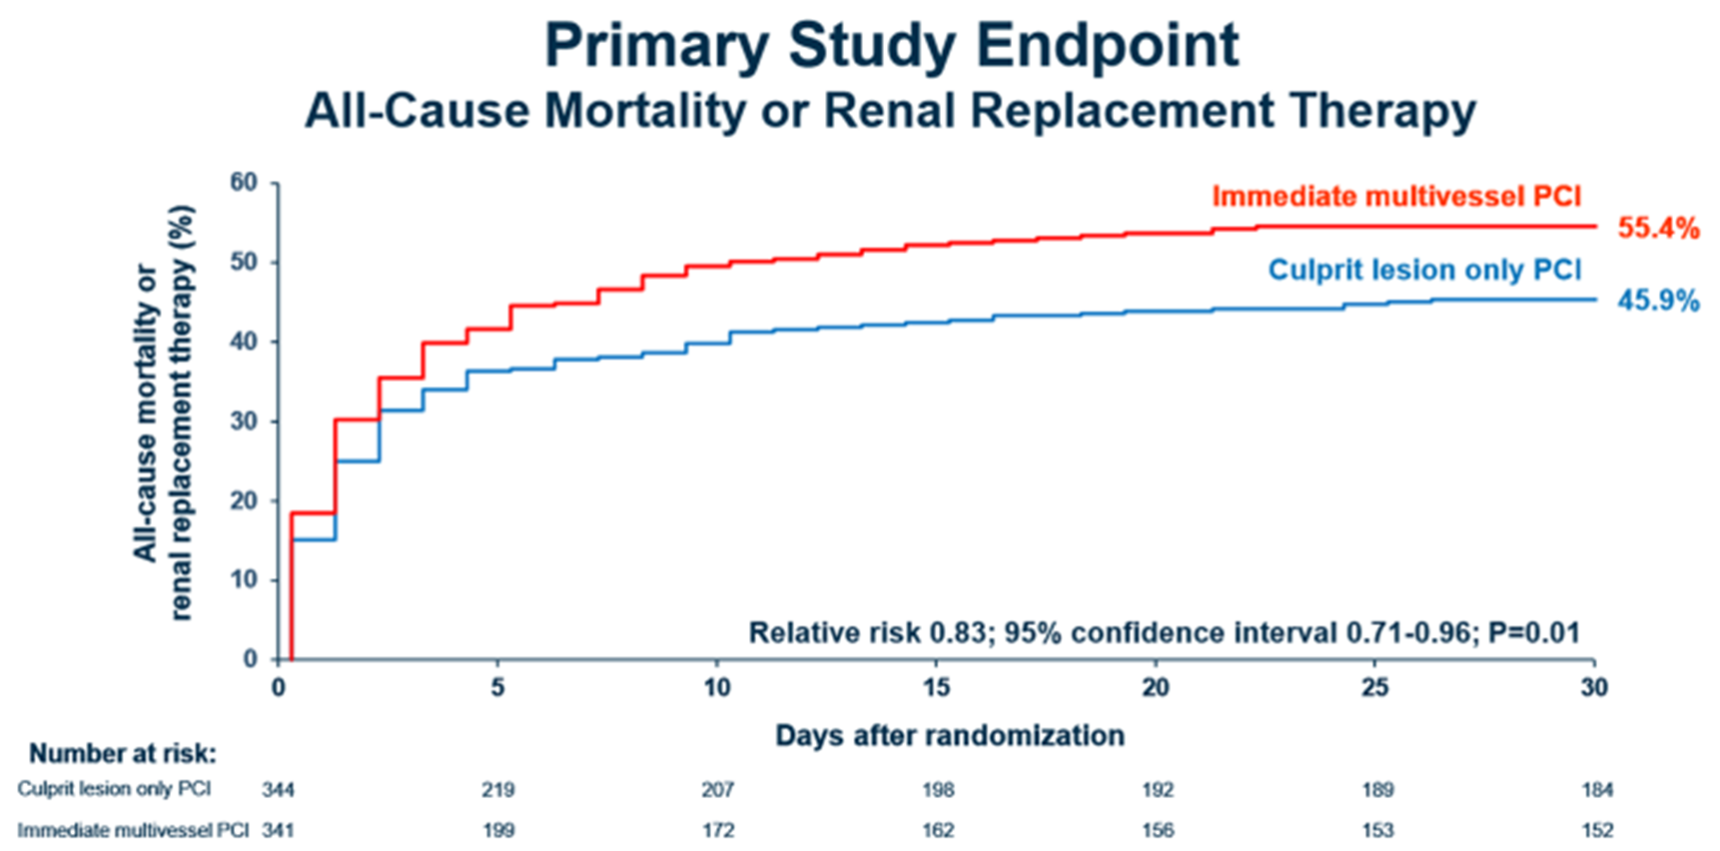
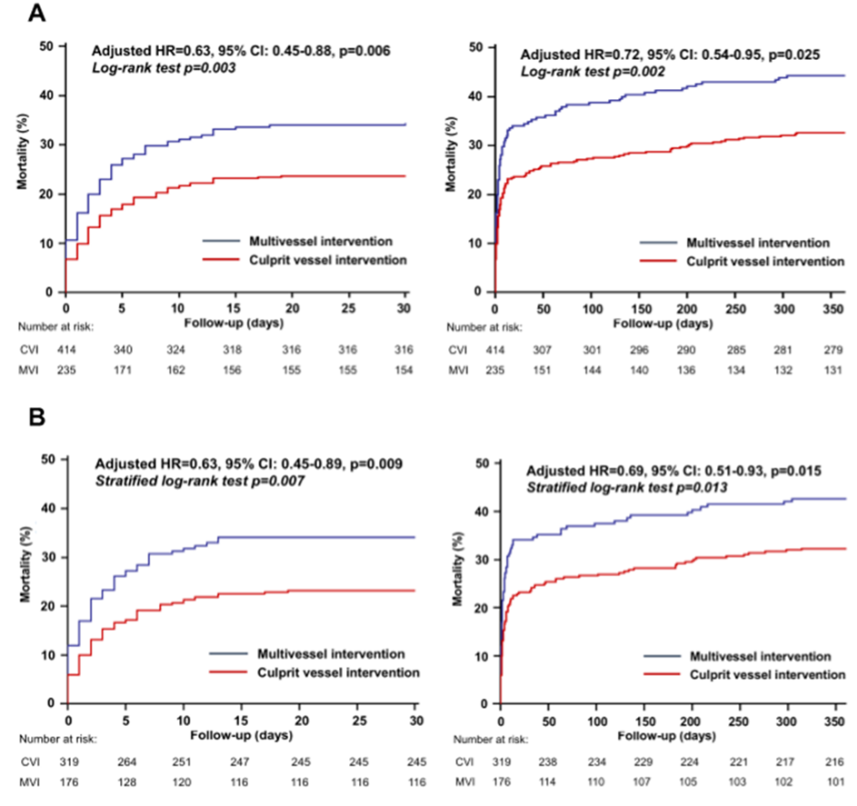
Are there deleterious effects of immediate MVI?
K-M Curve BC Registry 1 year all cause mortality
44.3%
32.6%
K-M Curve Culprit Shock 30 day composite primary end point*
34.5%
23.7%
The early separation of the Kaplan-Meier curves in our study and in CULPRIT-SHOCK trial would suggest that the negative impact associated with immediate MVI is acute and transient, and occurs early during the period of shock physiology.
K-M Curve BC Registry 30 day mortality rate
*Thiele et al. N Engl J Med 2017; 377:2419-2432

Slide 61
Conclusions
In patients with AMI and CS, a strategy of CVI appears to be associated with lower mortality
However, MVI may be considered in selected patients and in the setting of non-culprit LCx and RCA disease
CVI was the preferable revascularization strategy specifically in patients aged < 80 years; non-diabetics; and those presenting with STEMI
PCI of non-culprit LAD disease was associated with higher mortality

Slide 62



The Hybrid Approach to Percutaneous Coronary Intervention for Chronic Total Occlusion:
Update from the PROGRESS CTO International Registry
  Peter Tajti, MD
  on behalf of the PROGRESS CTO investigators
  1. Minneapolis Heart Institute, Abbott Northwestern Hospital, MN, USA
  2. University of Szeged, Division of Invasive Cardiology, Second Department of Internal Medicine and Cardiology Center, Hungary

Slide 63
PROspective Global REgiStry for the Study of CTO interventions
www.progresscto.org
NCT02061436
35 Sites – Study PI: E. S. Brilakis – National coordinator: B.V. Rangan – Database manager: P. Tajti
Minneapolis VAMC, MN
S. Garcia
Beth Israel Deaconess MC, MA
R.W. Yeh
Appleton Cardiology, WI
K. Alaswad
PeaceHealth St. Joseph Medical Center, WA
W. Lombardi
Minneapolis Heart Institute, MN
N. Burke, E.S. Brilakis
Massachusetts General Hospital, MA
F. Jaffer
Henry Ford, MI
K. Alaswad
Columbia University, NY
D. Karmpaliotis, J. Moses, N. Lembo, A.J. Kirtane, R. Hatem, M. Parikh, Z. Ali
Northwestern Cardiovascular Institute, IL
M. Ricciardi
Torrance Medical Center, CA
M.R. Wyman
UPMC, PA
C. Toma, A.J. Conrad Smith
Medical Center of the Rockies, CO
A. Doing, P. Dattilo
Trinity Medical, NY
H. Meltser
CWRU, OH
M. Costa, H. Bezerra,
P. Poommipanit,
F. Forouzandeh
San Diego VAMC and UCSD, CA
E. Mahmud, M. Patel
Mid America Heart Institute, MO
J.A. Grantham
Maimonides MC, NY
B.A. Malik
Banner Samaritan Medical Center, AZ
A. Pershad
Tristar Centennial, TN
B. Jefferson, T. Patel
Carolina East HC, NC
D. Jessup, M. Groove, Alex R. Kirby
CAVHS, AR
B. Uretsky
Emory Hospital, GA
W. Jaber, H. Samady
UT Southwestern, TX
S. Banerjee
Dallas VAMC, TX
S. Abdullah, H. Khalili
Tulane, LA
N. Abi-Rafeh, O. Mogabgab
Piedmont Heart Institute, GA
D. Kandzari
Providence Health Center, TX
C. Shoultz
Baylor Dallas, TX
J. Choi
International sites:
Meshalkin Novosibirsk Research Institute, Russia,
O. Krestyaninov, D. Khelimskii
Korgialeneio-Benakeio Hellenic Red Cross Hospital, Greece,
M. Koutouzis, Y. Tsiafoutis
Henry Dunant Heart Hospital, Greece,
V.Tzifos, A. Kolyviras, D. Damaskos
Memorial Hospital, FL
L. Van-Thomas Crisco
Baylor Plano, TX
L. Holper
Funding: Abbott Northwestern Hospital Foundation
Houston Methodist, TX,
A. Shah

Slide 64
CTO PCI outcomes using the hybrid approach
Appleton Cardiology, WI
Baylor Heart and Vascular Hospital, TX
Beth Israel Deaconess Medical Center, MA
Columbia University, NY
Central Arkansas VAMC, AR
Dallas VAMC/UTSW, TX
Henry Ford Hospital, MI
Hellenic Red Cross General Hospital of Athens, Greece
Massachusetts General Hospital, MA
Medical Center of the Rockies, CO
Minneapolis VAMC, MN
Minneapolis Heart Institute, MN
Meshalkin Novosibirsk Research Institute, Russia
PeaceHealth St. Joseph MC, WA
Piedmont Heart Institute, GA
San Diego VAMC and UCSD, CA
St Luke’s Mid America Heart Institute, MO
The Heart Hospital Baylor Plano, TX
Torrance Medical Center, CA
UPMC Medical Center, PA
5/2012 to 12/2017
20 centers, 3,122 lesions in 3,055 patients

Slide 65
Successful crossing strategy stratified by J-CTO score
p<0.0001
ADR: antegrade dissection and re-entry
AWE: antegrade wire escalation

Slide 66
Procedural complications
p<0.0001
p<0.0001
p<0.0001
p=0.0171
p=0.2999
p=0.2629
p=0.1228
p=0.6637
ADR: antegrade dissection and re-entry; AWE: antegrade wire escalation; CABG: coronary artery bypass graft; MI: myocardial infraction; PCI: percutaneous coronary intervention

Slide 67
Multivariable logistic regression

Slide 68
Conclusions
Hybrid approach for CTO PCI: high procedural success, acceptable complication rate
Higher annual CTO PCI volume is associated with higher procedural success
Our results provide important benchmarking for discussion of risk/benefit ratio of CTO PCI with patients/providers
Bridging the gap of what is currently achieved at most centers and what can be achieved should be a major focus of upcoming research and education

Slide 69
The Abbott Post-Approval Study 1 MitraClip Registry: 1-year Results of the First 2,000 Patients in the STS/ACC TVT Registry
James Hermiller MD, Ramon Quesada MD, Mark Reisman MD, Vasilis Babaliaros MD, D. Scott Lim MD, Jason Rogers MD,
Robert Kipperman MD, Andrew Wang MD, Paul Sorajja MD, Vivek Rajagopal MD, and Saibal Kar MD

Slide 70
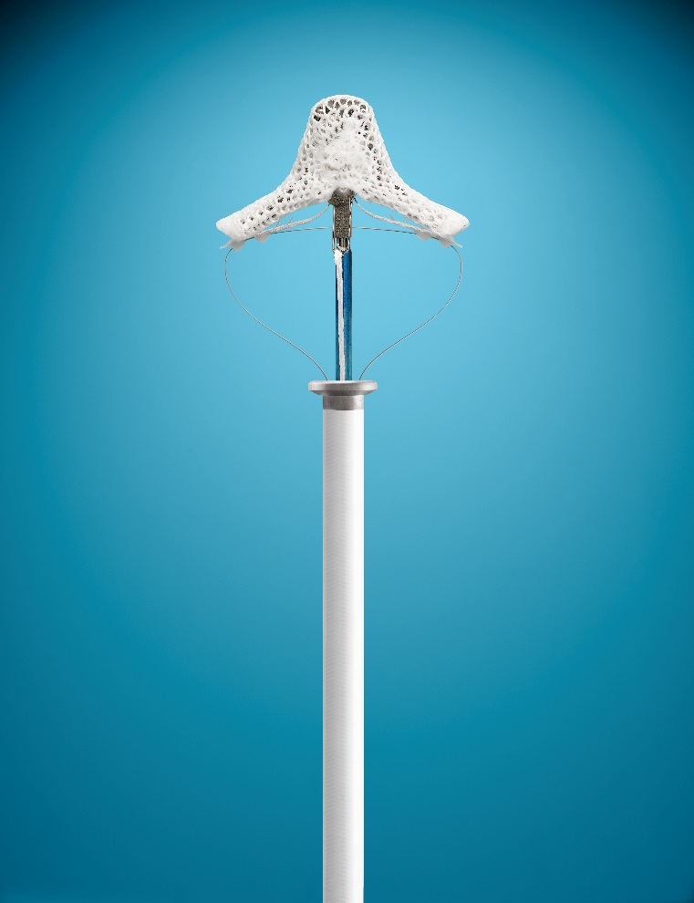
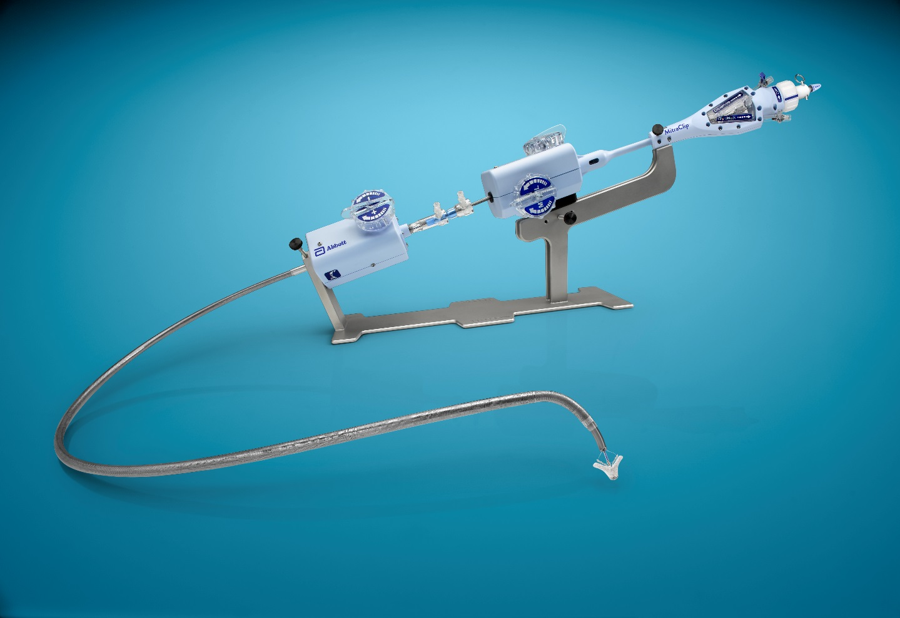
MitraClip® Therapy
Worldwide Clinical Experience
Received CE mark in 2008.
Received FDA approval in 2013 for significant symptomatic degenerative mitral regurgitation (DMR) in patients at prohibitive risk (PR) for MV surgery.
>60,000 patients treated worldwide.
All drawings are artist's representations only and should not be considered as an engineering drawing or photograph.

Slide 71
Study Design
Prospective, single-arm, multi-center, observational study
Data extracted from first 2,000 MitraClip patients consecutively entered into the TVT Registry
PAS-1 is the first and largest report of site-reported echocardiographic and clinical (functional and quality of life) outcomes from commercial US experience as captured in the TVT Registry through 1-year.

Slide 72
Procedural Results and MitraClip Implant Rate
Implant Rate: 97.1%
Procedural Results (mean ± SD) | PAS-1 (N=1,998)
Procedure Time (min) | 186 ± 71 (1716)
Device Time (min) | 87 ± 58 (1631)
Fluoroscopy Duration (min) | 37.9 ± 23.6 (1935)
Notes:
Device Time = Stop Time (Delivery System Retracted or SGC device removal) – Start Time (SGC in intra-atrial septum)
Procedure Time = Stop Time (Last Cath/TEE Removed) – Start Time (Vascular or TEE access)

Slide 73
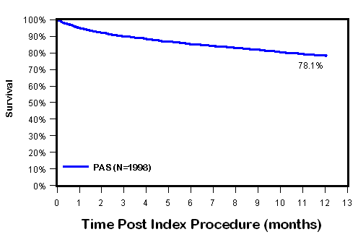
All-Cause Mortality Through 1 Year
Kaplan-Meier Estimate of Freedom from Mortality
95.0%
85.2%
78.1%
 | Baseline | 30 Days | 180 Days | 365 Days
At Risk | 1,998 | 1,714 | 1,335 | 963
Events | 3 | 94 | 251 | 359
Notes:
Kaplan-Meier freedom from All-Cause mortality results are consistent with PR DMR (N=127). Graph comparing all-cause mortality PAS-1 vs PR DMR can be found in backup slide #48.
¹ Patients who withdrew or lost to follow up before their 30 days/12 months visit (early window, e.g. 23 days for 30 days visit and 305 days for 12 months visit) will be excluded from the summary unless they are known to have died within 30 days/12 months.

Slide 74
Mitral Regurgitation Severity
MR ≤ 2+:
5.1%
87.6%
5.1%
86.6%
p<0.0001
p<0.0001
0.4%
0.6%
4.7%
4.5%
17.9 %
18.0 %
48.7%
41.0%
77.0%
76.9%
45.6%
38.9%
6.6 %
7.3%
5.8%
6.1%
Note: the p-value is calculated from McNemar test to compare the proportion of subjects with MR ≤ 2+ vs MR > 2+ at baseline and follow-up.
Notes:
p-values calculated using the McNemar’s Test, comparing MR ≤2+ vs MR >2+.

Slide 75
Changes in Left Ventricular Volume and Dimension
Left Ventricular End Diastolic Volume
Left Ventricular Internal Dimension at End Diastole
= -6.7 ml
p = 0.0044
= -0.14 cm
p < 0.0001
= -0.20 cm
p < 0.0001
= -8.5 ml
p = 0.0201

Slide 76
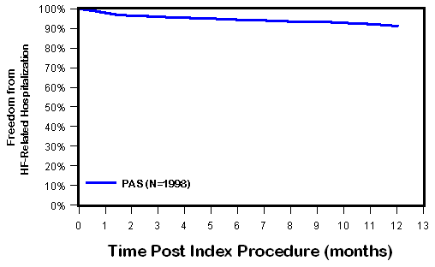
HF-Related Hospitalizations Through 1 Year
CEC-Adjudicated
Kaplan-Meier Freedom from HF-Related Hospitalizations
97.9%
94.4%
 | Description | PAS1 (N=1,998)
HF-Related Hospitalizations | # Patients | 128
 | # Hospitalizations | 159
 | Rate per Patient Year | 0.09
91.4%
58.6% (1,015/1,733) had heart failure hospitalization(s) 1 year prior to the MitraClip procedure.
 | Baseline | 30 Days | 180 Days | 365 Days
At Risk | 1,998 | 1,682 | 1,286 | 908
Events | 0 | 38 | 90 | 128
Notes:
Number of Hospitalizations = 159
Total Patient Year = 1736.6
Linearized Rate per Patient Year = 0.09 (159/1736.6)

Slide 77
6MWT Distance and KCCQ Quality of Life
6MWT Distance
KCCQ Quality of Life
= 37.9 meters
p < 0.0001
= 34.4 meters
p < 0.0001
= 30.0 points
p < 0.0001
= 26.3 points
p < 0.0001

Slide 78
Conclusion
In US commercial use, the MitraClip procedure provides meaningful clinical benefits in prohibitive risk DMR patients.
  Improvement in MR severity and LV measures
  Improvement in NYHA, KCCQ and 6MWT
Acute and 1-year outcomes in the MitraClip PAS-1 are consistent with other clinical and real-world use in high risk patients.
Commercial use of the MitraClip device remains a safe and effective therapeutic option for select patients and has not presented any new concerns during the follow-up of the PAS-1 study.
Notes:
device in prohibitive risk DMR

Slide 79
Strategies to Reduce Acute Kidney Injury and Improve Clinical Outcomes After Percutaneous Coronary Intervention: A Subgroup analysis of the Prevention of Serious Adverse Events Following Angiography (PRESERVE) Trial
Santiago Garcia, MD on behalf of PRESERVE investigators
University of Minnesota and Minneapolis VA Healthcare System
garci205@umn.edu

Slide 80
Background
Contrast-associated acute kidney injury (CAAKI) affects 7% of patients undergoing PCI
CA-AKI increases morbidity and mortality
Two widely used strategies to prevent CA-AKI in clinical practice include the use of intravenous (IV) sodium bicarbonate to induce urine alkalinization and scavenging of reactive oxygen species through peri-procedural oral administration of acetylcysteine
Results of clinical trials and meta-analyses of these interventions have yielded inconsistent results
Tsai et al. JACC Cardiovasc Interv 2014; 7:1-9.

Slide 81
No benefit of IV sodium bicarbonate over IV sodium chloride or of oral acetylcysteine over placebo for the prevention of death, need for dialysis or persistent decline in kidney function at 90 days
The generalizability of the PRESERVE trial results to high-risk patients receiving larger contrast volume has been questioned
Objective: To conduct a subgroup analysis of PRESERVE participants who underwent PCI to compare the efficacy of IV sodium bicarbonate with IV sodium chloride and of oral acetylcysteine compared with placebo in this high-risk patient group
N Engl J Med. 2018;378(7):603-14.
Nat Rev Nephrol. 2018.

Slide 82
PRESERVE
International, double-blind, placebo and comparator-controlled, randomized clinical trial with a 2 x 2 factorial design
Patients were enrolled at 53 medical centers in the United States (35 Veterans Affairs sites), Australia (13 sites), Malaysia (3 sites), and New Zealand (2 sites)
The administration of IV fluids was protocolized with dose/timing/rate ranges (3-12 ml/kg prior to angiography, 1-1.5 ml/kg/hour during angiography/PCI, and 1-3 ml/kg/hour after angiography)
Inclusion criteria: Pre-angiography eGFR <45 ml/min/1.73m² with or without diabetes mellitus or Pre-angiography eGFR <60 ml/min/1.73m² with diabetes, undergoing PCI
Primary end-point: A composite of death, need for dialysis, or a persistent increase of at least 50% in serum creatinine at 90 days after angiography.
Secondary end-point: CAAKI, defined as an increase in serum creatinine of at least 25% or 0.5 mg/dl at 4 days following angiography.

Slide 83
Baseline characteristics according to treatment assignment
 | IV Sodium Bicarbonate (n=568) | IV Sodium Chloride (n=593) | p-value | NAC (n=598) | Placebo (n=563) | p-value
Age – mean (std) – years | 69.1 ± 8.4 | 69.5 ± 8.4 | 0.92 | 69.5 ± 8.4 | 69.1 ± 8.3 | 0.80
eGFR - median (IQR) – ml/min/1.73m² | 50.3 (40.9 - 60.3) | 51.3 (42.7 - 59.9) | 0.4 | 50.9 (42.5 - 60.1) | 50.5 (41.1 - 60.1) | 0.5
Diabetes mellitus – no. (%) | 464 (81.7%) | 488 (82.3%) | 0.79 | 486 (81.3%) | 466 (82.8%) | 0.51
Contrast type Iodixanol – no. (%) | 324 (57%) | 322 (54.3%) | 0.35 | 330 (55.2%) | 316 (56.1%) | 0.75
Contrast volume – median (IQR) – ml | 155 (112.5 - 220) | 160 (120 - 220) | 0.52 | 170 (118 - 225) | 150 (112 - 220) | 0.06
IV fluids Pre-angiography median (IQR) – ml | 354 (278 - 464) | 348 (282 - 444) | 0.35 | 350 (282 - 450) | 348 (280 - 454) | 0.97
Intra-angiography median (IQR) – ml | 152 (106 - 215) | 167 (113 - 222) | 0.05 | 160 (111 - 221) | 160 (108 - 220) | 0.89
Post-angiography median (IQR) – ml | 588 (498 - 678) | 590 (485 - 692) | 0.64 | 588 (491 - 683) | 590 (488 - 690) | 0.92

Slide 84
Results
PRIMARY OUTCOME:
Sodium Bicarbonate vs. Sodium Chloride: OR 0.64 (0.33-1.24)
Acetylcysteine vs. Placebo: OR 1.37 (0.71-2.62)
SECONDARY OUTCOME:
Sodium Bicarbonate vs. Sodium Chloride: OR 0.93 (0.65-1.34)
Acetylcysteine vs. Placebo: OR 0.98 (0.69-1.41)
Conclusion: We found that neither IV sodium bicarbonate nor oral acetylcysteine were beneficial in reducing serious adverse
90-day events after PCI. Intravascular volume expansion with isotonic sodium chloride should be considered the standard of care for the prevention of adverse renal outcomes in patients undergoing PCI.

