Slide 1
EXPERT RECOMMENDATIONS ON THE ASSESSMENT
OF WALL SHEAR STRESS IN HUMAN CORONARY ARTERIES: EXISTING METHODOLOGIES, TECHNICAL CONSIDERATIONS, AND CLINICAL APPLICATIONS
Frank Gijsen, Thorax center, Erasmus MC Rotterdam, The Netherlands

Slide 2
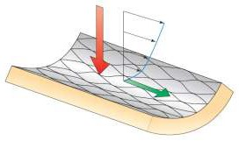
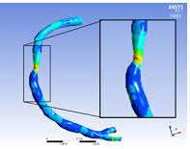
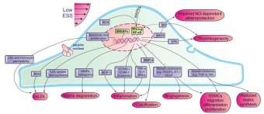
shear stress in human coronaries
influences endothelial function
impacts atherosclerotic disease

Slide 3
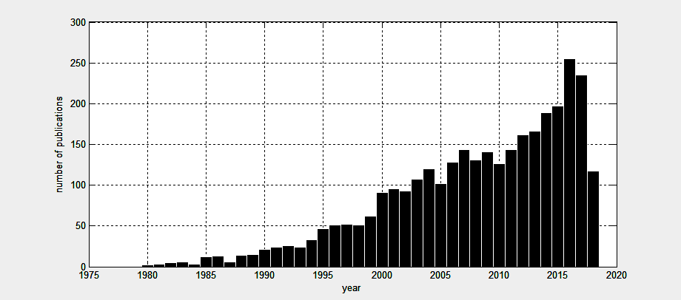
shear stress in human coronaries
65% of first authors clinical of biological background!

Slide 4
shear stress in human coronaries

Slide 5
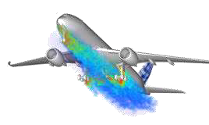
shear stress in human coronaries
CFD: powerful, well-accepted but complex engineering tool
CFD: but in the hands of the novice, many
things can go wrong …
(you wouldn’t want an untrained engineer perform a PCI, right?)

Slide 6
shear stress in human coronaries
CFD = Computational Fluid Dynamics
CFD ≠ Colors For Doctors

Slide 7
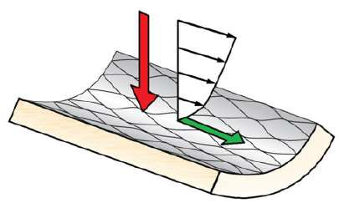
shear stress in human coronaries
Introduction
The biological relevance of shear stress
Imaging coronary arteries: a brief review
Wall shear stress in native arteries
Wall shear stress in stents
Clinical application
Concluding remarks Appendices

Slide 8
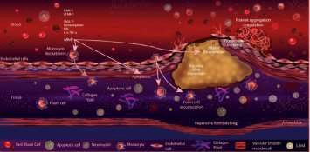
shear stress in human coronaries
Introduction
The biological relevance of shear stress
Imaging coronary arteries: a brief review
Wall shear stress in native arteries
Wall shear stress in stents
Clinical application
Concluding remarks Appendices

Slide 9
shear stress in human coronaries
Introduction
The biological relevance of shear stress
Imaging coronary arteries: a brief review
Wall shear stress in native arteries
Wall shear stress in stents
Clinical application
Concluding remarks Appendices

Slide 10
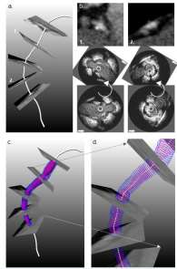
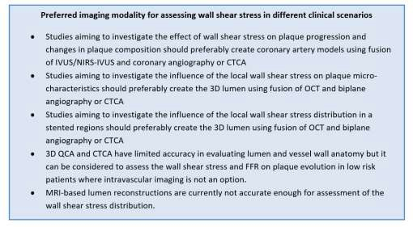
shear stress in human coronaries

Slide 11
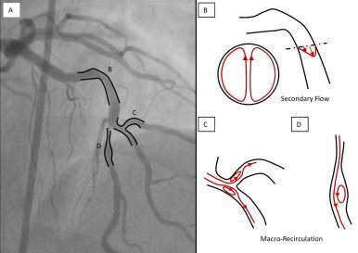
shear stress in human coronaries

Slide 12
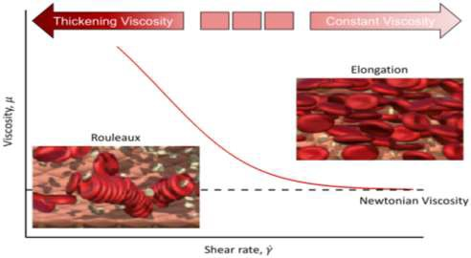
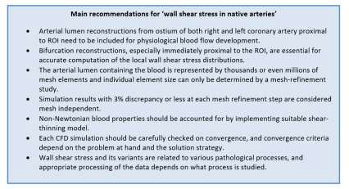
shear stress in human coronaries

Slide 13
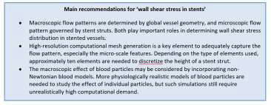
shear stress in human coronaries

Slide 14
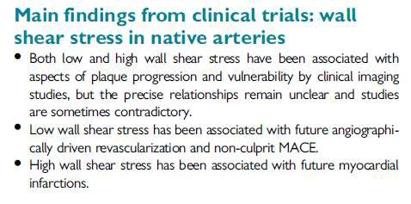
shear stress in human coronaries
Introduction
The biological relevance of shear stress
Imaging coronary arteries: a brief review
Wall shear stress in native arteries
Wall shear stress in stents
Clinical application
Concluding remarks Appendices

Slide 15
shear stress in human coronaries
Introduction
The biological relevance of shear stress
Imaging coronary arteries: a brief review
Wall shear stress in native arteries
Wall shear stress in stents
Clinical application
Concluding remarks Appendices

Slide 16
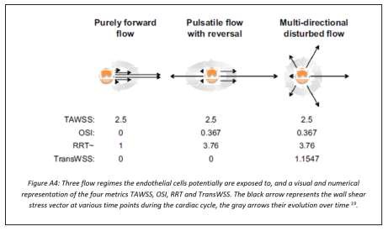
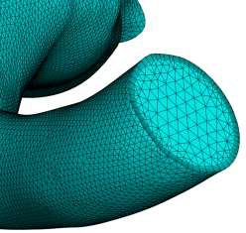
shear stress in human coronaries

Slide 17
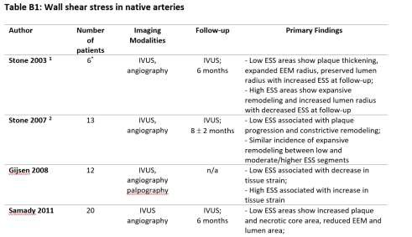
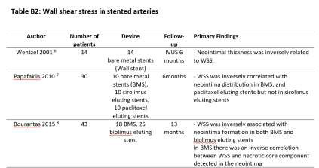
shear stress in human coronaries

Slide 18
shear stress in human coronaries
CFD ≠ Colors For Doctors ≠ Certificate For Doctors!

