Slide 1
AZALEA-TIMI 71
Christian T. Ruff, MD, MPH
on behalf of the AZALEA-TIMI 71 Steering Committee & Investigators

Slide 2

DISCLOSURES
Research grants through institution:
Anthos, AstraZeneca, Daiichi Sankyo, Janssen and Novartis
Honoraria for scientific advisory boards and consulting:
Altimmune, Anthos, Bayer, Bristol Myers Squibb, Daiichi Sankyo, Janssen, Merck and Pfizer.
Member of TIMI Study Group, which has received institutional research grant support through Brigham and Women’s Hospital from:
Abbott, Amgen, Anthos Therapeutics, ARCA Biopharma, Inc., AstraZeneca, Bayer HealthCare Pharmaceuticals, Inc., Daiichi-Sankyo, Eisai, Intarcia, Ionis Pharmaceuticals, Inc., Janssen Research and Development, LLC, MedImmune, Merck, Novartis, Pfizer, Quark Pharmaceuticals, Regeneron Pharmaceuticals, Inc., Roche, Siemens Healthcare Diagnostics, Inc., Softcell Medical Limited, The Medicines Company, Zora Biosciences

Slide 3


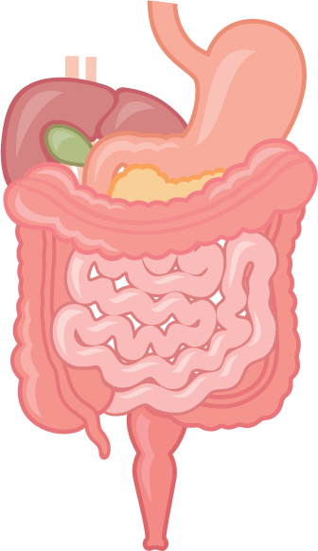

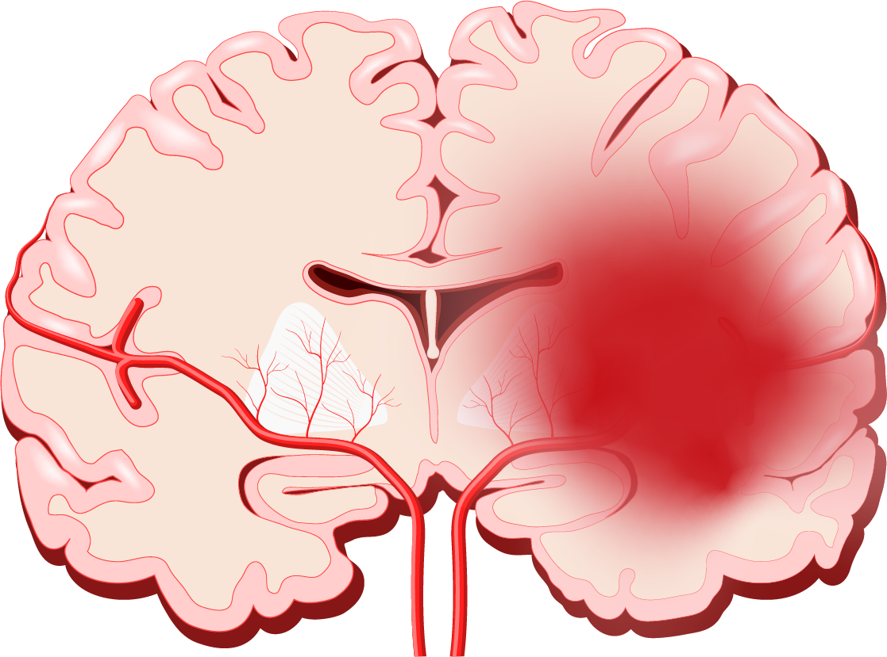
Stroke prevention in af: DOACs vs. warfarin
Meta-Analysis: ARISTOTLE, ENGAGE AF-TIMI 48, ROCKET-AF & RE-LY Trials
Stroke
Death
Major Bleeding
Ischemic
Hemorrhagic
Similar
50%
10%
14%
25%
Ruff CT, et al. Lancet 2014;383:955-962
Carnicelli AP, et al. Circulation 2022;145:242-255

Slide 4
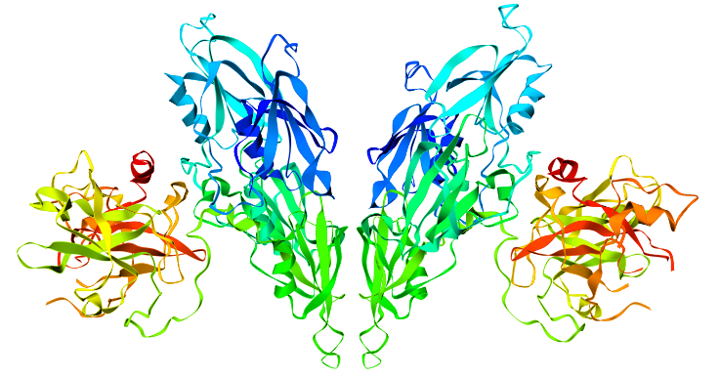
Abelacimab
Highly selective, fully human monoclonal antibody
Factor XI
Homodimeric structure (two identical subunits)
Binds to Factor XI and locks it in the inactive state preventing the formation of activated factor XI (FXIa).
Modifications to minimize the chances of off-target effects
Papagrigoriou E, et al. Nat Struct Mol Biol 2006;13:557-558

Slide 5
TRIAL DESIGN
1287 Patients with AF at Moderate-to-High
Risk of Ischemic Stroke
1:1:1 Randomization
Open label abelacimab vs. riva
Abelacimab
150 mg SC Monthly
Abelacimab
90 mg SC Monthly
Rivaroxaban
20 mg Daily*
Abelacimab dose blinded to subjects & Investigators
*15 mg if CrCl ≤50 ml/min at randomization or during study
Event driven study targeting 166 Major or CRNM bleeds
1° EP (Safety): Major or Clinically Relevant Non-Major Bleeding

Slide 6
Factor XI inhibition (%)
>95% Inhibition
Preliminary Datacut

Slide 7
Primary endpoint

Slide 8
Bleeding endpoints
Endpoint (ISTH Definition) | Riva 20 mg (N=430) Incidence Rate | Abelacimab 150 mg (N=427) Incidence Rate | HR (95% CI) | P Value | Abelacimab 90 mg (N=425) Incidence Rate | HR (95% CI) | P-Value
Major + CRNM Bleeding | 8.1 | 2.7 | 0.33 (0.19-0.55) | <0.001 | 1.9 | 0.23 (0.13-0.42) | <0.001
Major Bleeding | 3.7 | 1.0 | 0.26 (0.11-0.61) | 0.002 | 0.7 | 0.19 (0.07-0.50) | <0.001
GI Bleeding | 2.1 | 0.1 | 0.07 (0.01-0.50) | 0.008 | 0.1 | 0.07 (0.01-0.51) | 0.009
ICH | 0.6 | 0.3 | 0.50 (0.09-2.72) | 0.42 | 0.6 | 1.03 (0.26-4.10) | 0.97
CRNM Bleeding | 4.6 | 1.8 | 0.39 (0.21-0.75) | 0.004 | 1.1 | 0.25 (0.11-0.54) | <0.001
Incidence rates per 100 Pt-years
On-Treatment Population
Based on final DMC Datacut

Slide 9
conclusion
Potent inhibition of FXI:
>95% inhibition over the dosing interval
Substantial reduction in bleeding with the 150 mg dose compared with rivaroxaban:
67% ↓ major or clinically relevant non-major bleeding
74% ↓ major bleeding
93% ↓ major GI bleeding

Slide 10
THANK YOU

