Slide 1
Randomized, Double-blind, Placebo-controlled, Phase 3, Study To Evaluate Lerodalcibep Long-term Efficacy And Safety In Patients With, Or At Very-high Or High Risk, For Cardiovascular Disease On Stable Lipid-lowering Therapy
(LIBerate-HR)
Eric Klug MB BCh M Med
Associate Professor, Division of Cardiology, Faculty of Health Sciences,
University of the Witwatersrand
COI statement: Honoraria from Novartis, Amgen and Sanofi-Aventis
Eric Klug, Sara Llerena, Lesley Burgess, Nyda Fourie, Russell Scott, Jeff Vest, Kate Caldwell, David Kallend, Evan A Stein for the LIBerate-HR Investigators
Financial support
This clinical trial was funded by LIB Therapeutics

Slide 2
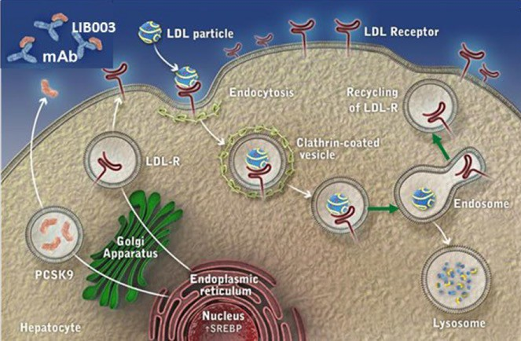
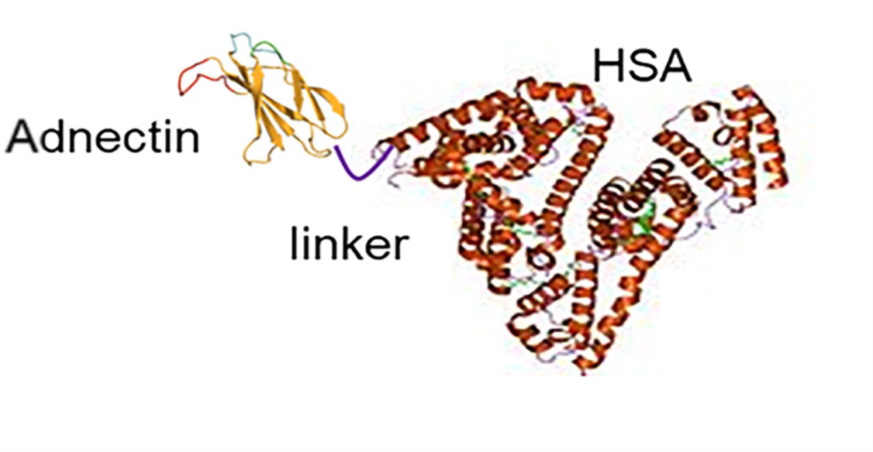
Lerodalcibep a small binding protein, consists of an 11kDa anti-PCSK9 domain (Adnectin), derived from human fibronectin, fused with human serum albumin with plasma half-life 12 to 15 days.
Similar to mAbs, LIB003 binds to PCSK9, blocks PCSK9 binding to LDLR, preventing LDLR degradation, increasing LDLR recycling, enhancing LDL-C clearance, and lowers LDL-C levels.
Different from mAbs, the small size (77kDa) and high solubility allows for a much smaller injection volume to achieve stable and prolonged LDL-C reductions between injections.
Phase 2 trial established a 300 mg dose in 1.2 mL dosed monthly as highly effective, reducing LDL-C >70%

Slide 3
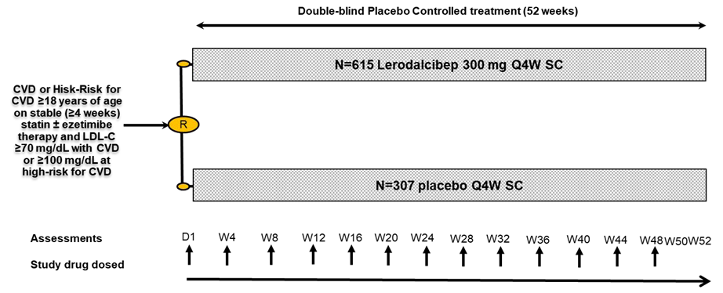
Efficacy and Safety of Lerodalcibep in Patients at Very-High and High Risk for CVD*: Phase 3, Double-blind Placebo-controlled 52-week trial (LIBerate-HR)
Study Design
*Very-High Risk (VHR) for CVD includes clinical CVD and CVD risk equivalents
Intervention: Randomized 2:1 to monthly 1.2 mL sub-cutaneous (SC) lerodalcibep 300mg or placebo for 52 weeks.
Setting: 66 clinical centers in 11 countries
Co-primary efficacy endpoints: % change from baseline in LDL-C at Week 52 and the mean of Weeks 50 and 52.
Secondary outcomes: achievement of LDL-C targets, other lipid and apolipoproteins changes.
Safety analysis: included all patients randomized and receiving a dose of study drug.
Trial Registrations: EudraCT: 2020-004393-22 Clinicaltrials.gov NCT04806893

Slide 4
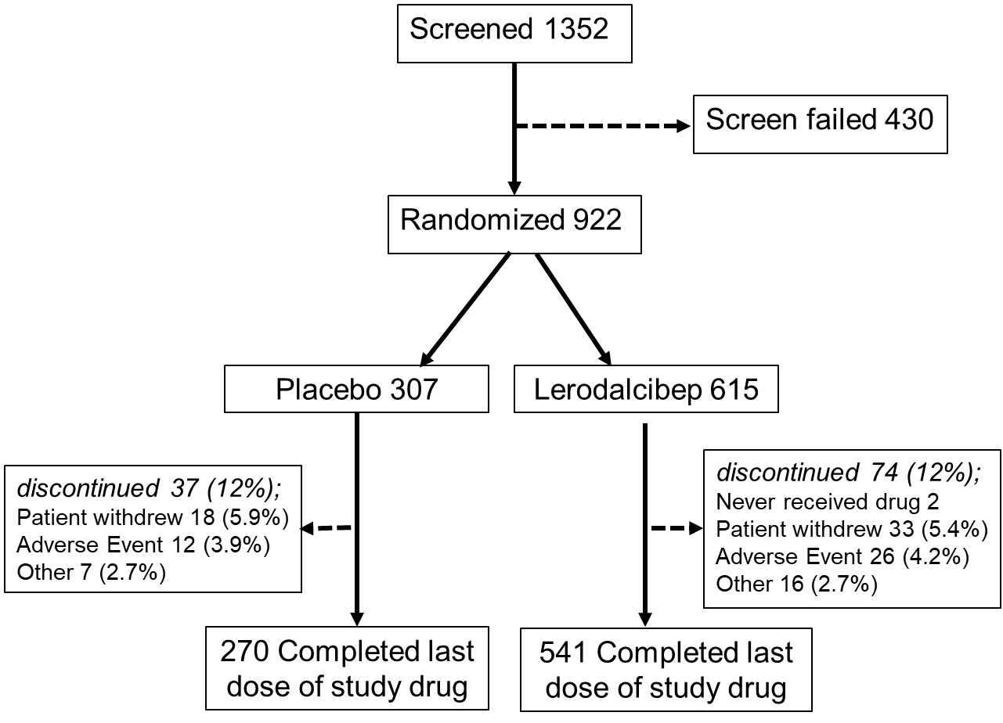
Patient Disposition (Consort Diagram) and Analysis Populations
Co-primary Efficacy Endpoint Analysis Populations
Population | Placebo N (%) | Lerodalcibep N (%)
Modified ITT (mITT) | 274 (89.3%) | 546 (88.8%)
Per-Protocol (PP) | 228 (74.3%) | 433 (70.4%)
ITT with imputation (ITT)* | 307 (100%) | 615 (100%)
*multiple imputation washout model assumes lerodalcibep subjects discontinued to have an outcome similar to those in the placebo group as per new FDA guidance 2021
*FDA. E9(R1) statistical principles for clinical trials: Estimands and sensitivity analysis in clinical trials. 2021. https://www.fda.gov/regulatory-information/search-fda-guidance-documents/e9r1- statistical-principles-clinical-trials-addendum-estimands-and-sensitivity-analysis-clinical

Slide 5
Baseline Demographics and Clinical Characteristics
Characteristic | Placebo (N=307) | Lerodalcibep (N=615)
Age – yr (range) | 64.5 (28-87) | 64.6 (27-84)
Female, no. (%) | 133 (46.6) | 281(45.7)
Race: White, no. (%) | 234 (76.2) | 485 (78.9)
Black / Multiracial, no. (%) | 58 (18.9) | 108 (17.6)
South Asian, no. (%) | 15 (4.9) | 20 (3.3)
Body Mass Index, mean kg / m² (SD) | 30.08 (5.04) | 30.02 (5.12)
Secondary Prevention: Documented CVD, no. (%) | 158 (51.5) | 282 (48.9)
Primary Prevention: VHR and HR for CVD, no. (%) | 149 (48.5) | 333 (51.2)
Diabetes Mellitus, no. (%) | 139 (45.3) | 259 (42.1)
Familial Hypercholesterolemia, no. (%) | 27 (8.8) | 62 (10.1)
Lipid modifying therapy – no. (%)
Statin; any dose | 258 (84.0) | 504 (82.0)
High intensity statin | 133 (43.3) | 227 (36.9)
Not high intensity statin | 125 (40.7) | 277 (45.0)
Ezetimibe | 51 (16.6) | 102 (16.6)
Lipid measures at baseline – mg / dL; mean (SD)
LDL-cholesterol (calculated) | 116.9 (44.68) | 116.3 (42.98)
Total cholesterol | 196.4 (50.53) | 196.7 (49.48)
HDL-cholesterol | 50.0 (15.49) | 50.5 (15.42)
Triglycerides - mean / median | 151.3 / 138 | 149.9 / 134
Apolipoprotein B | 102.9 (29.09) | 103.3 (29.22)
Lipoprotein (a), mean / median (nmol / L) | 102.6 / 42 | 105.6 / 47

Slide 6
LDL-C Change from Baseline:
Co-Primary Endpoints by mITT, PP and ITT (with Imputation)
 | Lerodalcibep | Placebo | Placebo-adjusted Change | P-value
mITT Analysis
Week 52 | -56.33% | -0.14% | -56.19% | <0.0001
Mean Week 50/52 | -63.25% | -0.56% | -62.69% | <0.0001
Per-Protocol (PP) Analysis
Week 52 | -60.39% | -0.12% | -60.27% | <0.0001
Mean Week 50/52 | -66.55% | -0.70% | -65.85% | <0.0001
ITT imputation Analysis*
Week 52 | -49.36% | 0.31% | -49.67% | <0.0001
Mean Week 50/52 | -55.46% | -0.14% | -55.33% | <0.0001
*multiple imputation washout model assumes lerodalcibep subjects who discontinued to have an outcome similar to the placebo group, as per new FDA 2021 guidance

Slide 7
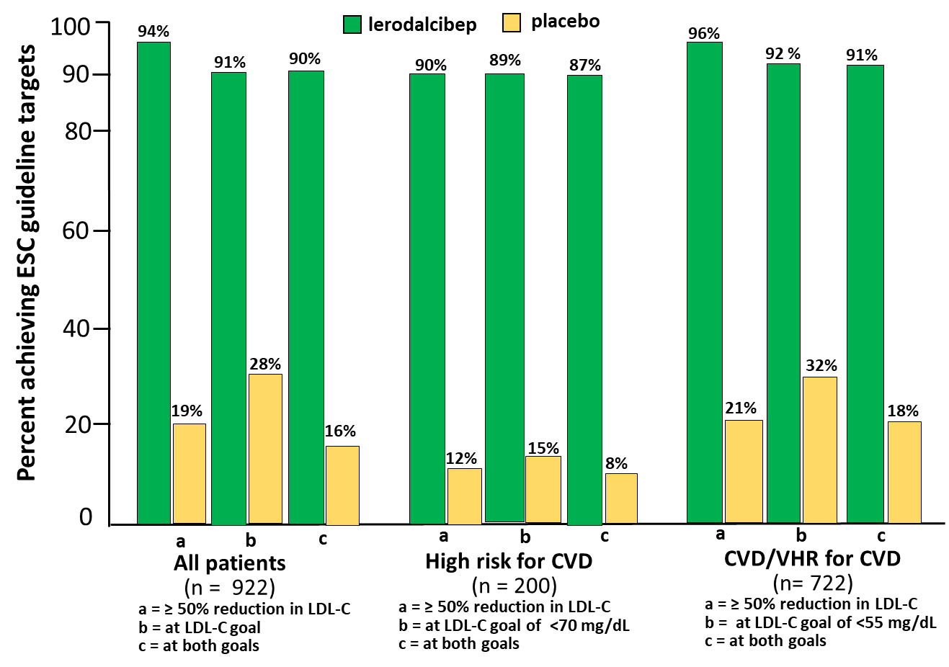
Percent achieving ESC recommended ≥50% reduction in LDL-C and LDL-C Targets with Lerodalcibep Compared to Placebo During the Study

Slide 8
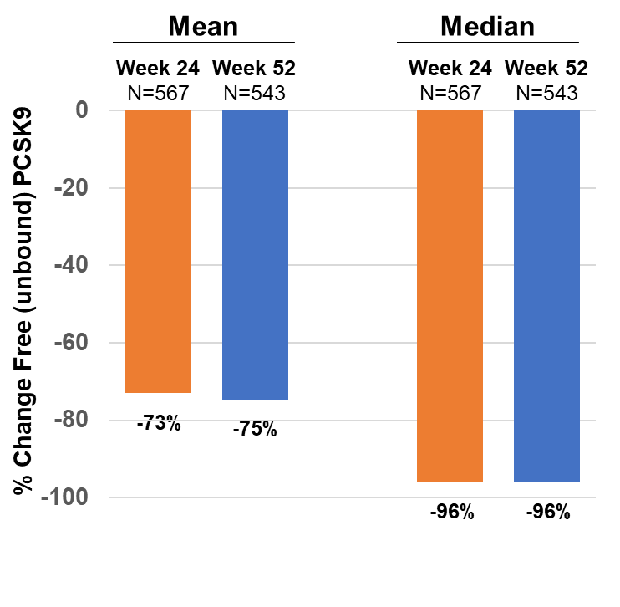
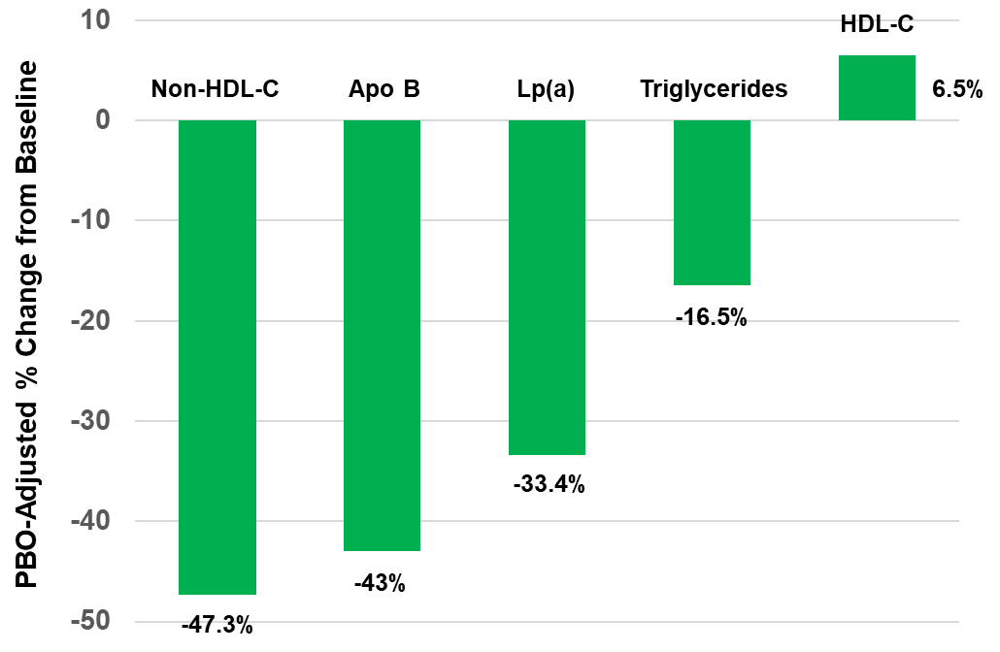
Additional Lipid and Apolipoproteins Placebo Adjusted LS mean change from Baseline: Week 52 - ITT Analysis
Free (unbound) PCSK9:
Weeks 24 and 52 Change from Baseline: Lerodalcibep Treated Group

Slide 9
Adverse events and key safety laboratory findings: Safety Population
 | Placebo (N=307) | Lerodalcibep (N=613) | Risk Difference (95% CI)
Adverse events- n (%)
Patients with at least one adverse event | 209 (68.1) | 439 (71.6) | 3.5 (-2.8, 9.9)
Patients with at least one event leading to withdrawal of study drug | 14 (4.6) | 26 (4.2)
Serious adverse events
Patients with at least one serious adverse event | 41 (13.4) | 76 (12.4)
Death | 2(0.7) | 9(1.5)
Cardiovascular deaths | 2(0.7) | 5 (0.8)
Cancer deaths | 0 | 2 (0.3)
Other cardiovascular adverse events
Prespecified exploratory cardiovascular events | 24 (7.8) | 35 (5.7)
Fatal and non-fatal myocardial infarction | 8 (2.6) | 5 (0.8)
Fatal and non-fatal stroke | 3 (1.0) | 1 (0.2)
Frequent adverse events
COVID-19 | 37 (12.1) | 79 (12.9) | 1.2 (-3.3, 5.6)
Upper respiratory tract infection | 20 (6.5) | 41 (6.7) | 0.2 (-3.2, 3.6)
Urinary Tract Infection | 18 (5.9) | 39 (6.4) | 0.5 (-3.8, 3.8)
Hypertension | 23 (7.5) | 31 (5.1) | -2.4 (-5.8, 1.0)
Nasopharyngitis | 12 (3.9) | 40 (6.5) | 2.6 (-0.3, 5.5)
Arthralgia | 16 (5.2) | 28 (4.6) | -0.6 (-3.6, 2.3)
Injection site reaction (ISR) N(%) of subjects* | 1 (0.3) | 42 (6.9) | 6.5 (4.4, 8.6)
Total ISR events (% of doses) | 0.4% | 2.6%
Discontinuations due to ISR (%) | 4.6% | 4.2%
Laboratory results – n (%)
Liver Function ALT or AST >3x ULN | 3(1.0) | 2 (0.3)
AST or ALT > 5x ULN | 1 (0.3) | 1 (0.2)
Muscle CK>5xULN | 6 (2.0) | 17 (2.8)
Immunogenicity:
Low levels transient and sporadic ADAs
In-vitro NAbs in 0.4% not associated with;
ISRs
Any attenuation in PCSK9 or LDL-C lowering efficacy.
*All ISRs graded as mild or moderate

Slide 10
Summary
Lerodalcibep decreased LDL-C; 56% at W52 (60.6 mg/dL), and
62% at mean W50 and W52 (74,5 mg/dL);
On Lerodalcibep ≥90% VHR and HR CVD patients on maximally tolerated statins achieved both the new more stringent ESC targets.
Lerodalcibep reduced non-HDL-C 47%, Apo B 43%, Lp(a) 33%
Lerodalcibep was well tolerated;
with adverse events similar to that with placebo:
ISRs, mild to moderate, no difference in discontinuations [lerodalcibep (4.2%) - placebo (4.6%)]
Lerodalcibep is not associated with in-vivo active ADAs or NAbs that attenuate either free PCSK9 suppression or LDL-C efficacy.

Slide 11
Conclusion
Lerodalcibep offers a novel, effective alternative to existing PCSK9 inhibitors:
Substantial LDL-C reductions on top of existing oral agents
Ability for >90% of patients to achieve the new ESC guideline targets
Robust reductions in all atherogenic lipids and lipoproteins
Very large and persistent reductions in free PCSK9 at 4-week trough
Tolerability and safety similar to placebo
Monthly, small (1.2 mL), SC dose and
Long ambient stability for patient home use

Slide 13
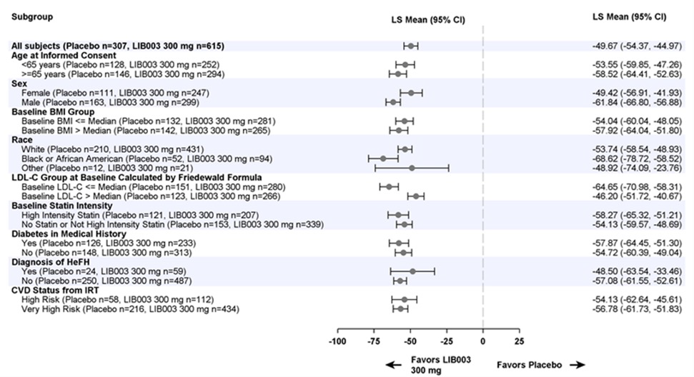
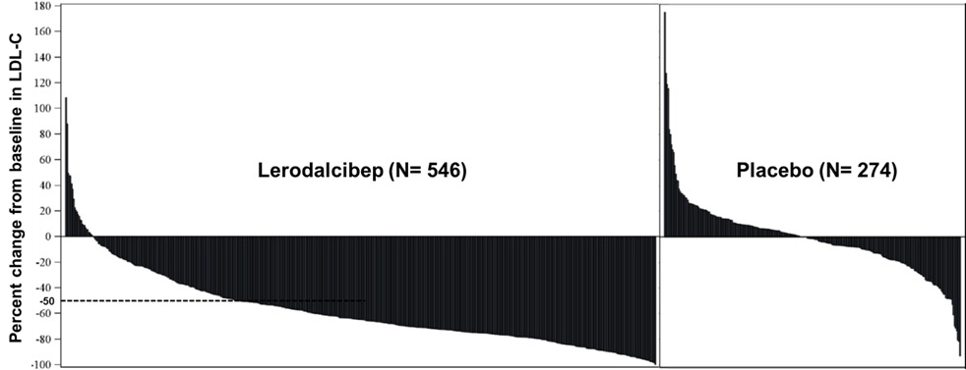
Consistent LDL-C reduction in all sub-groups and robust LDL-C reductions >50% in the majority of patients treated with lerodalcibep
Waterfall plot of % change in LDL-C at Week 52 in individual patients*
Favors Lerodalcib
Favors
ep
Placebo

