Slide 1
Topical Tranexamic Acid to Reduce Seizures
in Cardiac Surgery
Dr. Andre Lamy on behalf of DEPOSITION Investigators Population Health Research Institute, Hamilton, Canada
Funding: Canadian Institutes of Health Research

Slide 2
Disclosure
None

Slide 3
Background
Perioperative bleeding in cardiac surgery is associated with morbidity and mortality
IV antifibrinolytics are standard of care: tranexamic acid (TxA)
IV TxA increases the risk of seizure

Slide 4
Problem
Anesthesiologists decrease the dose of TxA to prevent seizures
It may increase the risk of bleeding
Giving TxA directly on the source of bleeding (topical) has been tested in various type of surgery
Promising alternative in our pilot study

Slide 5
Question
In patients undergoing on-pump cardiac surgery, does topical tranexamic acid (intra-pericardial) compared to the usual intravenous tranexamic acid administration
-reduce the risk of in-hospital seizure without increasing red blood cell transfusion?

Slide 6
Design
Randomized controlled trial
Double dummy to maintain blinding
Each patient received 2 syringes (up to 10g) for intravenous use and 2 syringes (up to 10g) for topical use
Investigator initiated trial
Sample size: 3800 patients
Funding: Canadian Institute of Health Research

Slide 7
Eligibility criteria
Included patients
≥18 yrs undergoing cardiac surgery with cardiopulmonary bypass
Median sternotomy
Excluded patients (too low or too high risk of bleeding)
Minimally invasive surgery or off-pump CABG
Bleeding disorder
eGFR <30 ml/min
Pre-operative hemoglobin >170 g/L or <110 g/L or thrombocytopenia (<50,000 platelets per μL)
Expected circulatory arrest
Active endocarditis

Slide 8
Intervention and Follow-up
Patients randomized to receive
TXA 1-10 g IV bolus or placebo at start and during surgery
TXA 1-10 g topical or placebo at end of surgery (Protamine)
Follow-up
until discharge or 10 days, whichever occurred first

Slide 9
Outcomes
Primary outcome
Seizure
Secondary outcome
Red blood cell transfusion
Tertiary outcomes: blood products transfusion, composite (death, MI, stroke), reoperation for bleeding or tamponade, ICU length of stay

Slide 10
Statistics
Primary outcome hypothesis
Topical TXA superior to IV TXA for seizure
Fisher’s exact test with 2-sided P <0.05
Secondary outcome hypothesis
Topical TXA noninferior to IV TXA for red blood cell transfusion
upper bound of 1-sided 97.5% CI for HR needed to fall below 1.15
1-sided P <0.025

Slide 11
Enrollment
Second pre-specified interim analysis by DSMB (75%)
DSMB recommended to stop the trial for safety
Operations Committee reviewed the data and stop enrollment in the trial on November 28,2023
3242 patients enrolled out of 3800

Slide 12
Baseline characteristics
Characteristics
Topical TXA (N=1624)
Intravenous TXA (N=1618)
Age – (mean yrs) | 66.3 | 65.7
Male | 77% | 78%
History of Myocardial infarction | 38% | 40%
Diabetes | 30% | 29%
Stroke | 4% | 4%
Seizure history | 0.9% | 0.4%
Elective surgery
65%
64%

Slide 13
Surgical characteristics
Characteristics | Topical TXA (N=1624) | Intravenous TXA (N=1618)
CABG only | 69% | 70%
Valve only | 13% | 12%
Ascending aorta only | 1% | 1%
Mixed | 16% | 15%
Cardio-pulmonary bypass time (mins)
88.7
88.6
Cross-clamp time (mins)
66.2
66.0

Slide 14
Compliance and Follow-up
In both TXA and placebo groups
– 96.5% of patients received active treatment allocation
Follow-up: 100% of participants completed

Slide 15
Primary outcome
 | Topical TXA | Intravenous TXA _{RR P}
Outcome | n=1624 | ^{n=1618} (95% CI) value
 | no. (%) | no. (%)
Seizure | 4 (0.2) | 11 (0.7) ^{0.36} 0.07
(0.12-1.14)
Fisher’s exact test

Slide 16
Post Hoc Primary outcome
Outcome | Topical TXA n=1624 no. (%) | Intravenous TXA n=1618 no. (%) | RR (95% CI) | P Value¶
Seizure* | 4 (0.2) | 11 (0.7) | 0.36 (0.12-1.14) | 0.07
Any seizure | 4 (0.2) | 14 (0.9) | 0.29 (0.09-0.86) | 0.02
*patients with seizure and stroke were excluded
¶ Fisher’s exact test

Slide 17
Post Hoc Primary outcome
Outcome | Topical | Intravenous | RR | P
Stroke | N=22 | n=12 | (95% CI) | value
 | no. (%) | no. (%)
Any seizure | 0 (0) | 3 (25%) | - | 0.04
Fisher’s exact test

Slide 18
Post Hoc Primary outcome
Outcome | Close chambers | Open chambers | RR | P
 | n=2268 | n=940 | (95% CI) | value
 | no. (%) | no. (%)
Seizure | 7 (0.3) | 8 (0.9) | 0.36 (0.13-0.99) | 0.04
Any seizure | 8 (0.4) | 10 (1.1) | 0.33 (0.13-0.84) | 0.01
Chi-square

Slide 19
Secondary outcome
Topical TXA n=1624
no. (%)
Intravenous TXA n=1618
no. (%)
RR (95% CI)
P
value
Outcome
RBC
transfusion
1.31
(1.18-1.46)
570 (35.1)
433 (26.8)
< 0.001
One-side value for non-inferiority P=0.007

Slide 20
Tertiary outcome
Outcome | Topical TXA n=1624 no. (%) | Intravenous TXA n=1618 no. (%) | RR (95% CI)
Any blood products | 756 (46.6) | 583 (36.0) | 1.29 (1.19-1.40)
Reoperation bleeding | 63 (3.9) | 46 (2.8) | 1.37 (0.94-1.98)
ICU LOS (hr) –median | 24 | 24 | -
MACE | 40 (2.5) | 31 (1.9) | 1.29 (0.81-2.04)

Slide 21
Post Hoc Tertiary outcome
Outcome | Topical TXA n=1618 no. (%) | Intravenous TXA n=1608 no. (%) | RR (95% CI) | P value | P value *
KDIGO stage 1 | 322 (19.9) | 330 (20.5) | 0.95 (0.92-0.99) | 0.02 | 0.45
KDIGO stage 2 | 7 (0.4) | 5 (0.3) | 1.37 (0.44-4.27) | 0.59 | 0.51
KDIGO stage 3 | 24(1.5) | 10 (0.6) | 2.35 (1.14-4.83) | 0.02 | 0.12
Dialysis | 19 (1.2) | 6 (0.4) | 3.16 (1.26-7.88) | 0.01 | 0.05
* Controlled for bleeding

Slide 22
Intravenous dosage and Outcomes
Intravenous TXA | Group | Seizure | Any Seizure | RBC transfusion
n=1618 | n= | no. (%) | no. (%) | no. (%)
no. (%)
0 to 36mg/kg | 612 | 5 (0.8) | 5 (0.8) | 164 (26.8)
36.1 to 60mg/kg | 621 | 4 (0.6) | 5 (0.8) | 154 (24.8)
>60.1 mg/kg | 355 | 2 (0.6) | 4 (1.1) | 110 (31.0)

Slide 23
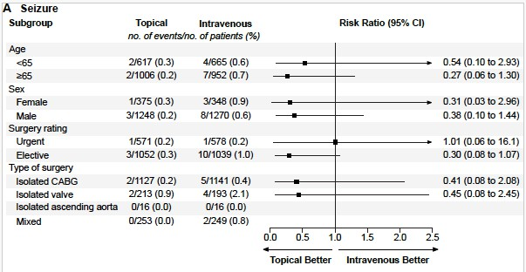
Subgroup Seizure

Slide 24
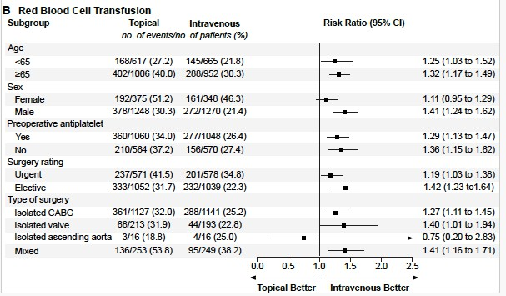
Subgroup RBC transfusion

Slide 25
Conclusions of our trial
Topical vs. Intravenous TXA cardiac surgery
Topical TXA does not reduce risk of seizure
Topical TXA increases the risk of transfusion

Slide 26
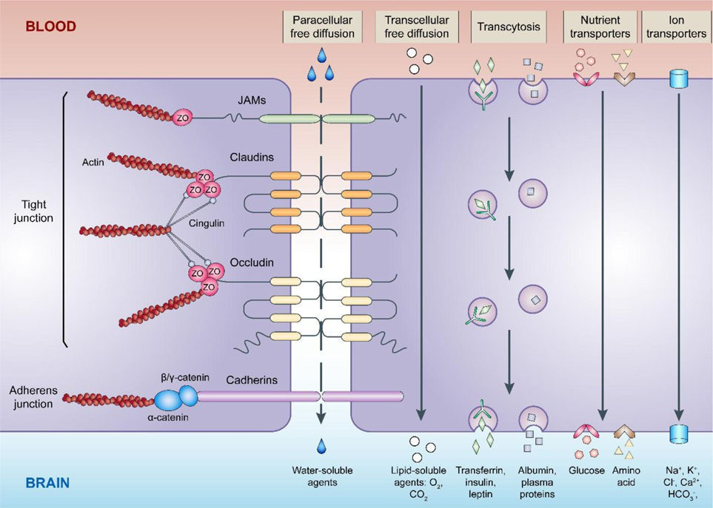
How does TxA cross the blood-brain barrier?
Jiang X, et al. Prog Neurobiol. 2018

Slide 27
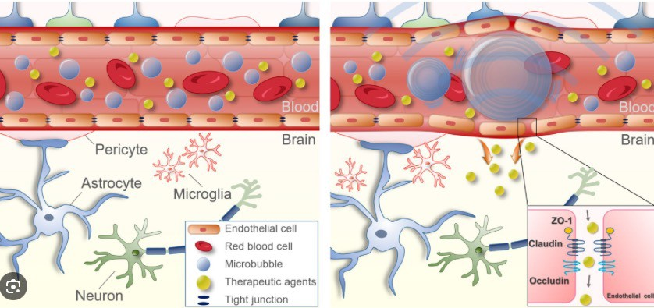
Micro-bubbles and Focused ultrasound

Slide 28
Further hypotheses
Mechanism of seizure is more complex
Not only related to dose of IV TxA
Probably mediated by embolism of air or debris
Presence or absence of TxA at the time of embolism could be the mechanism: timing
Easily available tests for TxA levels are needed

Slide 29
Thank you.

Slide 30
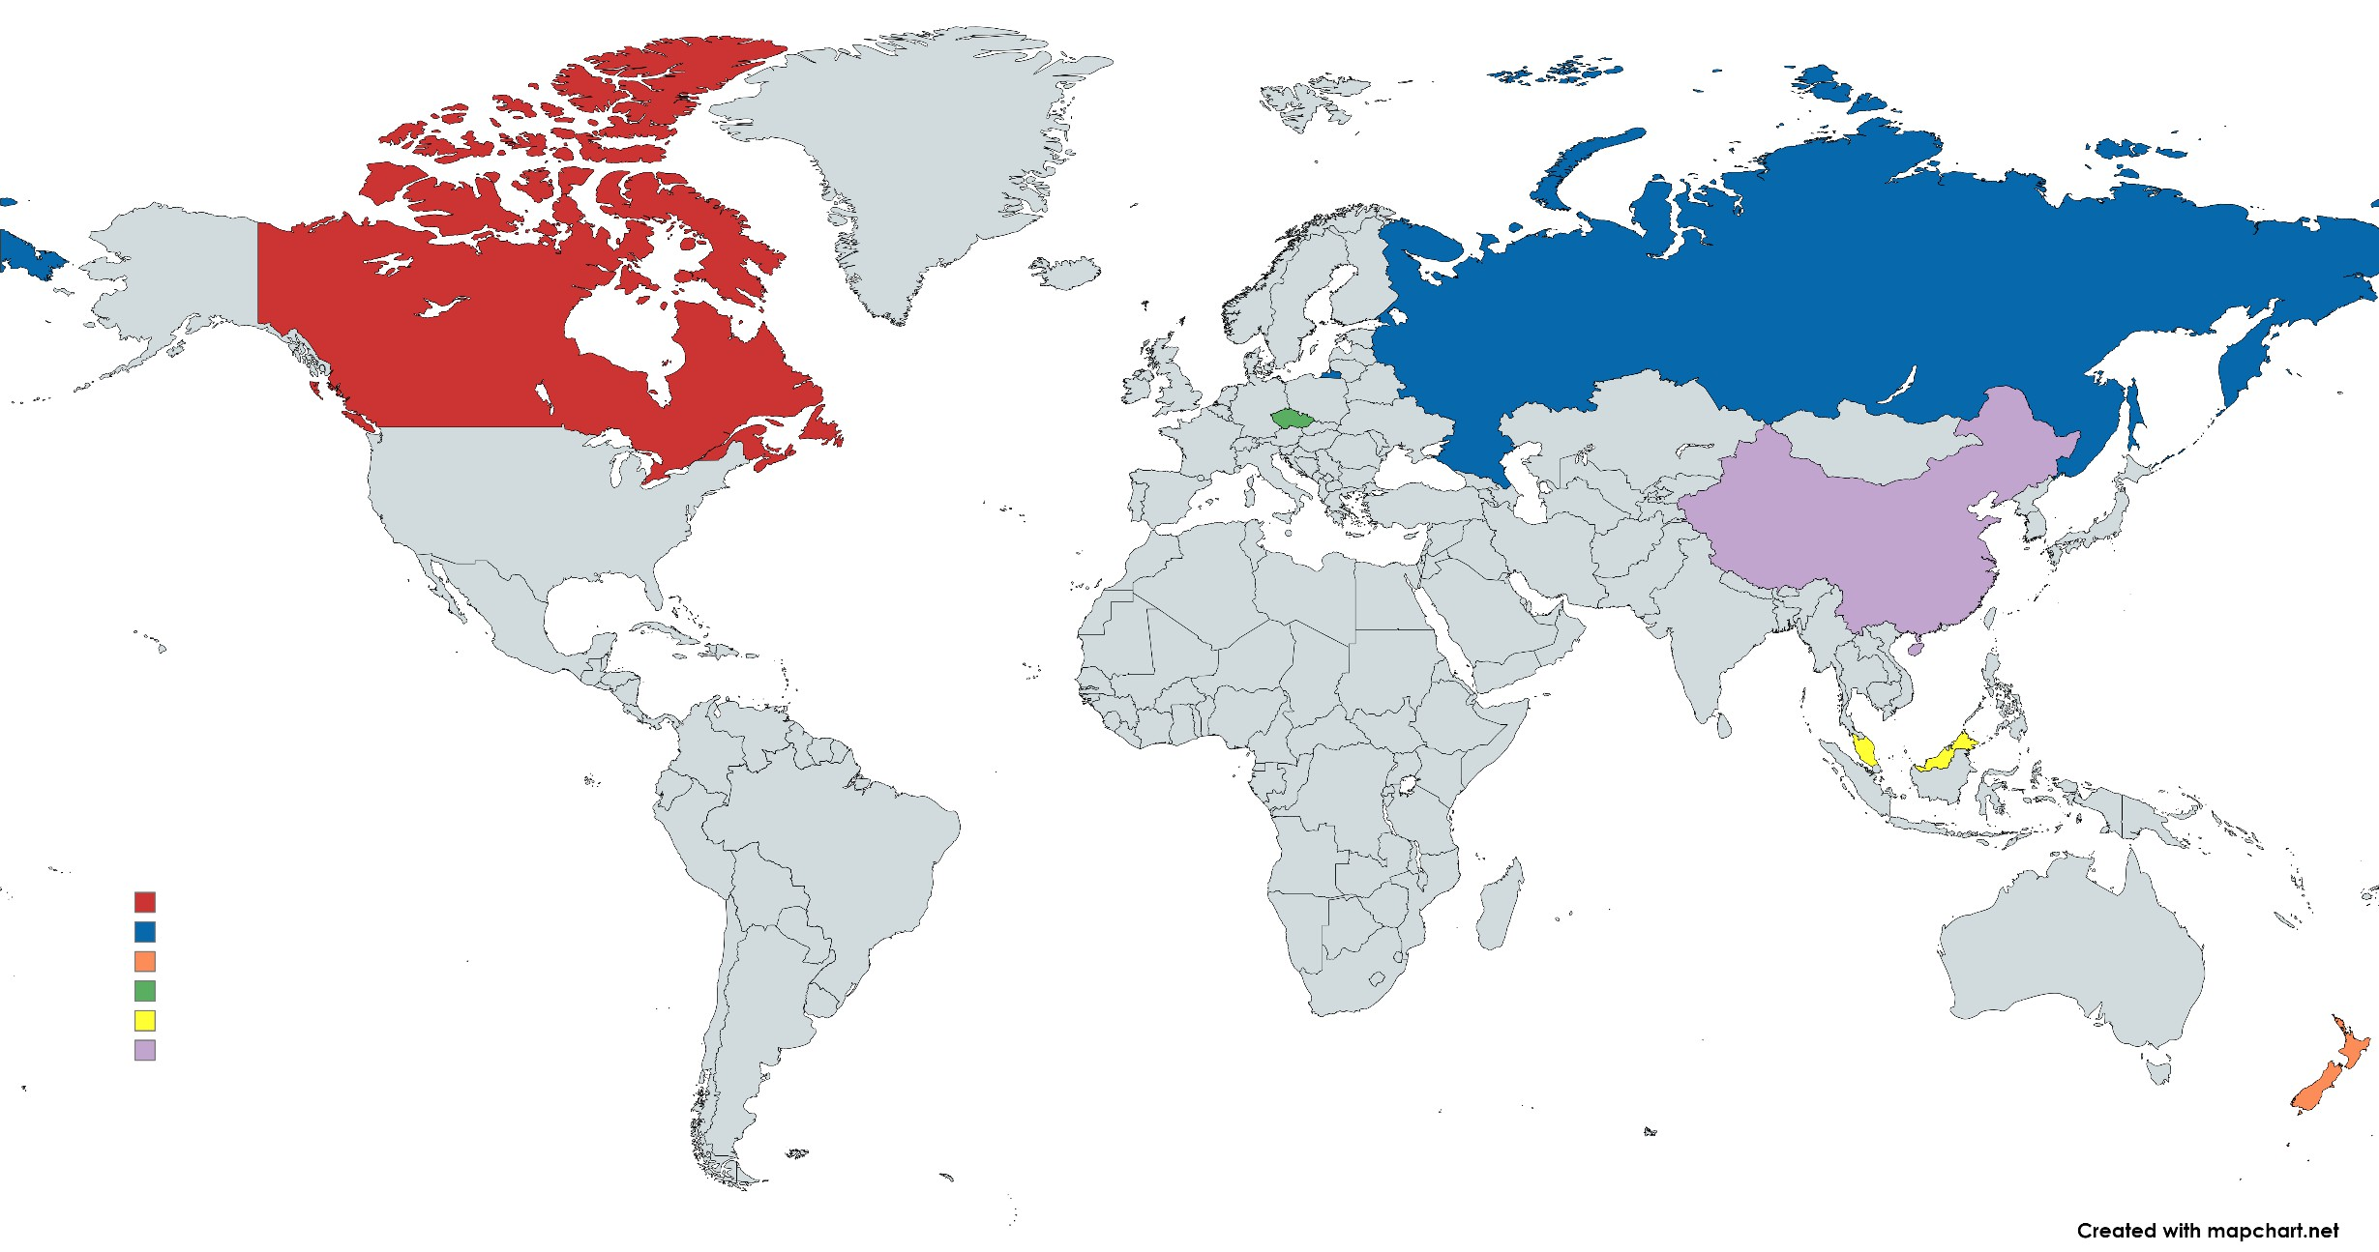
3242 patients randomized
16 centres in 6 countries
1,791
1,290
38
22
66
35

Slide 31
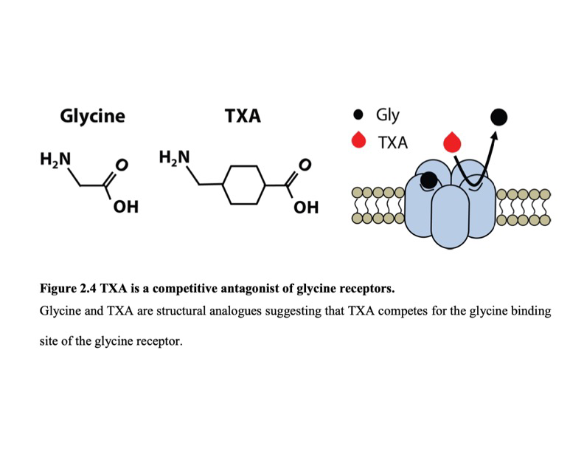
Glycine receptors

