Slide 1
SHASTA-2 Final Study Results Plozasiran (ARO-APOC3), an Investigational RNAi Therapeutic, Demonstrates Profound and Durable Reductions in APOC-3 and Triglycerides (TG) in Patients With Severe Hypertriglyceridemia (SHTG)
Daniel Gaudet, MD, PhD
ECOGENE-21 and Dept of Medicine, Université de Montréal on behalf of the SHASTA-2 Study Team

Slide 2
Financial Disclosures
Presenter
D Gaudet reports grants and/or honoraria from Alnylam, Amgen, Arrowhead, AstraZeneca, Boehringer-Ingelheim, CRISPR Therapeutics, Dalcor Pharma, Eli Lilly, Esperion, Ionis, Kowa, Novartis, Pfizer, Regeneron, Sanofi, Ultragenyx and Verve Therapeutics.
Co-Authors
D Pall reports grants and/or honoraria from (all paid to institution, not individual) Arrowhead Pharmaceuticals Inc., AstraZeneca, Boehringer Ingelheim, Eli Lilly, Esperion, Ionis, Kowa, Novartis, NovoNordisk, Pfizer.
GF Watts reports grants and/or honoraria from Amgen, Novartis, Arrowhead, Esperion, Astrazeneca, Pfizer, Novo Nordisk, Silence Therapeutics, CSL Seqirus, and Sanofi-Regeneron.
SJ Nicholls reports grants and/or honoraria from Akcea, Amarin, Amgen, Anthera, Arrowhead Pharmaceuticals Inc, AstraZeneca, Boehringer Ingelheim, Cerenis, CSL Behring, Eli Lilly, Esperion, InfraReDx, LipoScience, The Medicines Company, Merck, New Amsterdam Pharma, Novartis, Omthera, Resverlogix, Roche, Sanofi-Regeneron, and Takeda.
RS Rosenson reports grant/research support from (all paid to institution, not individual): Amgen, Arrowhead, Novartis, Eli Lilly, Regeneron; consulting fees from Amgen, Arrowhead, CRISPR Therapeutics, Eli Lilly, Lipigon, Novartis, Precision Biosciences, Regeneron, UltraGenyx, Verve; non-promotional speaking fee from Amgen and Kowa; other support from MediMergent, LLC (significant); and is an UpToDate, Inc. stock shareholder (significant).
CM Ballantyne reports grants and/or honoraria from Abbott Diagnostic, Akcea, Althera, Amarin, Amgen, Arrowhead, AstraZeneca, Denka Seiken, Esperion, Genentech, Gilead, Illumina, Ionis, Matinas BioPharma Inc, Merck, New Amsterdam, Novartis, Novo Nordisk, Pfizer, Regeneron, Roche Diagnostic, and Sanofi-Synthelabo.
J Hellawell, is a current employee of Arrowhead Pharmaceuticals
J San Martin and K. Modesto were former employees of Arrowhead Pharmaceuticals
2

Slide 3
SHTG Therapy Goal is to Sustainably Reduce TGs Below Pancreatitis Risk
Severe hypertriglyceridemia (SHTG) is characterized by TG levels > 500 mg/dL¹⁻³
Very severe forms (TG> 880 mg/dl = chylomicronemia) include FCS and MCS⁴⁻⁶
FCS (2-9 cases per million) is a rare recessive condition caused by bi-allelic or digenic pathogenic variants in the lipoprotein lipase (LPL) pathway;
MCS is far more frequent (1/600) and is usually multifactorial;
SHTG significantly increases the risk of ASCVD and acute pancreatitis (AP), often with recurrent attacks requiring repeat hospital admissions and worsening outcomes^{1-3,6}
AP risk is proportional to number, characteristics, and concentration of triglyceride rich lipoproteins (TRLs), particularly chylomicrons, and increases linearly as TGs rise⁷
Limited treatment options exist to sustainably reduce TGs below pancreatitis risk threshold ¹⁻³
1. Pejic RN, et al. J Am Board Fam Med. 2006; 19:310-6. 2. Grundy SM, et al. J Am Coll Cardiol. 2019; 73(24):e285-350; 3. NCEP, ATPIII final report. NIH publication no.: 02–5215, 2002. 4. Christian JB, et al. Am J Cardiol. 2011;107(6):891-897. 5. Fan W, et al. Cardiol Ther. 2020;9(1):207-213. 6. Okazaki H. J Atheroscler Thromb. 2021; 28(9): 883–904; 7. Yang,
A.L. et al., Pancreatology, 2020. 20(5): p. 795 800.
3

Slide 4
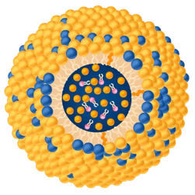
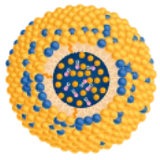
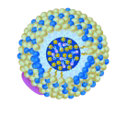
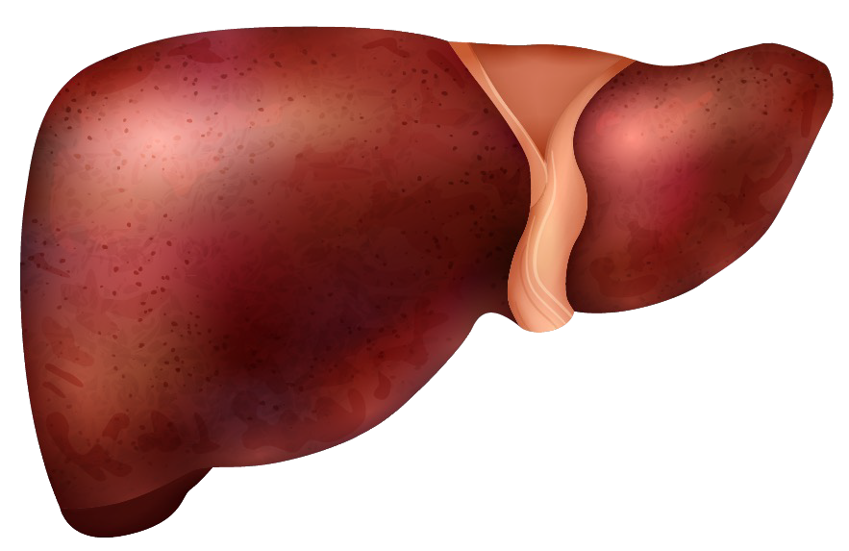
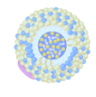
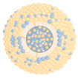
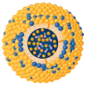
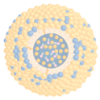
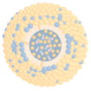
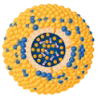
In this Phase 2 Study, Plozasiran (ARO-APOC3) Reduces APOC3, A Key Mediator of Elevated TG, Chylomicronemia and Atherogenic Lipoproteins
APOC3¹
APOC3 Inhibits TRL Catabolism and Hepatic Clearance Leading to Increased TGs
Chylomicron VLDL
TRL
Plozasiran
Silencing of APOC3 Enables TRL Catabolism and Hepatic Clearance Leading to Reduced TGs
Chylomicron
VLDL
TRL
Increased TRL catabolism by LPL
LPL
Dependent
Plozasiran
LPL
Independent
LPL
Dependent
LPL
Independent
APOC3
APOC3
APOC3
APOC3
TRL-Remnants
TRL-Remnants
Increased TRL clearance
1. Van Zwol W et al. J Clin Med. 2019; 8:1085. Chylomicrons are large triglyceride rich lipoproteins produced in enterocytes from dietary lipids. Remnant cholesterol is a very atherogenic lipoprotein composed primarily of very low-density lipoprotein (VLDL) and intermediate-density lipoprotein (IDL). It represents the amount of cholesterol in remnant lipoproteins.
4

Slide 5
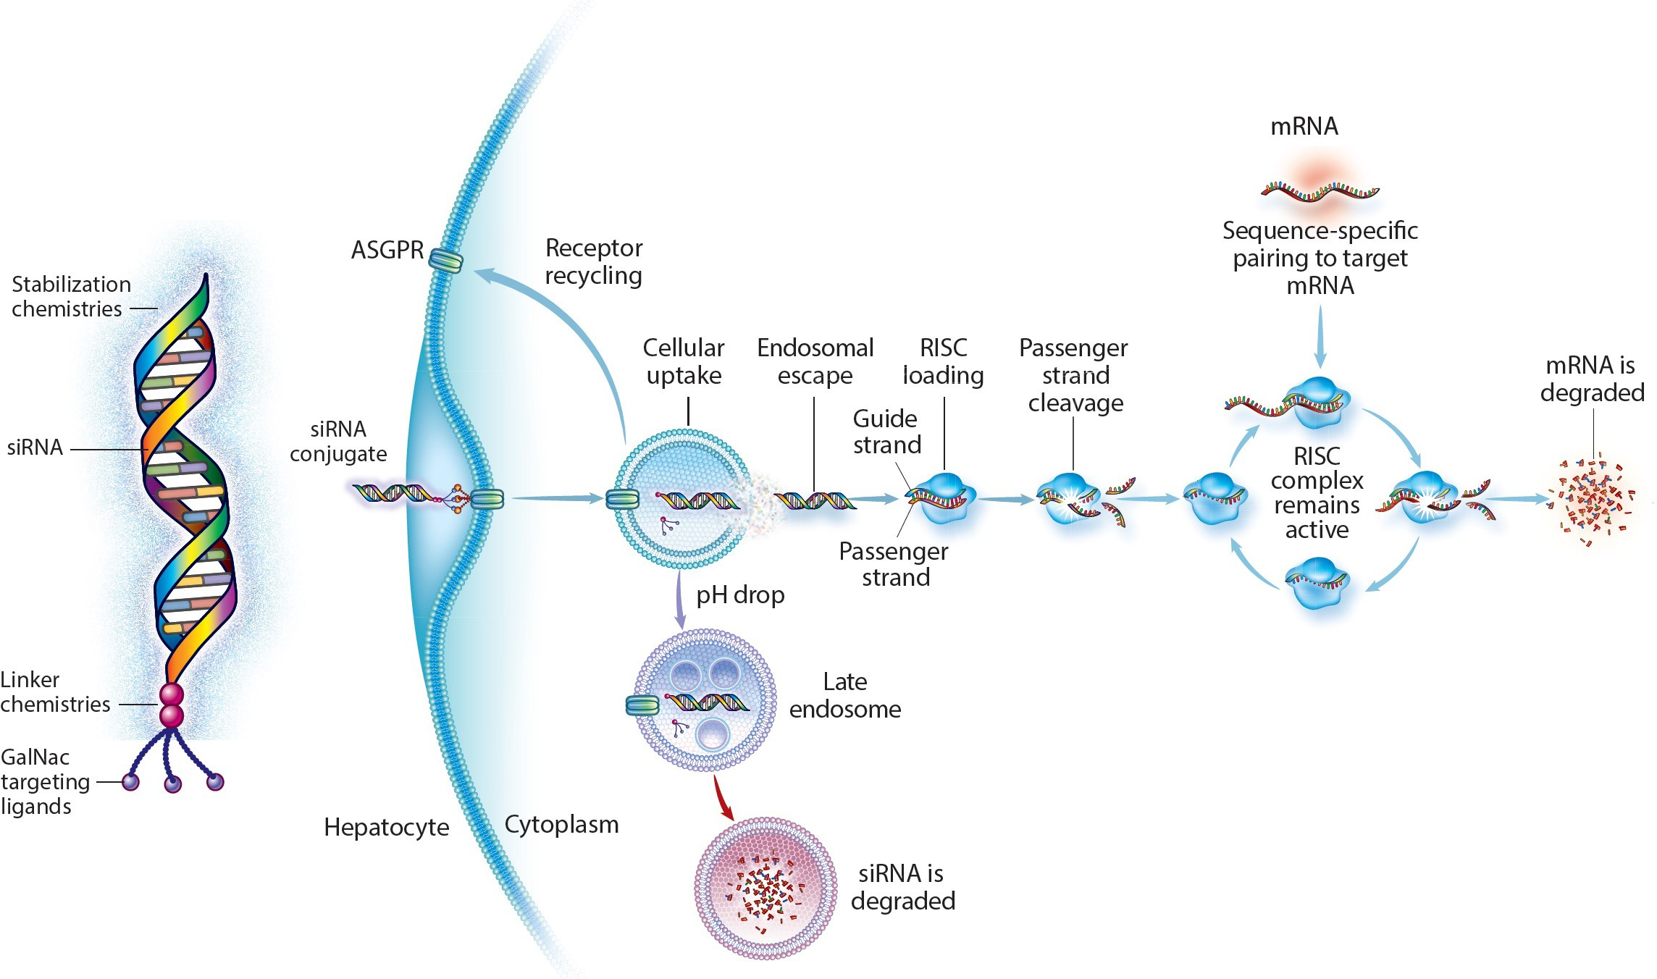
Key Features Of Using RNAi As A Therapeutic Modality
Arrowhead's Targeted RNAi Molecule (TRiMTM) technology leverages the RNAi mechanism
RNAi is a natural process that uses short fragments of RNA molecules to interfere with mRNA translation into associated proteins.
High Specificity:
Allowing to suppress the expression of a specific gene
Potent Activity:
Deep and consistent silencing of target genes
Safety:
Minimal off target adverse effects due to targeted delivery (GalNAc) and sequence specificity
Infrequent Dosing:
Long tissue PK/PD, on target effect
5

Slide 6
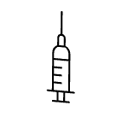
SHASTA-2: A Double-blind, Phase 2b Placebo-Controlled, Dose Ranging Study Of Plozasiran In Subjects With SHTG
Study Objectives: To evaluate safety and efficacy for lowering TG and atherogenic lipoproteins and severity/occurrences of AP in subjects with SHTG, and to explore optimal dosing
Study Population: SHTG history of TG
500 mg/dL and fasting TG of 500 – 4,000 mg/dL during screening period
Key Endpoints*: % change from baseline and over time in:
Primary endpoint: TG
Key LP parameters: APOC3, non- HDL-C, LDL-C, HDL-C, APOB,
Remnant Cholesterol
Safety
Data Analysis: Phase 2 study data evaluated
at Week 24 and Week 48
Randomization
Plozasiran 10 mg (N=54)
Screening/ Diet Run-in
≤ 6 weeks
Plozasiran 25 mg (N=55)
Plozasiran 50 mg (N=57)
Pooled Placebo (N=60)
0 12 24
36
48
EOS
All subjects were eligible to enroll in an Open Label Extension (OLE) at end of the study.
Week
Doses
SHASTA-2. *All samples taken after ≥ 10 hour fast.
6

Slide 7
Baseline Characteristics
Pooled Placebo (N=60) |  | Plozasiran
 |  | 10 mg (N=54) | 25 mg (N=55) | 50 mg (N=57)
Mean (SD) age, years | 56 (11) | 53 (10) | 56 (11) | 54 (11)
Female, n (%) | 14 (23) | 8 (15) | 12 (22) | 16 (28)
White, n (%) | 55 (92) | 47 (87) | 48 (87) | 53 (93)
Mean (SD) BMI, kg/m² | 31 (4) | 33 (5) | 32 (5) | 32 (5)
Mean (SD) APOC3,ª mg/dL | 31 (16) | 33 (15) | 34 (17) | 32 (16)
Median (Q1, Q3) triglyceride, mg/dL | 679 (540, 929) | 696 (559, 1088) | 598 (517, 982) | 663 (531, 1028)
Mean (SD) non-HDL-C, mg/dL | 185 (79) | 209 (74) | 206 (91) | 196 (88)
Mean (SD) ApoB, mg/dL | 95 (29) | 103 (44) | 103 (32) | 110 (55)
Mean (SD) remnant cholesterol,^{b} mg/dL | 115 (82) | 134 (88) | 132 (98) | 124 (92)
Mean (SD) LDL-C, UC, mg/dL | 69 (39) | 75 (44) | 74 (40) | 72 (42)
Mean (SD) HDL-C, mg/dL | 30 (12) | 28 (9) | 30 (11) | 31 (13)
ªAnalysis that removed n=2 participants with baseline values of BLOQ (ad hoc); ^{b}Based on calculation: Total cholesterol – HDL-C – LDL-C (UC). Data are shown for the full analysis set of 226, ie all randomized patients who received at least 1 dose of investigational product.
7

Slide 8
Plozasiran Demonstrates Significant Decreases in APOC3 and Contributes to Restore Triglyceride Homeostasis
APOC3ª
Triglycerides
16Wk Nadir
APOC3 - Mean Percent Change (± SEM) From Baseline
40
20
0
-20
-40
Triglyceride - Mean Percent Change (± SEM) From Baseline
40
20
0
-20
-40
-60
-80
-60
-80
-100
-100
0 4 8 12 16 20 24 28 32 36 40 44 48
Study Week
0 4 8 12 16 20 24 28 32 36 40 44 48
Study Week
LS Mean*ª % Change from Baseline at Weeks 24 & 48
LS Mean* % Change from Baseline at Weeks 24 & 48
Placebo |  | Plozasiran
 |  | 10mg | 25mg | 50mg
Week 24 | -1% | -69% p<0.0001 | -72% p<0.0001 | -78% p<0.0001
Week 48 | 4% | -34% p<0.0001 | -48% p<0.0001 | -47% p<0.0001
Placebo |  | Plozasiran
 |  | 10mg | 25mg | 50mg
Week 24 | -17% | -66% p<0.0001 | -70% p<0.0001 | -74% p<0.0001
Week 48 | -7% | -31% p<0.05 | -58% p<0.0001 | -53% p<0.0001
Placebo Plozasiran 10 mg Plozasiran 25 mg Plozasiran 50 mg
ªAnalysis that removed n=2 participants with baseline values of BLOQ (ad hoc). *Statistical significance was determined using Mixed Model Repeat Measures (MMRM) analysis. Nadir achieved at 16 weeks where Placebo corrected LSM of 77% difference achieved, i.e. 135 mg/dL from 942 mean baseline
8

Slide 9
Plozasiran Decreases Remnant Cholesterol and Increases HDL-C
Remnant Cholesterol HDL-C
Remnant Cholesterol - Mean Percent Change (± SEM) From Baseline
40
20
0
-20
-40
100
80
HDL-C - Mean Percent Change (± SEM) From Baseline
60
40
20
-60
-80
-100
0
-20
-40
0 4 8 12 16 20 24 28 32 36 40 44 48
Study Week
0 4 8 12 16 20 24 28 32 36 40 44 48
Study Week
LS Mean* (UC) % Change from Baseline at Weeks 24 & 48
LS Mean* % Change from Baseline at Weeks 24 & 48
Placebo |  | Plozasiran
 |  | 10mg | 25mg | 50mg
Week 24 | 2% | -60% p<0.0001 | -62% p<0.0001 | -57% p<0.0001
Week 48 | 2% | -24% p<0.05 | -45% p<0.0001 | -34% p=0.002
Placebo |  | Plozasiran
 |  | 10mg | 25mg | 50mg
Week 24 | 11% | 54% p<0.0001 | 63% p<0.0001 | 68% p<0.0001
Week 48 | 6% | 24% p<0.05 | 32% p=0.0007 | 38% p<0.0001
Placebo
Plozasiran 10 mg
Plozasiran 25 mg
Plozasiran 50 mg
For all panels: *Statistical significance was determined using Mixed Model Repeat Measures (MMRM) analysis.
9

Slide 10
Plozasiran Impact on Additional Lipid Parameters
LDL-C
Total ApoB
Non-HDL-C
50
125
100
75
50
25
0
-25
-50
50
Mean Percent Change (± SEM) From Baseline
Mean Percent Change (± SEM) From Baseline
Mean Percent Change (± SEM) From Baseline
25
25
0
0
-25
-50
-25
0 4 8 12 16 20 24 28 32 36 40 44 48
Study Week
0 4 8 12 16 20 24 28 32 36 40 44 48
Study Week
0 4 8 12 16 20 24 28 32 36 40 44 48
Study Week
 | LS Mean* % Change from Baseline at Week 24 & 48
Week 24 | -2% | -29% p<0.0001 | -28% p<0.0001 | -22% P=0.0001
Week 48 | 1% | -10% NS | -24% P=0.0003 | -14% p<0.05
 | LS Mean* % Change from Baseline at Week 24 & 48
Week 24 | 18% | 49% p<0.05 | 44% NS | 78% p<0.0001
Week 48 | 21% | 34% p<0.05 | 34% NS | 45% p<0.05
 | LS Mean* % Change from Baseline at Week 24 & 48
Week 24 | 8% | 6% NS | -5% NS | 1% NS
Week 48 | 6% | 6% NS | 0% NS | 2% NS
Placebo
10 mg Plozasiran
25 mg Plozasiran
50 mg Plozasiran
*Statistical significance was determined using Mixed Model Repeat Measures (MMRM) analysis.
10

Slide 11
Most Subjects Treated With Plozasiran Achieved Triglyceride Levels < 500 mg/dL and Half Reached Values Below 150 mg/dl
400*
Placebo Plozasiran 10 mg Plozasiran 25 mg Plozasiran 50 mg
120
100
80
60
40
20
0
-20
-40
-60
-80
-100
% Change from Baseline in Fasting TG (mg/dL) at Week 24
†
88% < 500 mg/dl
93% < 500 mg/dl
91% < 500 mg/dl
n/N (%) | Placebo (Pooled) | Plozasiran
 |  | 10 mg | 25 mg | 50 mg
All Patients Who Reached TG < 150 mg/dL at Wk 24 | 4/59 (7%) | 22/50 (44%) | 27/54 (50%) | 28/55 (51%)
All subjects Who Reached TG < 500 mg/dL at Wk 24 | 32/59 (54%) | 44/50 (88%) | 50/54 (93%) | 50/55 (91%)
Subjects with Baseline TG > 880 mg/dL Who Reached TG < 500 mg/dL at Wk 24 | 5/15 (33%) | 9/14 (64%) | 13/16 (81%) | 14/17 (82%)
*Axis adjusted for one patient in placebo group as outlier (percent change greater than 400%). †In this patient who was randomized to 25 mg plozasiran, the absence of decrease in triglyceride at Week 24 was later found to be caused by a causal mutation for glycerol kinase deficiency, an X linked recessive disorder, where free glycerol concentrations are most often >2.0 mmol/L. These markedly elevated free glycerol levels cause significant over estimations of triglyceride levels, ie “pseudo hypertriglceridemia”, due to enzymatic techniques used in conventional triglyceride laboratory measures. This patient was found to be a responder. Data are from highest dose group.
Pardo, J.F., et al. Atherosclerosis, 2019. 287: p. e237
11

Slide 12
Summary of Adverse Events at 48 Weeks
Pooled Placebo (N=61) |  | Plozasiran
 |  | 10 mg (N=54) | 25 mg (N=55) | 50 mg (N=56)
TEAEs | 43 (71) | 43 (80) | 36 (66) | 49 (88)
TEAEs occurring in ≥ 5 subjects
COVID-19 | 10 (16.7) | 10 (18.5) | 8 (14.5) | 8 (14.0)
Worsening glycemic control* | 7 (11.7) | 12 (22.2) | 9 (16.4) | 11 (19.6)
Diarrhea | 5 (8.3) | 3 (5.6) | 1 (1.8) | 1 (1.8)
Urinary tract infection | 5 (8.3) | 3 (5.6) | 1 (1.8) | 2 (3.5)
Headache | 3 (5.0) | 8 (14.8) | 5 (9.1) | 2 (3.5)
Treatment related adverse events | 8 (13.3) | 14 (25.9) | 8 (14.5) | 10 (17.5)
Serious TEAEs | 10 (16.4) | 4 (7.4) | 2 (3.6) | 7 (12.5)
TEAEs leading to drug discontinuation, dose interruptions, or study withdrawal | 0 | 1 (1.9) | 0 | 0
Local Injection Site Reactionsª | 0 | 0 | 0 | 1 (2)
Acute pancreatitis,^{b} adjudicated cases, No. (%) | 2 (3) | 0 (0) | 0 (0) | 1 (2)
Death | 0 | 0 | 0 | 0
TEAEs reflect the comorbidities and underlying conditions of the study population
Serious TEAEs were deemed not related to Plozasiran
All serious TEAEs resolved without sequelae (except 2 subjects with malignancies), with no deaths
Data includes exposure out to 48 weeks
*Worsening glycemic control defined by multiple glycemic control parameters including but not limited to hemoglobic A1c, new onset diabetes mellitus, type 2 diabetes mellitus, diabetes mellitus, hyperglycemia, insulin resistance. n (%) ªlocal injection site reactions only include events that start on the day of injection and persist for at least 48 hours post injection. ^{b}The event in the patient assigned to the 50-mg plozasiran cohort occurred during the safety observation period c, at which time the patient’s triglyceride levels had returned to baseline level of greater than 2000 mg/dL from an on-treatment nadir of 106 mg/dL.
12
12

Slide 13
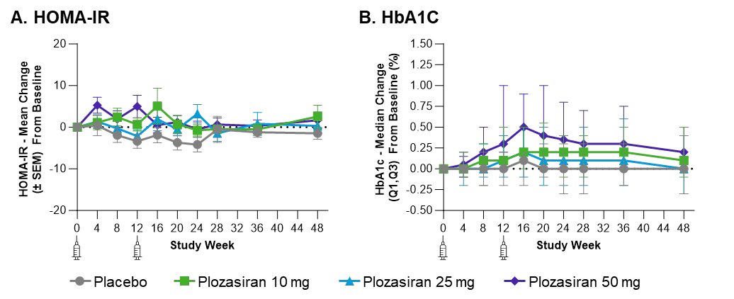
HbA1c Elevations Seen With 50 mg Plozasiran Were Mostly in Diabetic Patients at Baseline Without Change in Insulin Sensitivity by HOMA-IR
Homa-IR assessments suggest no change in insulin sensitivity. There was an imbalance in HbA1c change in the highest dose group
HbA1c increases observed in diabetics was transient, reversible, manageable, and not associated with significant clinical symptoms or withdrawal
Note: Diabetic patients are defined as having HbA1c ≥6.5% or Fasting Glucose ≥126 mg/dL or with medical history of ‘diabetes’ or receiving diabetic medications at baseline.
13

Slide 14
SHASTA-2 Study Conclusion
Plozasiran decreases LS mean serum APOC3, TGs, and remnant cholesterol while increasing HDL-C at 24 weeks (persisting at 48 weeks) for all dose levels:
APOC3 to -78%, (-48%)
TG to -74%, (-58%)
Remnant cholesterol to -62%, (-45%)
HDL-C up to +68%, (+38%)
Over 90% of subjects at 24 weeks treated with plozasiran achieved TGs < 500 mg/dL and below the risk threshold for Acute Pancreatitis
Plozasiran has a favorable safety profile at 48 weeks
These data support further development of plozasiran in planned phase 3 programs for the treatment of chylomicronemia and SHTG
Based on these results, RNAi-mediated silencing of hepatic APOC3 expression via plozasiran is a promising potential treatment for subjects with SHTG
13

Slide 15
JAMA Cardiology
Gaudet D, Pall D, Watts GF,Nicholls SJ, Rosenson RS, Modesto K, Martin JS, Hellawell J, and Ballantyne CM.
Plozasiran (ARO-APOC3) for Severe Hypertriglyceridemia
The SHASTA-2 Randomized Clinical Trial
Published Online April 7, 2024 ACC.24
Available at jamacardiology.com
Scan to learn more
13

Slide 16
THANK YOU
We Would Like To Thank The Patients And Caregivers Who Participated In This Study

Slide 17
Acronyms
ALT= alanine transaminase; AP, acute pancreatitis; ApoA=apolipoprotein A; ApoB, apolipoprotein B; ApoC=apolipoprotein C; APOC3, apolipoprotein C3; ASCVD, atherosclerotic cardiovascular disease; ASGPR, asialoglycoprotein receptor AST=aspartate aminotransferase; BLOQ, below limits of quantitation; BMI, body mass index; EOS, end of study; FCS, familial chylomicronemia syndrome; GalNAc, N-Acetylgalactosamine HbA1C=hemoglobin A1C; HDL-C, high density lipoprotein cholesterol; HOMA-IR=homeostasis model assessment-estimated insulin resistance; hsCRP=high-sensitivity C-reactive protein; LDL-C, low density lipoprotein cholesterol; LP, lipoproteins; Lp(a)=lipoprotein (a); LPL, lipoprotein lipase; LS, least squares; MCS, multifactorial chylomicronemia syndrome; MRI-PDFF= magnetic resonance imaging-proton density fat fraction; mRNA, messenger ribonucleic acid; N, number; OLE, open label extension; PD, pharmacodynamic; pH, potential of Hydrogen; PK, pharmacokinetic; Q, quartile; RISC, RNA-induced silencing complex; RNA, ribonucleic acid; RNAi, ribonucleic acid interference; SD, standard deviation; SE, standard error; SEM, standard error of the mean; SHTG, severe hypertriglyceridemia; siRNA, small interfering ribonucleic acids; TEAEs, treatment emergent adverse events. TG, triglycerides. TRL, triglyceride rich lipoproteins; UC, ultracentrifuge; VLDL, very low-density lipoprotein.
17

Slide 18
BACKUP SLIDES
17

Slide 19
Key Safety Endpoints
Serum Concentration |  | Placebo (n=61) | Plozasiran
 |  |  | 10 mg (n=54) | 25 mg (n=55) | 50 mg (n=56)
ALT | Baseline mean (SD) (U/L) | 26.3 (9.3) | 34.2 (18.4) | 33.2 (15.6) | 30.3 (17.5)
 | LS mean (SE) % change at Week 24 | -3.3 (2.1) | 3.5 (2.2) | 5.0 (2.1) | 6.9 (2.1)
 | LS mean of difference vs placebo, % [95% CI] |  | 6.8 [0.9, 12.8] | 8.3 [2.5, 14.2] | 10.2 [4.4, 16.0]
 | LS mean (SE) % change at Week 48 | -4.9 (1.7) | 1.2 (1.6) | -1.9 (1.6) | 0.9 (1.5)
 | LS mean of difference vs placebo, % [95% CI] |  | 6.1 [1.6, 10.5] | 3.0 [-1.4, 7.4] | 5.8 [1.4, 10.1]
AST | Baseline mean (SD) (U/L) | 21.3 (7.8) | 24.8 (12.9) | 24.2 (9.3) | 22.9 (9.8)
 | LS mean (SE) % change at Week 24 | -2.7 (1.2) | 0.5 (1.3) | 2.4 (1.3) | 1.6 (1.2)
 | LS mean of difference vs placebo, % [95% CI] |  | 3.2 [-0.3, 6.7] | 5.1 [1.7, 8.5] | 4.3 [0.9, 7.7]
 | LS mean (SE) % change at Week 48 | -1.8 (1.2) | 1.5 (1.2) | -0.8 (1.2) | 0.1 (1.2)
 | LS mean of difference vs placebo, % [95% CI] |  | 3.3 [0.1, 6.5] | 1.0 [-2.2, 4.2] | 1.8 [-1.3, 5.0]
Liver fat (MRI-PDFF) | _{N}b | 17 | 9 | 12 | 11
 | Baseline mean (SD) | 17.9 (6.5) | 19.3 (5.7) | 19.7 (8.8) | 22.4 (10.7)
 | LS mean (SE) change at Week 24 | -0.4 (1.4) | -0.3 (2.3) | 0.0 (1.8) | 2.3 (1.7)
 | LS mean of difference vs placebo [95% CI] |  | 0.1 (-5.2, 5.3) | 0.4 (-4.2, 5.0) | 2.7 (-2.0, 7.3)
 | LS mean (SE) % change at Week 48 | 0.4 (8.6) | -2.2 (13.7) | 1.5 (11.2) | 21.3 (10.7)
 | LS mean of difference vs placebo, % [95% CI] |  | -2.5 (34.5, 29.4) | 1.1 (-26.9, 29.2) | 20.9 (-7.0, 48.8)
Acute pancreatitis, adjudicated cases | Acute pancreatitis, n (%) | 2 (3) | 0 (0) | 0 (0) | 1 (2)ª
 | Needing emergent apheresis, n (%) | 0 (0) | 0 (0) | 0 (0) | 0 (0)
 | Hospitalized, n (%) | 2 (3) | 0 (0) | 0 (0) | 1 (2)
ªThe event in the patient assigned to the 50-mg plozasiran cohort occurred during the safety observation period c, at which time the patient’s triglyceride levels had returned to baseline level of >2000 mg/dL from an on-treatment nadir of 106 mg/dL. ^{b}MRI-PDFF analysis set.
ANCOVA model includes covariates treatment arm, stratification factor, and baseline value for liver fat, MRI-PDFF
*p<0.05; **p<0.001. Statistical significance of A1C, ALT, AST was determined using Mixed Model Repeat Measures (MMRM) analysis.
17

Slide 20
Most Subjects Treated With Plozasiran (>90%) Achieved Triglyceride Levels < 500 mg/dL, Below the Risk Threshold for Acute Pancreatitis
400*
120
Placebo Plozasiran 10 mg
Plozasiran 25 mg
Plozasiran 50 mg
100
80
60
40
20
0
-20
-40
-60
-80
-100
% Change from Baseline in Fasting TG (mg/dL) at Week 24
†
n/N (%) | Placebo (Pooled) | Plozasiran
 |  | 10 mg | 25 mg | 50 mg
All Patients Who Reached TG < 150 mg/dL at Wk 24 | 4/59 (7%) | 22/50 (44%) | 27/54 (50%) | 28/55 (51%)
All subjects Who Reached TG < 500 mg/dL at Wk 24 | 32/59 (54%) | 44/50 (88%) | 50/54 (93%) | 50/55 (91%)
Subjects with Baseline TG > 880 mg/dL Who Reached TG < 500 mg/dL at Wk 24 | 5/15 (33%) | 9/14 (64%) | 13/16 (81%) | 14/17 (82%)
*Axis adjusted for one patient in placebo group as outlier (percent change greater than 400%). †In this patient who was randomized to 25 mg plozasiran, the absence of decrease in triglyceride at Week 24 was later found to be caused by a causal mutation for glycerol kinase deficiency, an X linked recessive disorder, where free glycerol concentrations are most often >2.0 mmol/L. These markedly elevated free glycerol levels cause significant over estimations of triglyceride levels, ie “pseudo hypertriglceridemia”, due to enzymatic techniques used in conventional triglyceride laboratory measures. This patient was found to be a responder. Data are from highest dose group.
Pardo, J.F., et al. Atherosclerosis, 2019. 287: p. e237
17

Slide 21
Abstract
Plozasiran (ARO-APOC3), an Investigational RNAi Therapeutic, Demonstrates Profound and Durable Reductions in APOC-3 and Triglycerides (TG) in Patients With Severe Hypertriglyceridemia (SHTG), SHASTA-2 Final Results
Gaudet D¹, Pall D², Watts GF³, Nicholls SJ⁴, Rosenson RS⁵, Modesto K⁶, Chang T⁶, Melquist S⁶, Fu R⁶, Muhsin M⁶, San Martin J⁶, and Ballantyne CM⁷
1 ECOGENE-21 and Dept of Medicine, Université de Montréal, QC, CA; 2Dept. of Medical Clinical Pharmacology, University of Debrecen, Debrecen, Hungary; 3University of Western Australia and Department of Cardiology, Royal Perth Hospital, Perth, Australia; 4Monash University, Victorian Heart Institute, Melbourne, VIC, Australia; 5Icahn School of Medicine at Mt Sinai, Mount Sinai, NY, USA; 6Arrowhead Pharmaceuticals; Pasadena, Ca; 7Baylor College of Medicine; Houston, Texas
Background: Individuals with severe hypertriglyceridemia have an increased acute pancreatitis (AP) risk. Current treatments fail to lower TGs below a threshold that exposes patients to the risk of AP. Plozasiran, a hepatocyte-targeted siRNA reduces circulating TGs by interfering with the production of APOC3, a key regulator of TG metabolism.
Methods: SHASTA-2, a randomized, placebo-controlled, Phase 2b study (NCT04720534) evaluated efficacy and safety of plozasiran in patients with SHTG. Eligible patients (n=229) randomized 3:1, received a total of 2 doses (SQ 10, 25, or 50 mg plozasiran) or matched placebo on Day 1 and at Wk12 and followed through Wk48. The primary endpoint was percent change from baseline in fasting TGs at Wk24. Mixed model repeated measure (MMRM) approaches were used for statistical modeling.
Results: Plozasiran produced LS mean reductions in APOC3 of -78% and TGs of -74% at Wk24 (p<0.0001). Reductions in APOC3 and TGs were –48% and -58% respectively at Wk48 (p
<0.0001). The majority, 78% of patients achieved TGs <500 mg/dL by Wk48 vs >90% at Wk24. Durable reductions in other lipoprotein parameters (remnant cholesterol, non-HDL-C, ApoB)
were also observed through Wk48. No significant increase in adverse events were reported in plozasiran treated patients. All SAEs were mild to moderate in severity (grade 1-3) and no SAEs led to discontinuation or death.
Conclusions: Plozasiran produced highly durable TG reductions below the threshold associated with elevated AP risk. Key atherogenic lipoprotein parameters also improved. The safety profile was favorable at all doses. These data support initiation of pivotal studies of plozasiran for the
Abstract text – Limited to 300words
17

