Slide 1
Transcatheter Aortic Valve Implantation vs. Surgical Aortic Valve Replacement In Patients At Low To Intermediate Risk
One Year Outcomes Of The Randomized DEDICATE-DZHK6 Trial
Moritz Seiffert, MD
On behalf of the DEDICATE-DZHK6 investigators

Slide 2
Within the past 24 months, I have had a financial interest/arrangement or affiliation with the organization(s) listed below.
Financial relationship
Speaker‘s Bureau
Company
Amgen, AstraZeneca, BMS/Pfizer, Boston Scientific, Daiichi Sankyo, Edwards Lifesciences, Inari Medical, Medtronic, Siemens Healthineers

Slide 3
Background
TAVI has become the preferred treatment for most patients with symptomatic severe aortic-valve stenosis
Current evidence for young low-risk patients restricted to device-specific and industry-sponsored trials, potentially limiting applicability to routine practice
In younger low-risk patients, eligible for TAVI or SAVR and with unrestricted access to contemporary devices, optimal treatment strategy remains unknown

Slide 4
Severe symptomatic aortic stenosis
+
Heart team assessment
(low to intermediate risk)
+
Age 65-85 years
SAVR
N = 702
1 : 1
TAVI
N = 702
Co-primary safety endpoint
(Freedom of stroke or death at 1 year)
Primary efficacy endpoint
(Freedom of stroke or death at 5 years)
https://clinicaltrials.gov (NCT03112980)

Slide 5
Congenital bicuspid/unicuspid or non-calcified aortic valve, endocarditis
Severe symptomatic aortic stenosis
Age: 65-85 years
Low or intermediate operative risk *
TAVI and (isolated) SAVR both medically justified and advisable*
Cardiac reoperation
Relevant CAD or PCI w/in 1 month Severe mitral or tricuspid valve disease
Severely impaired LV function (LVEF <20%) Stroke/ICB w/in 1 month
Contraindication for isolated aortic valve procedure
* According to Heart team assessment

Slide 6
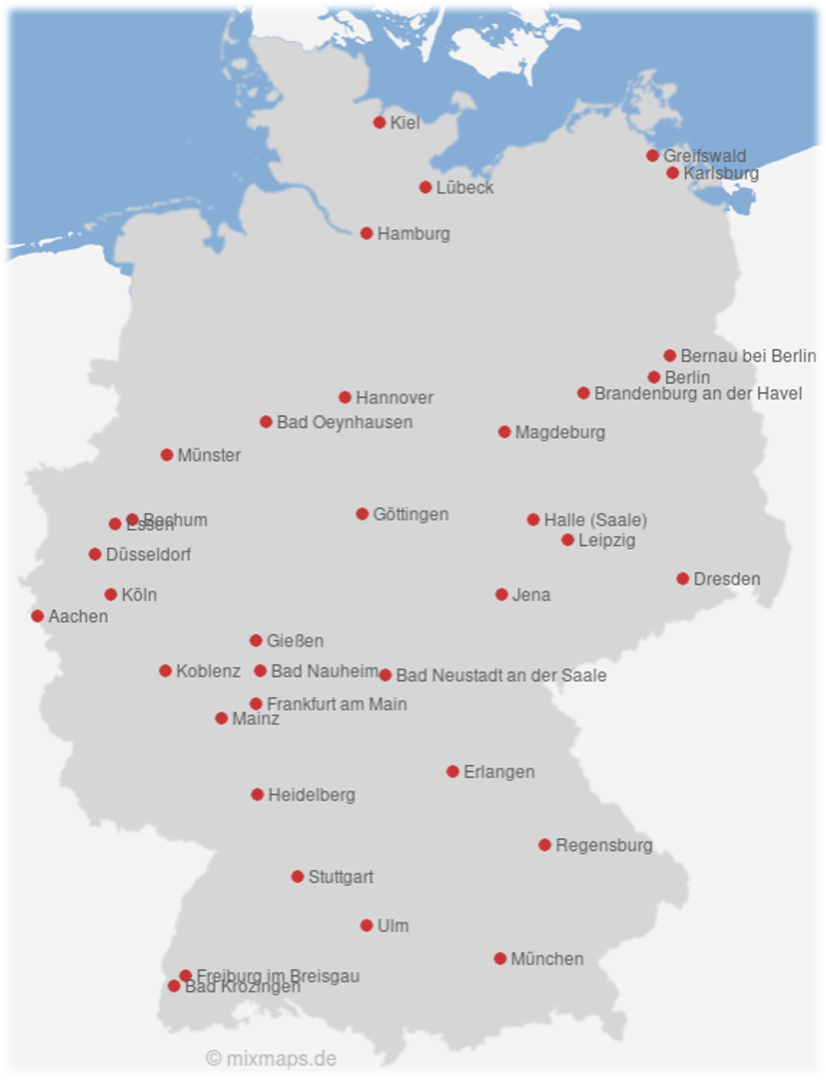
Universitäres Herz- und Gefäßzentrum Hamburg (190)
Kerckhoff-Klinik Bad Nauheim (151)
Herzzentrum Leipzig – Universität Leipzig (121)
Deutsches Herzzentrum Charité Berlin including Vivantes Berlin (93) Universitätsklinikum Schleswig-Holstein, Campus Kiel (75) Universitätsklinikum Heidelberg (73)
Universitäts-Herzzentrum Freiburg-Bad Krozingen (Bad Krozingen) (68)
Herz- und Diabeteszentrum NRW Bad Oeynhausen (65)
Deutsches Herzzentrum München (51)
Universitätsklinikum Schleswig-Holstein, Campus Lübeck (46) Universitätsklinikum an der TU Dresden (45) Universitätsklinikum Regensburg (41)
Charité Universitätsmedizin Berlin (Campus Benjamin-Franklin) (36)
Universitätsklinikum Frankfurt (32)
Universitätsklinikum Köln (28)
Universitätsklinikum Münster (27)
Universitätsklinikum Gießen und Marburg (Gießen) (23)
Universitätsklinikum Göttingen (22)
LMU Klinikum der Universität München (21)
Bundeswehrzentralkrankenhaus Koblenz (19)
Universitätsklinikum Jena (18)
Immanuel Klinikum Bernau Herzzentrum Brandenburg (15)
Robert-Bosch-Krankenhaus Stuttgart (14)
Charité Universitätsmedizin Berlin (Campus Mitte) (13)
Universitätsklinikum Halle (Saale) (13)
Medizinische Hochschule Hannover (13)
RWTH Aachen (12)
Herz- und Gefäß-Klinik Bad Neustadt/Saale (12)
Charité Universitätsmedizin Berlin (Campus Virchow) (12)
Universitätsklinikum Ulm (12)
Universitätsklinikum Düsseldorf (9)
Otto-von-Guericke-Universität Magdeburg (9)
Universitätsklinikum Erlangen (8)
Universitätsklinikum Brandenburg (8)
Universitäts-Herzzentrum Freiburg-Bad Krozingen (Freiburg) (8)
Universitätsmedizin Mainz (5)
BG Universitätsklinikum Bergmannsheil Bochum (4)
Universitätsmedizin Greifswald / Klinikum Karlsburg (2)
Universitätsklinikum Essen (0)

Slide 7
Principal Investigators Blankenberg, S (Hamburg) Cremer, J (Kiel)
Coordinating Investigator
Seiffert, M (Hamburg, Bochum)
Steering Committee Baumgartner, H (Münster) Blankenberg, S (Hamburg) Borger, MA (Leipzig)
Choi, YH (Bad Nauheim) Cremer, J (Kiel)
Falk, V (Berlin)
Frey, N (Kiel) Hagl, C (München)
Hamm, C (Bad Nauheim)
Landmesser, U (Berlin) Massberg, C (München) Reichenspurner, H (Hamburg) Seiffert, M (Hamburg)
Thiele, H (Leipzig) Walther, T (Frankfurt) König, I (Lübeck) Vonthein, R (Lübeck) Ziegler, A (Davos)
Trial management
UHZ Hamburg (Hamburg)
Event Adjudication Committee
Häusler, KG (Würzburg) Hofmann, U (Würzburg)
Gorski, A (Würzburg, Hamburg)
Echocardiographic Corelab
Hagendorff, A (Leipzig)
Data & Safety Monitoring Board
Friede, T (Göttingen)
Klein, H (Hannover/Rochester) Müller, L (Innsbruck)
Advisory Board Zeiher, A (Frankfurt) Windecker, S (Bern) Wendler, O (London)
Funding
German Center for Cardiovascular Research (DZHK) German Heart Foundation

Slide 8
Primary Outcome
Composite of death from any cause or stroke within 1 year after randomization
(Co-primary safety endpoint)
Primary analyses performed for non-inferiority of TAVI vs. SAVR
Evaluated in Intention-to-treat population (ITT), validated in As-treated dataset (AT)
Stratification according to the STS-PROM score
Events assessed by a blinded event adjudication committee
Definitions according to the Valve Academic Research Consortium (VARC-2)

Slide 9
Statistical Analysis
Assumed event rate: 6.2% (overall incidence of the primary outcome)
Non-inferiority margin: HR of 1.14 for TAVI vs. SAVR (rejectable absolute between-group difference at 1 year: 1%)
Sample size: app. 1,404 patients for a power of 80% to reject the non-inferiority assumption at 1 year

Slide 10
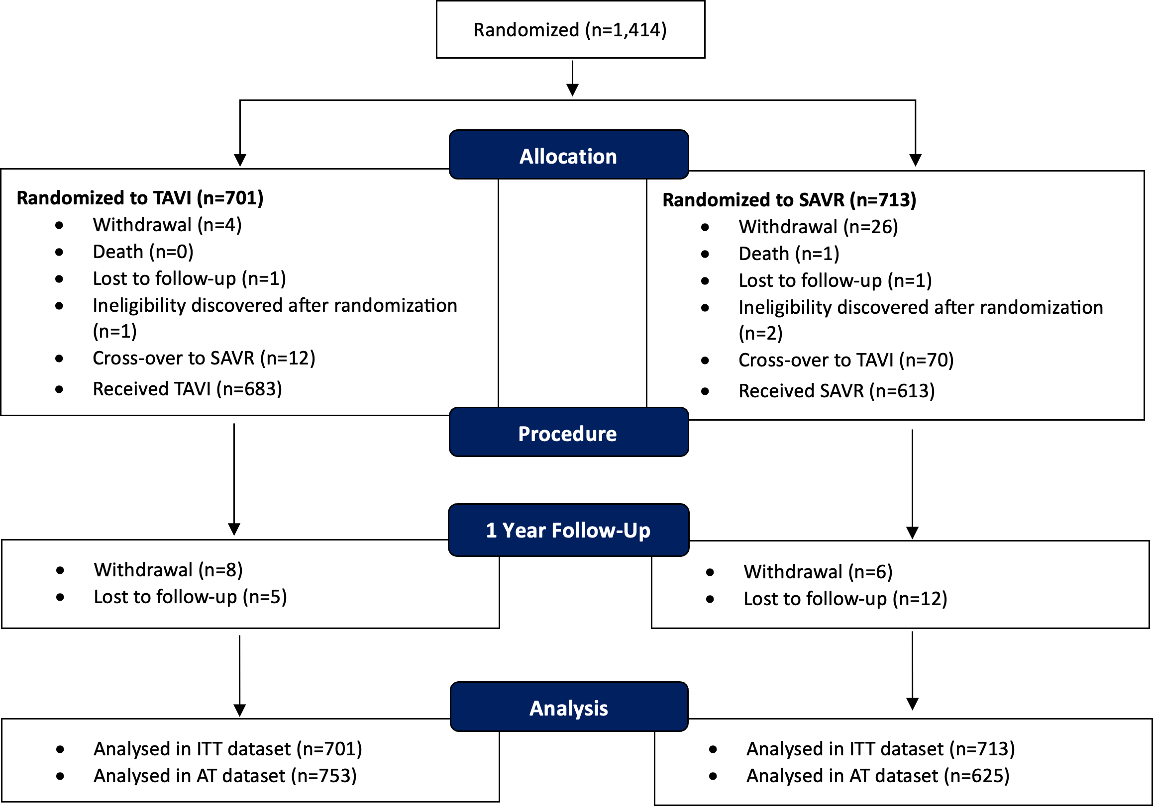

Slide 11
TAVI (n=701) |  | SAVR (n=713)
Age (years) | 74.3 ± 4.6 | 74.6 ± 4.2
Male (%) | 56.0% | 57.3%
BMI (kg/m²) | 28.1 (25.3 - 31.9) | 28.1 (25.4 - 31.2)
STS-PROM (%) | 1.8 (1.2 - 2.4) | 1.9 (1.2 - 2.5)
EuroSCORE II (%) | 2.1 ± 1.4 | 2.1 ± 1.8
NYHA Class III/IV | 46.2% | 45.6%
LV-EF (%) | 57.8 ± 9.8 | 57.7 ± 9.3
Diabetes mellitus | 33.8% | 32.8%
Coronary artery disease | 34.3% | 38.2%
Mean ± SD or median and interquartile range, Intention-to-treat population

Slide 12
TAVI (n=701) |  | SAVR (n=713)
Peripheral vascular disease | 4.9% | 6.5%
Cerebrovascular disease | 4.0% | 4.5%
Previous stroke | 6.1% | 6.0%
Atrial fibrillation | 28.9% | 27.4%
COPD | 14.5% | 16.9%
Pulmonary hypertension | 12.1% | 10.6%
Permanent pacemaker | 5.3% | 5.0%
Left bundle branch block | 7.8% | 7.9%
Right bundle branch block | 9.6% | 9.5%
Mean ± SD or median and interquartile range, Intention-to-treat population

Slide 13
TAVI (n=752) |  | SAVR (n=625)
Conscious sedation or Local anesthesia | 75.1% | -
Transfemoral access | 97.3% | -
Partial sternotomy | - | 38.7%
Balloon-expandable THV | 61.4% | -
Self-expanding THV | 35.1% | -
Stented SAVR | - | 77.4%
Sutureless SAVR | - | 15.8%
Cerebral embolic protection | 5.1% | -
Mean ± SD or median and interquartile range, As-treated population

Slide 14
TAVI (n=752) |  | SAVR (n=625)
Procedure time (min) | 48 (35 - 65) | 165 (136 - 201)
Dose-area-product (cGy*cm²) | 2,375 (764 - 5,552) | -
Contrast medium (ml) | 100 (69 - 140) | -
Extracorporeal circulation (min) | - | 88 (72 - 108)
Aortic cross clamp (min) | - | 61 (50 - 75)
Concomitant procedures
CABG | - | 1.8%
Ascending aorta repl. | - | 1.0%
MV/TVsurgery | - | 0.5%
ICU stay (days) | 1 (1 - 2) | 2 (1 - 4)
Hospital stay (days) | 5 (4 - 7) | 9 (8 - 12)
Mean ± SD or median and interquartile range, As-treated population

Slide 15
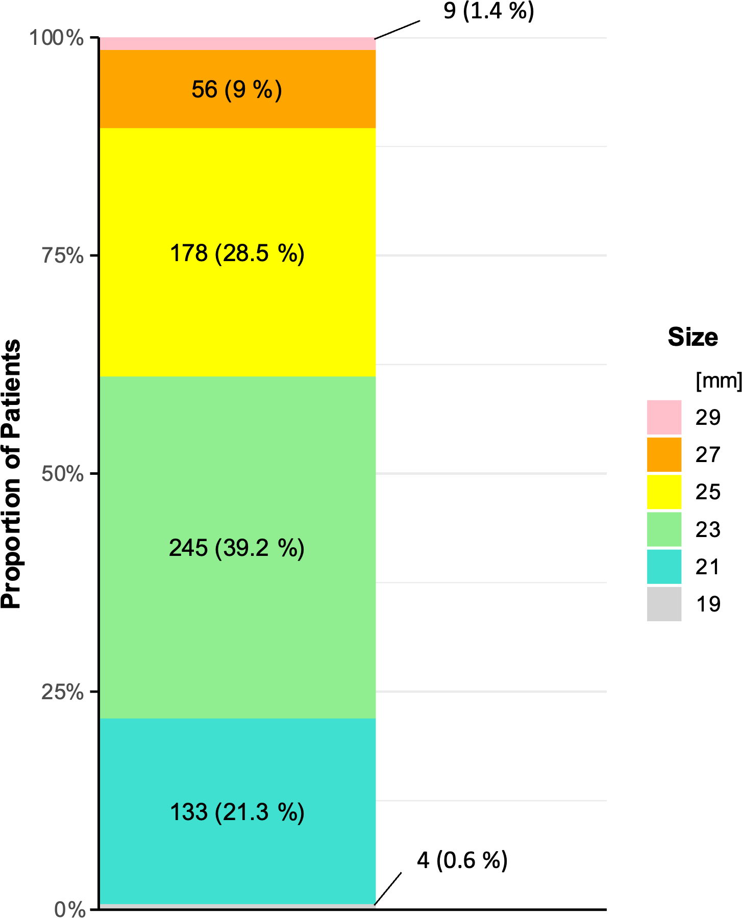
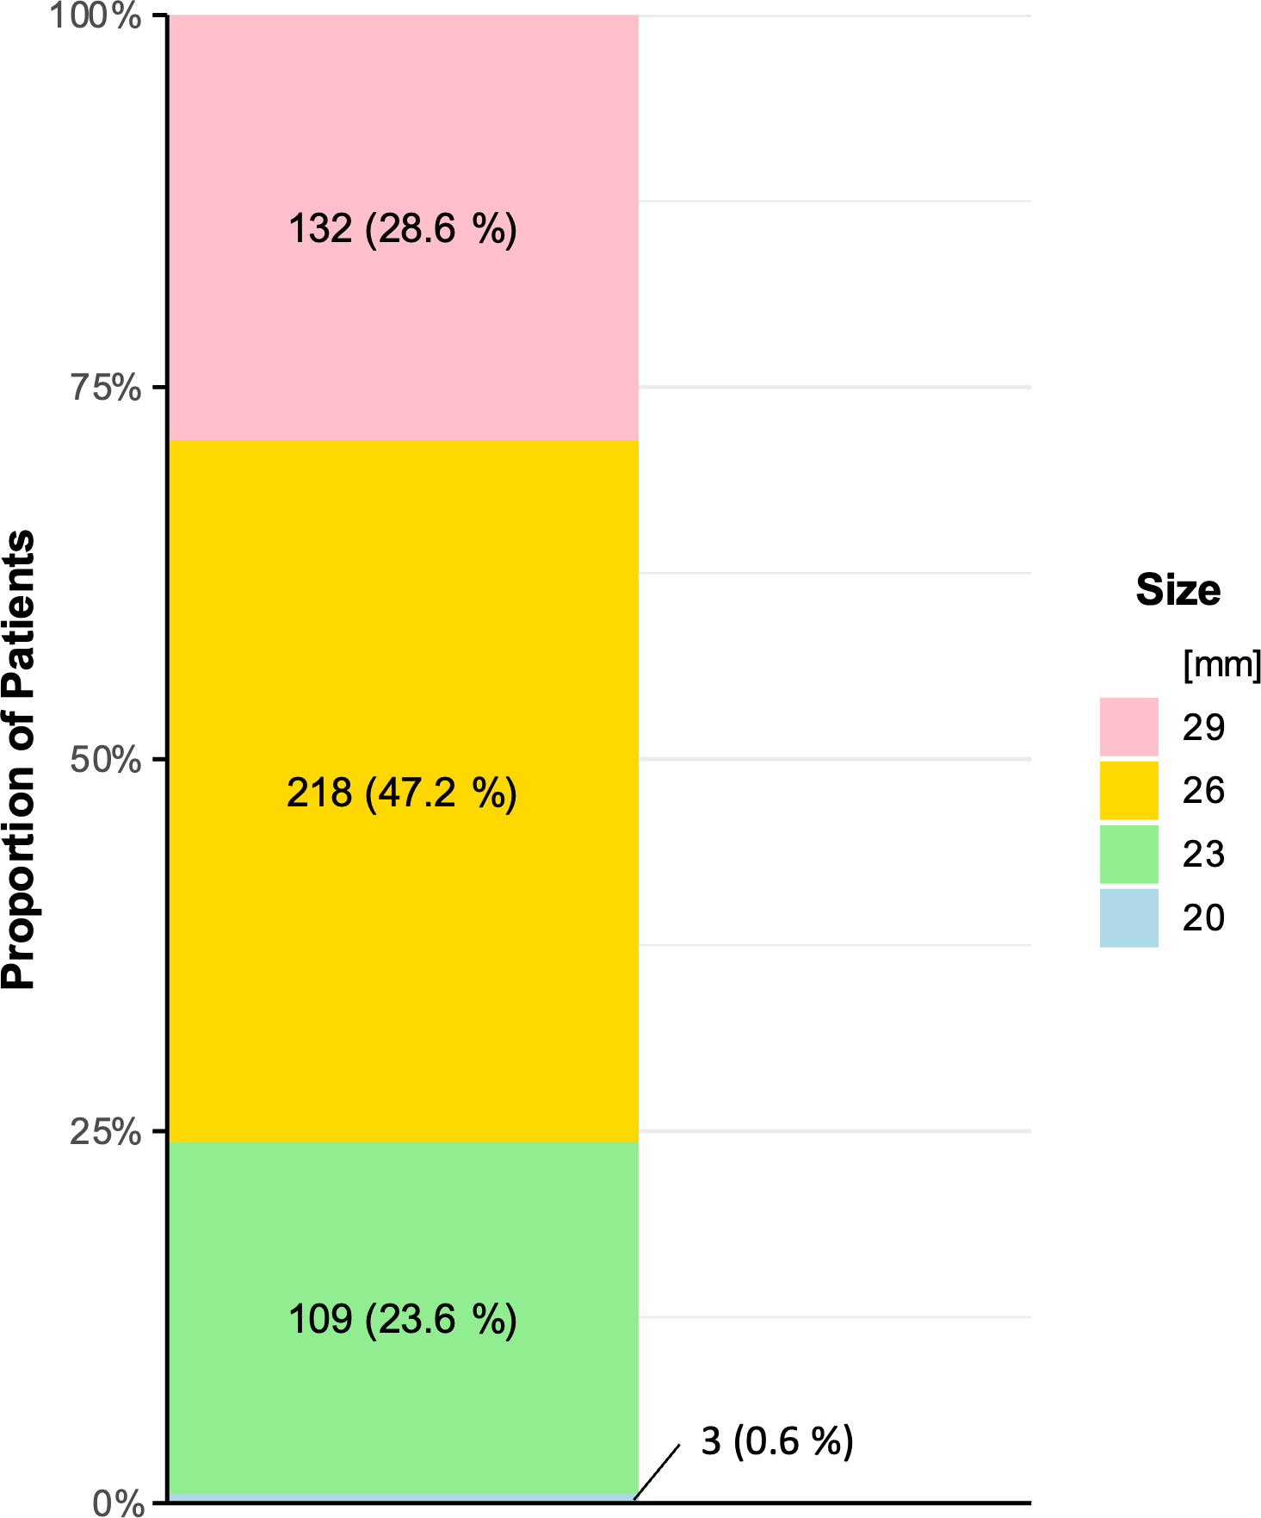
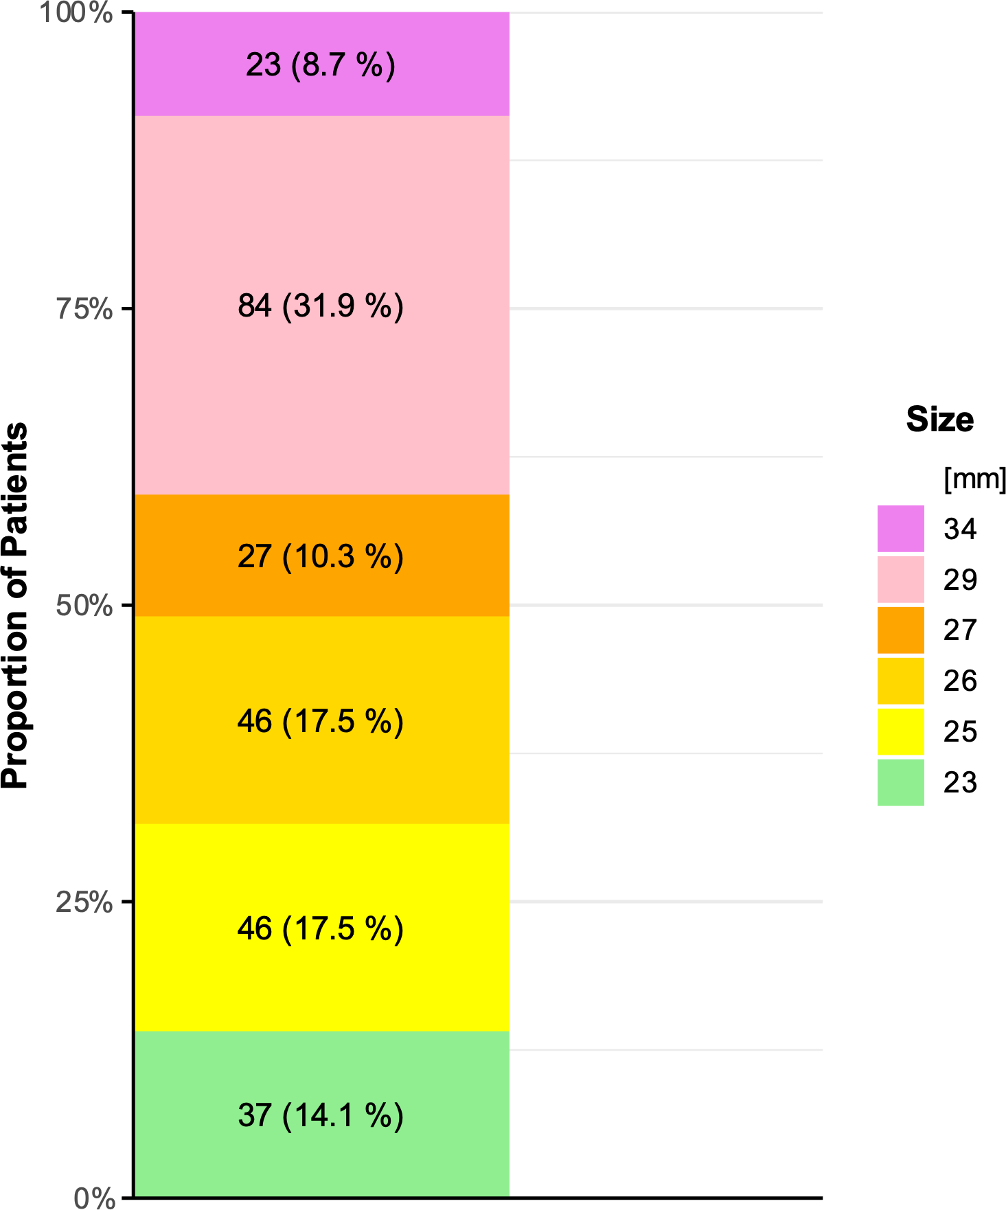
SAVR
TAVI (Balloon-expandable)
TAVI (Self-expanding)
As-treated population

Slide 16
TAVI (n=752) |  | SAVR (n=625)
Conversion to open heart surgery * | 0.8% (6) | -
Implantation of a 2nd valve prosthesis | 0.4% (3)
Pericardial tamponade | 0.5% (4) | 0.5% (3)
Coronary obstruction | 0.1% (1) | 0.3% (2)
Prosthesis malposition or embolization ** | 0.8% (6) | -
* Conversion to open-heart surgery due to valve embolization (n=3), wire-induced perforation (n=2) or annulus rupture (n=1).
** Prosthesis malposition or embolization resulted in conversion to open-heart surgery (n=3) or implantation of a 2nd valve prosthesis (n=3).
Mean ± SD or median and interquartile range, As-treated population

Slide 17
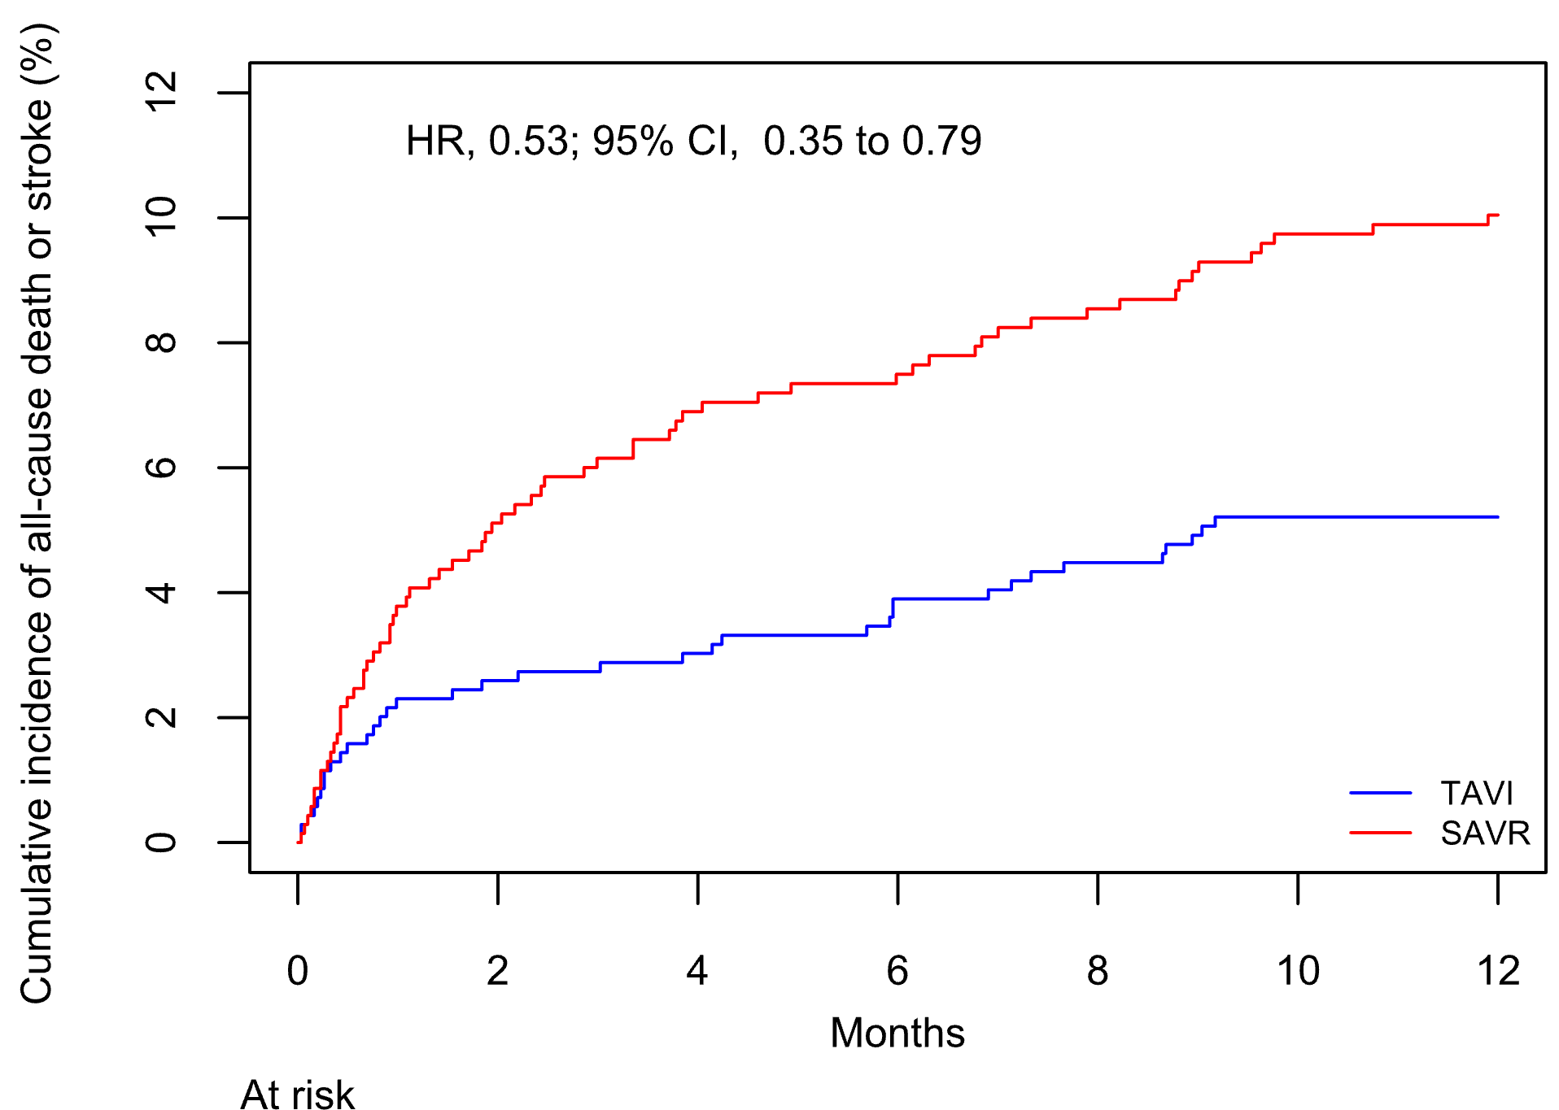
HR 0.53 (95% CI 0.35-0.79)
10.0%
5.4%
Intention-to-treat population, analysis stratified by STS-PROM score class, Kaplan-Meier estimates

Slide 18
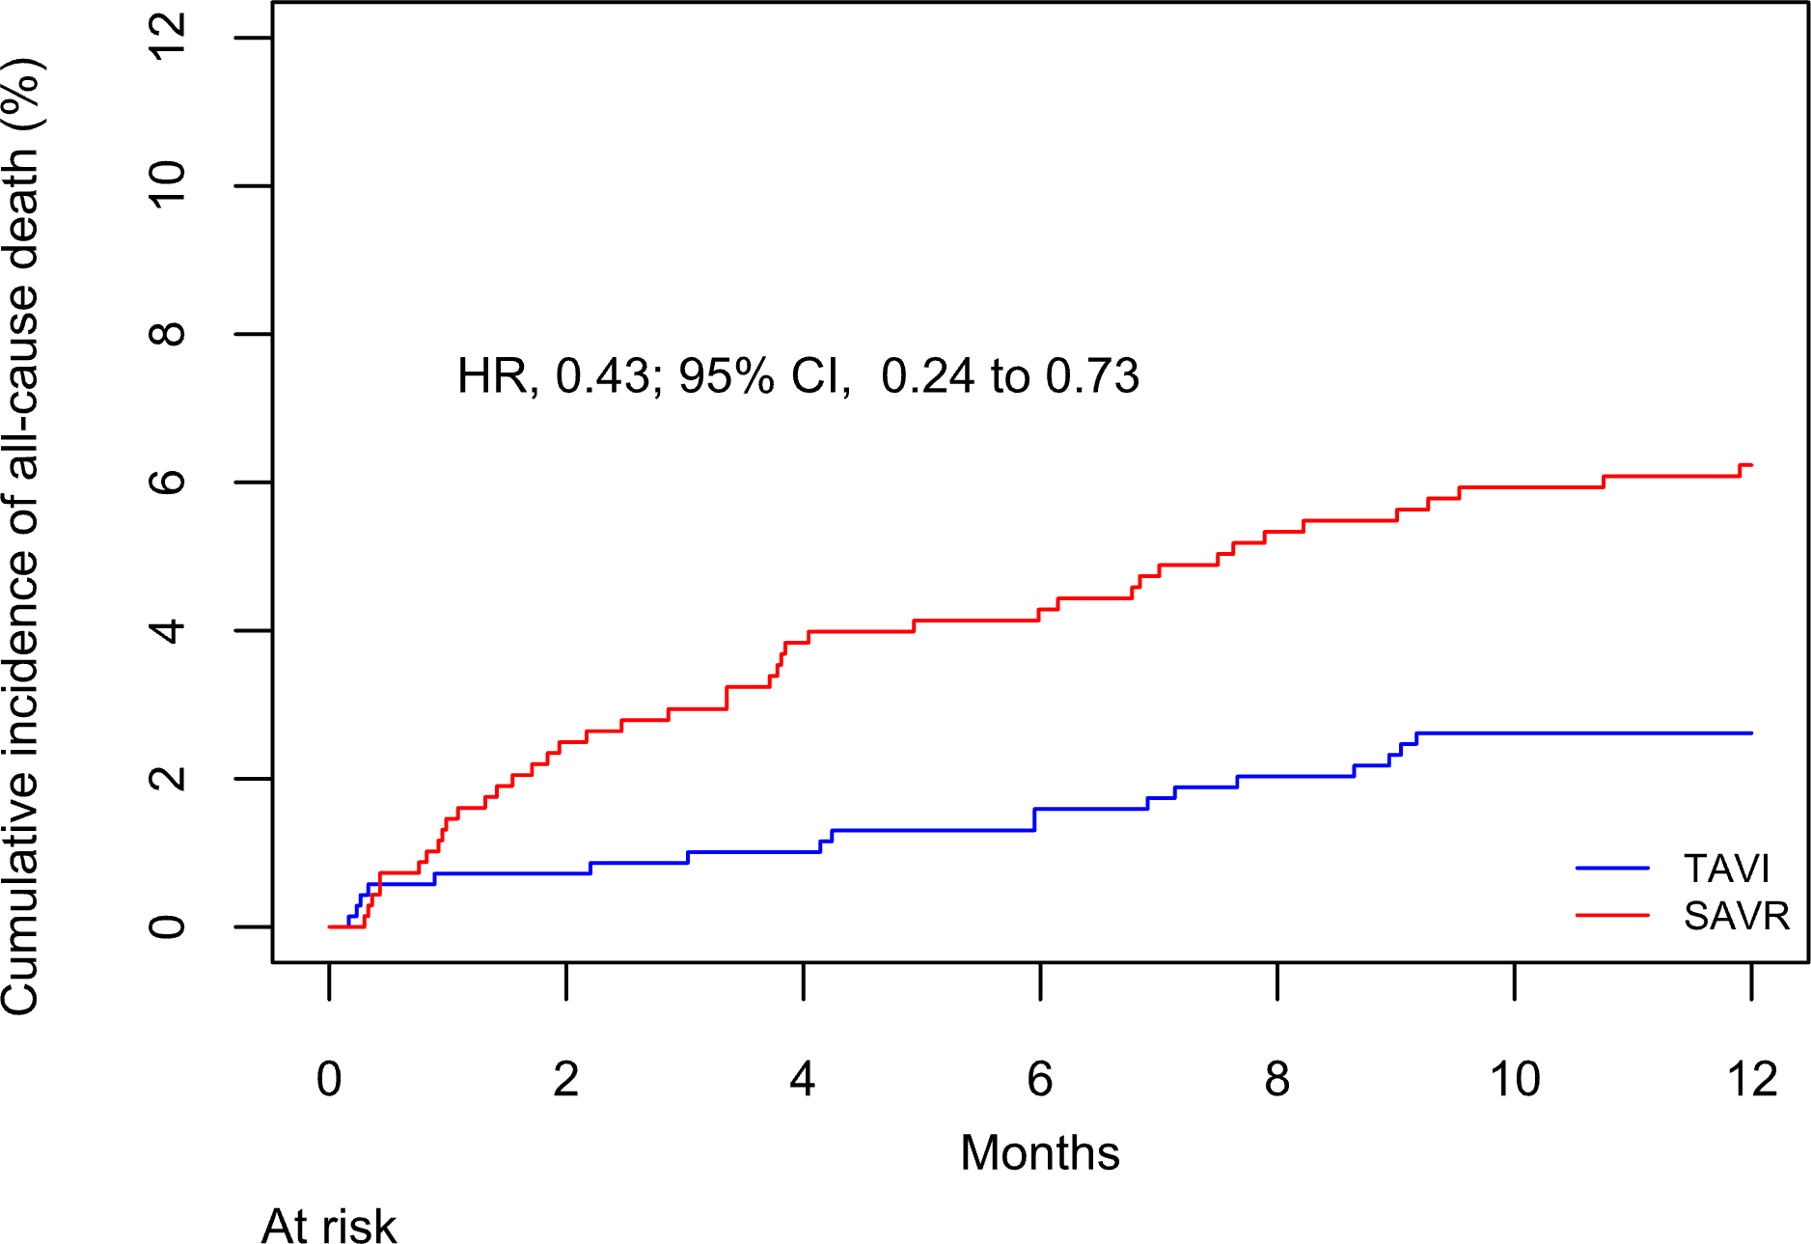
HR 0.43 (95% CI 0.24-0.73)
6.2%
2.6%
Intention-to-treat population, analysis stratified by STS-PROM score class, Kaplan-Meier estimates.

Slide 19
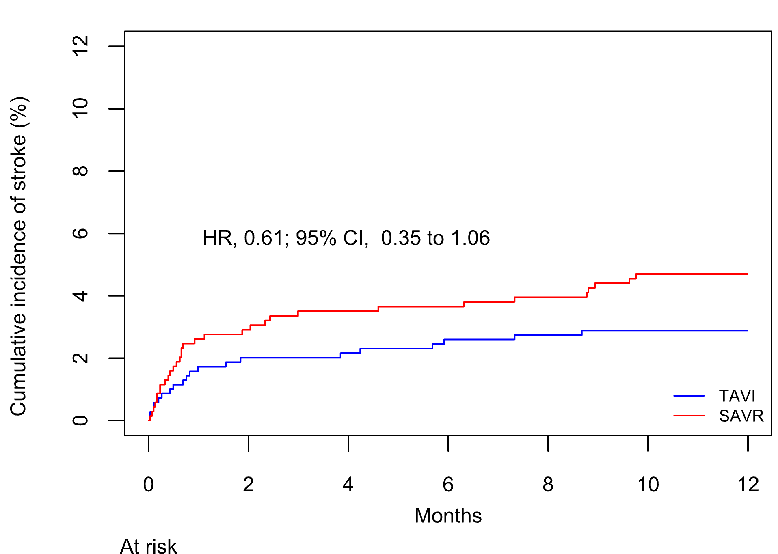
HR 0.61 (95% CI 0.35-1.06)
4.7%
2.9%
Intention-to-treat population, analysis stratified by STS-PROM score class, Kaplan-Meier estimates.

Slide 20
Outcomes at 1 year | TAVI (n=701) | SAVR (n=713) | HR (95% CI)
Disabling stroke | 1.3% | 3.1% | 0.42 (0.19-0.88)
Cardiovascular death | 2.0% | 4.4% | 0.47 (0.24-0.86)
Vascular access site complication (minor or major) | 7.9% | 0.7% | 10.64 (4.84-28.94)
Bleeding (major or life-threatening/disabling) | 4.3% | 17.2% | 0.24 (0.16-0.35)
AKI stage II/III | 1.3% | 2.5% | 0.56 (0.24-1.21)
Myocardial infarction | 1.0% | 2.1% | 0.51 (0.20-1.19)
New-onset atrial fibrillation | 12.4% | 30.8% | 0.36 (0.28-0.46)
New-onset LBBB | 32.0% | 17.5% | 2.03 (1.63-2.54)
New permanent pacemaker implantation | 11.8% | 6.7% | 1.81 (1.27-2.61)
Intention-to-treat population, analysis stratified by STS-PROM score class.

Slide 21
Outcomes at 1 year | TAVI (n=701) | SAVR (n=713) | HR (95% CI)
Prosthetic valve dysfunction | 1.6% | 0.6% | 2.44 (0.87-8.15)
Prosthetic valve endocarditis | 0.6% | 0.9% | 0.66 (0.18-2.19)
Prosthetic valve thrombosis | 0.7% | 0.3% | 2.09 (0.50-11.64)
Aortic-valve reintervention | 0.6% | 0.3% | 1.70 (0.38-9.78)
Rehospitalization (Cardiovascular) | 12.2% | 13.3% | 0.89 (0.66-1.20)
Intention-to-treat population, analysis stratified by STS-PROM score class.

Slide 22
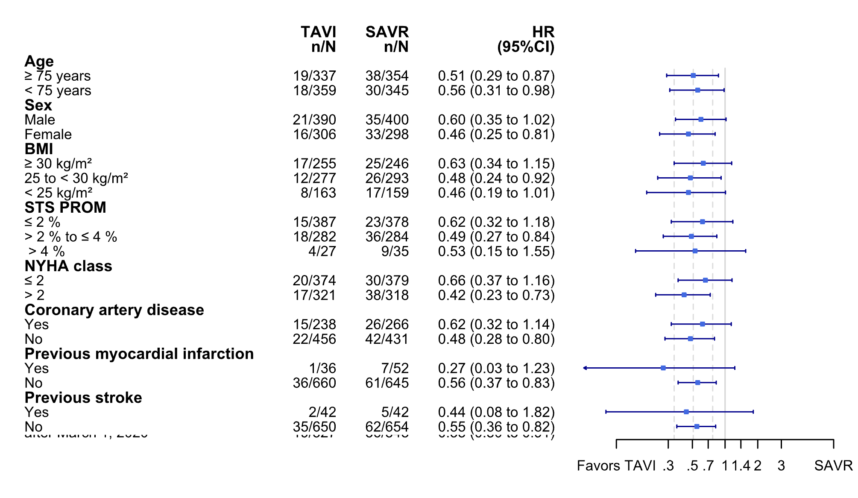
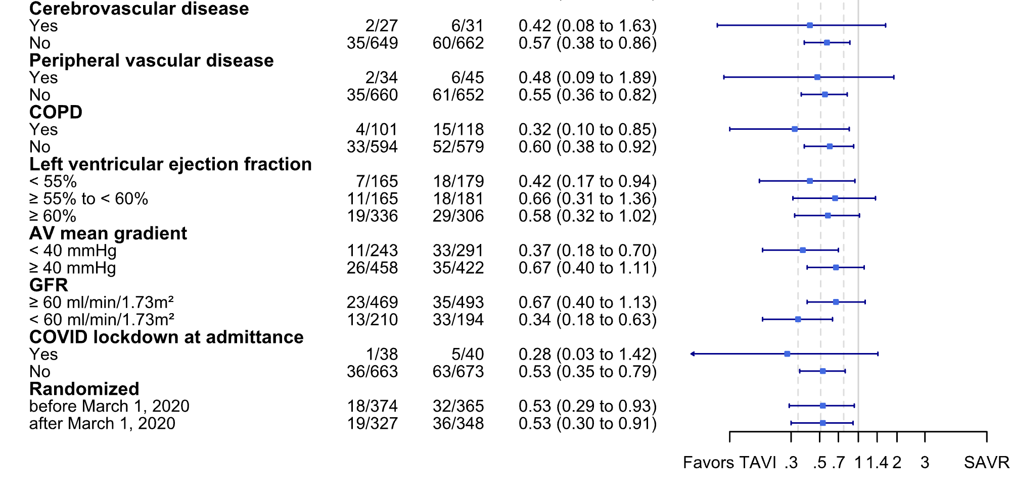
Intention-to-treat population

Slide 23
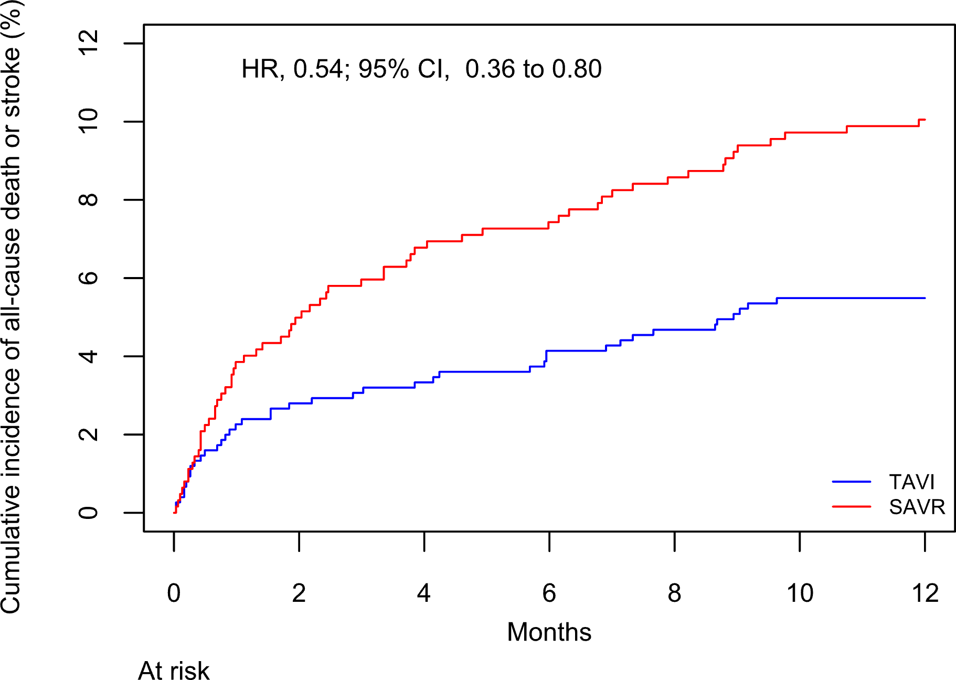
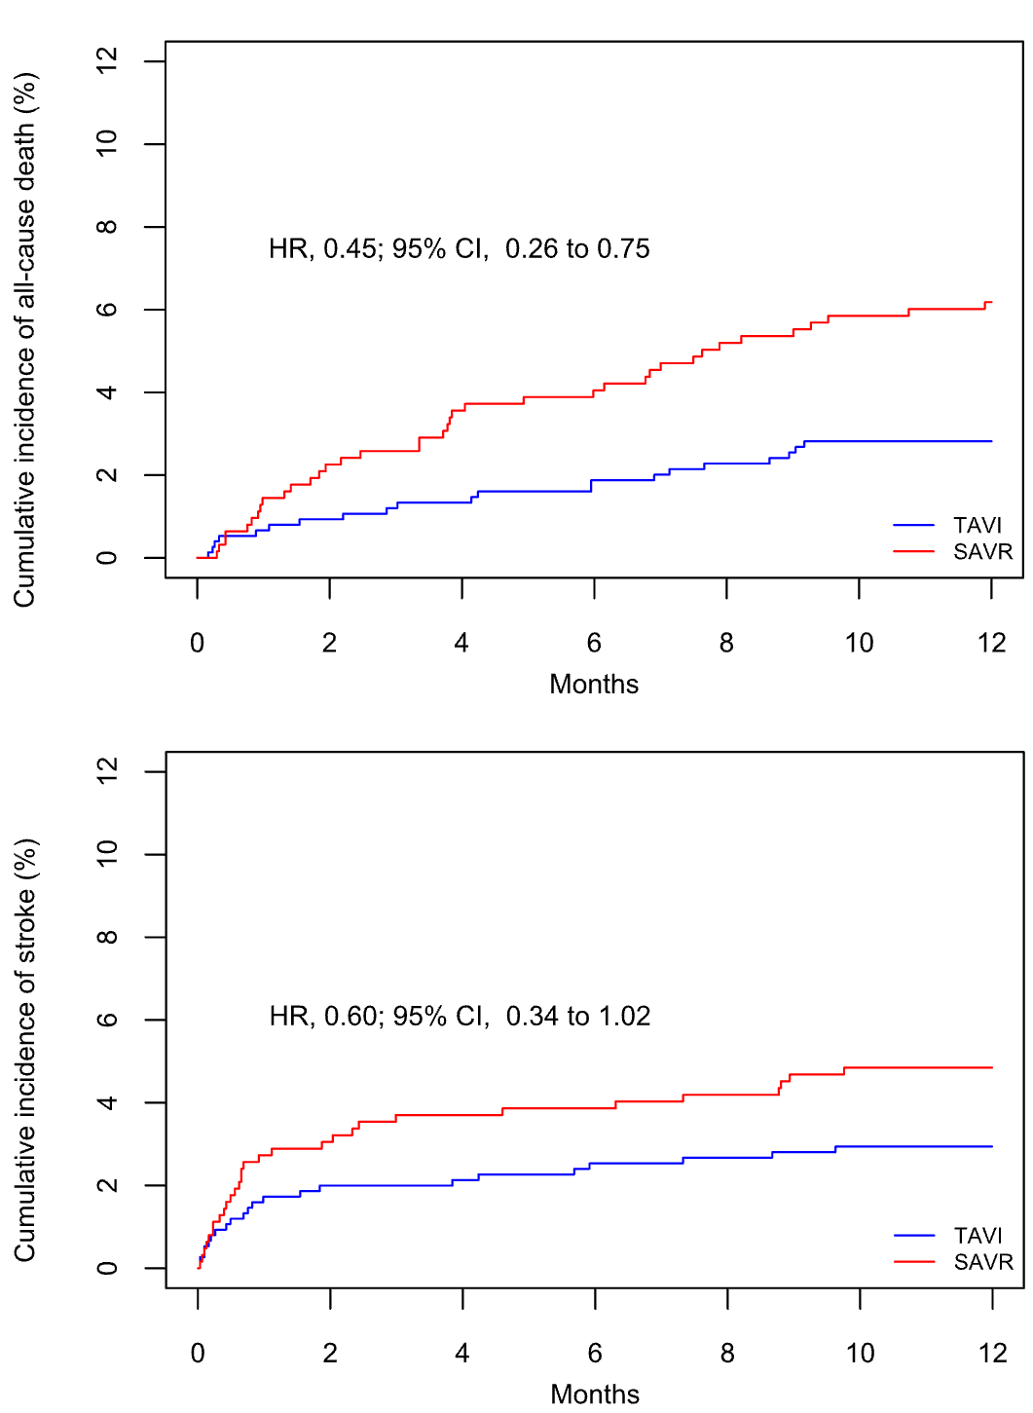
HR 0.54 (95% CI 0.36-0.80)
HR 0.45 (95% CI 0.26-0.75)
10.1%
6.2%
2.8%
5.6%
HR 0.60 (95% CI 0.34-1.02)
4.9%
2.9%
As-treated population, analysis stratified by STS-PROM score class, Kaplan-Meier estimates

Slide 24
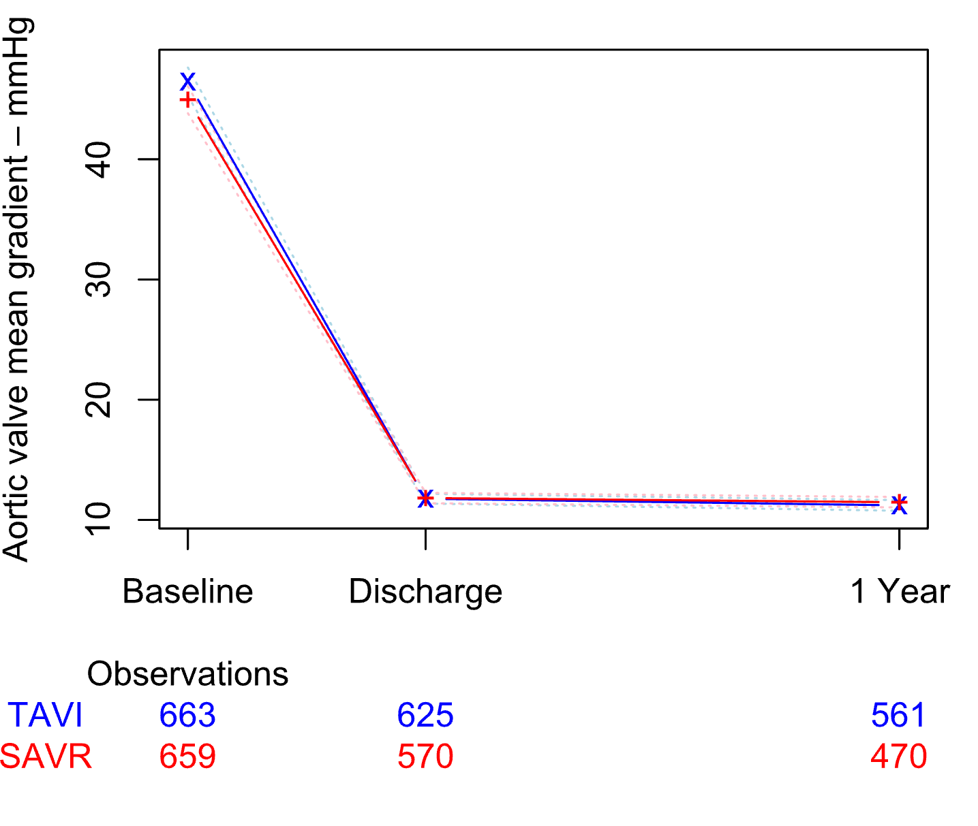
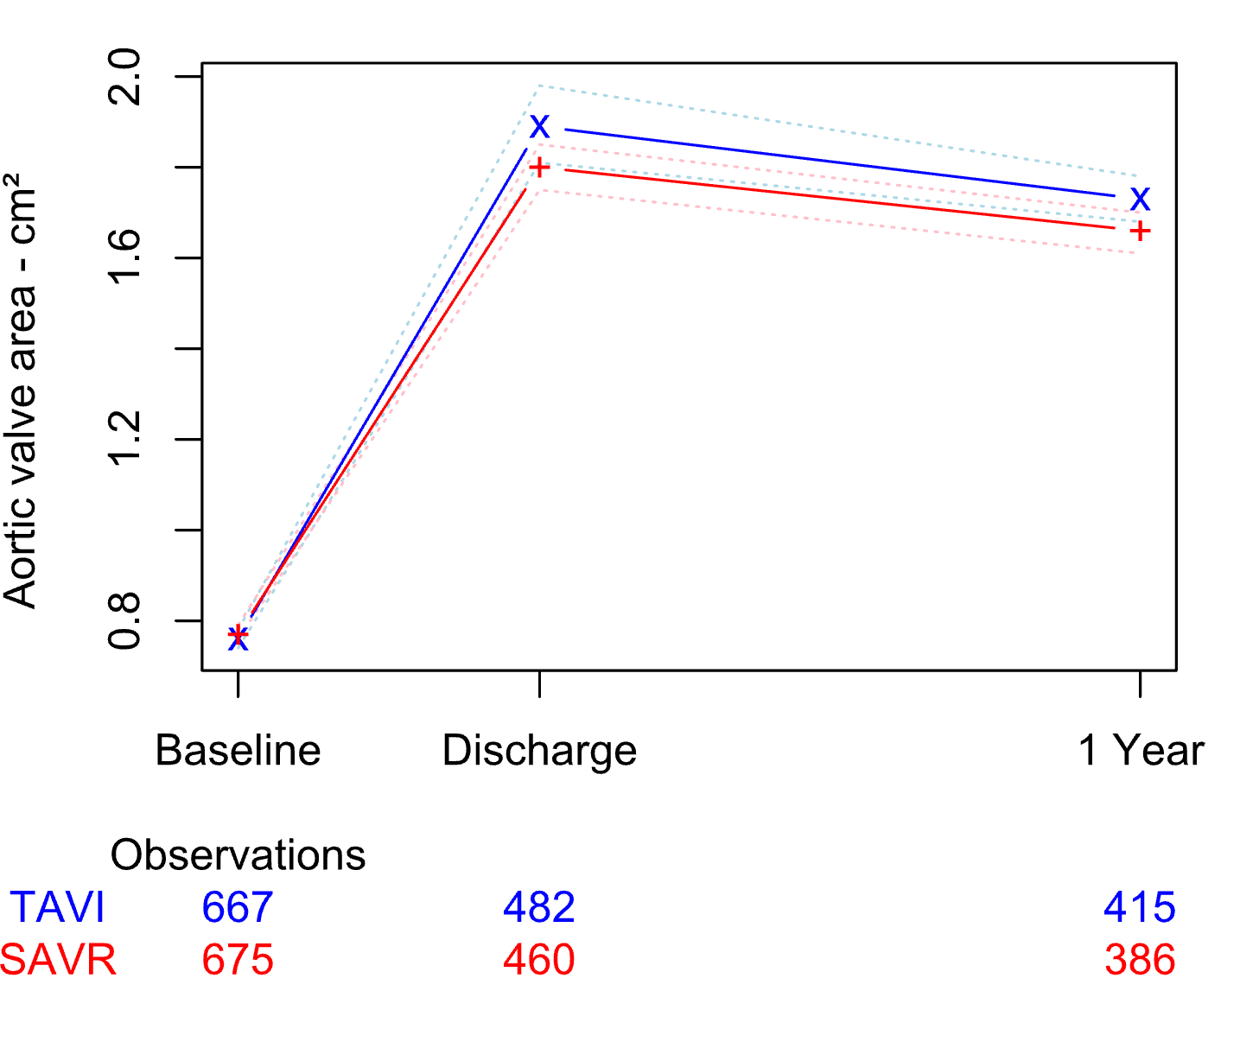
45 mmHg
44 mmHg
1.6 cm²
1.6 cm²
mmHg
mmHg
0.8 cm²
0.8 cm²
Intention-to-treat population.

Slide 25
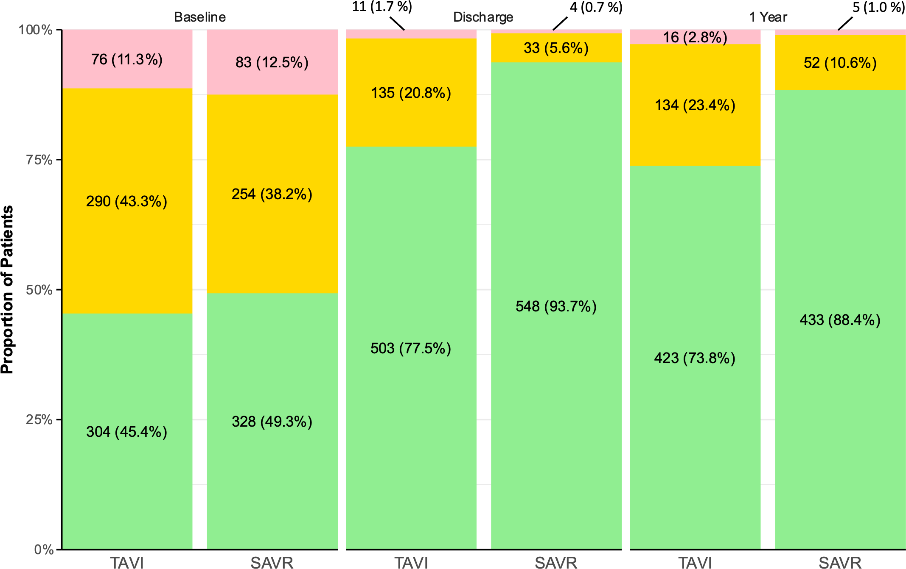
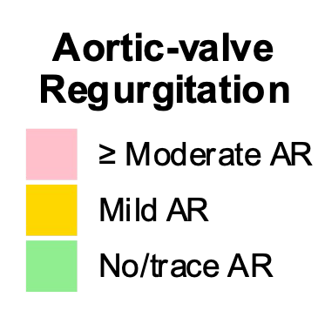
Intention-to-treat population.

Slide 26
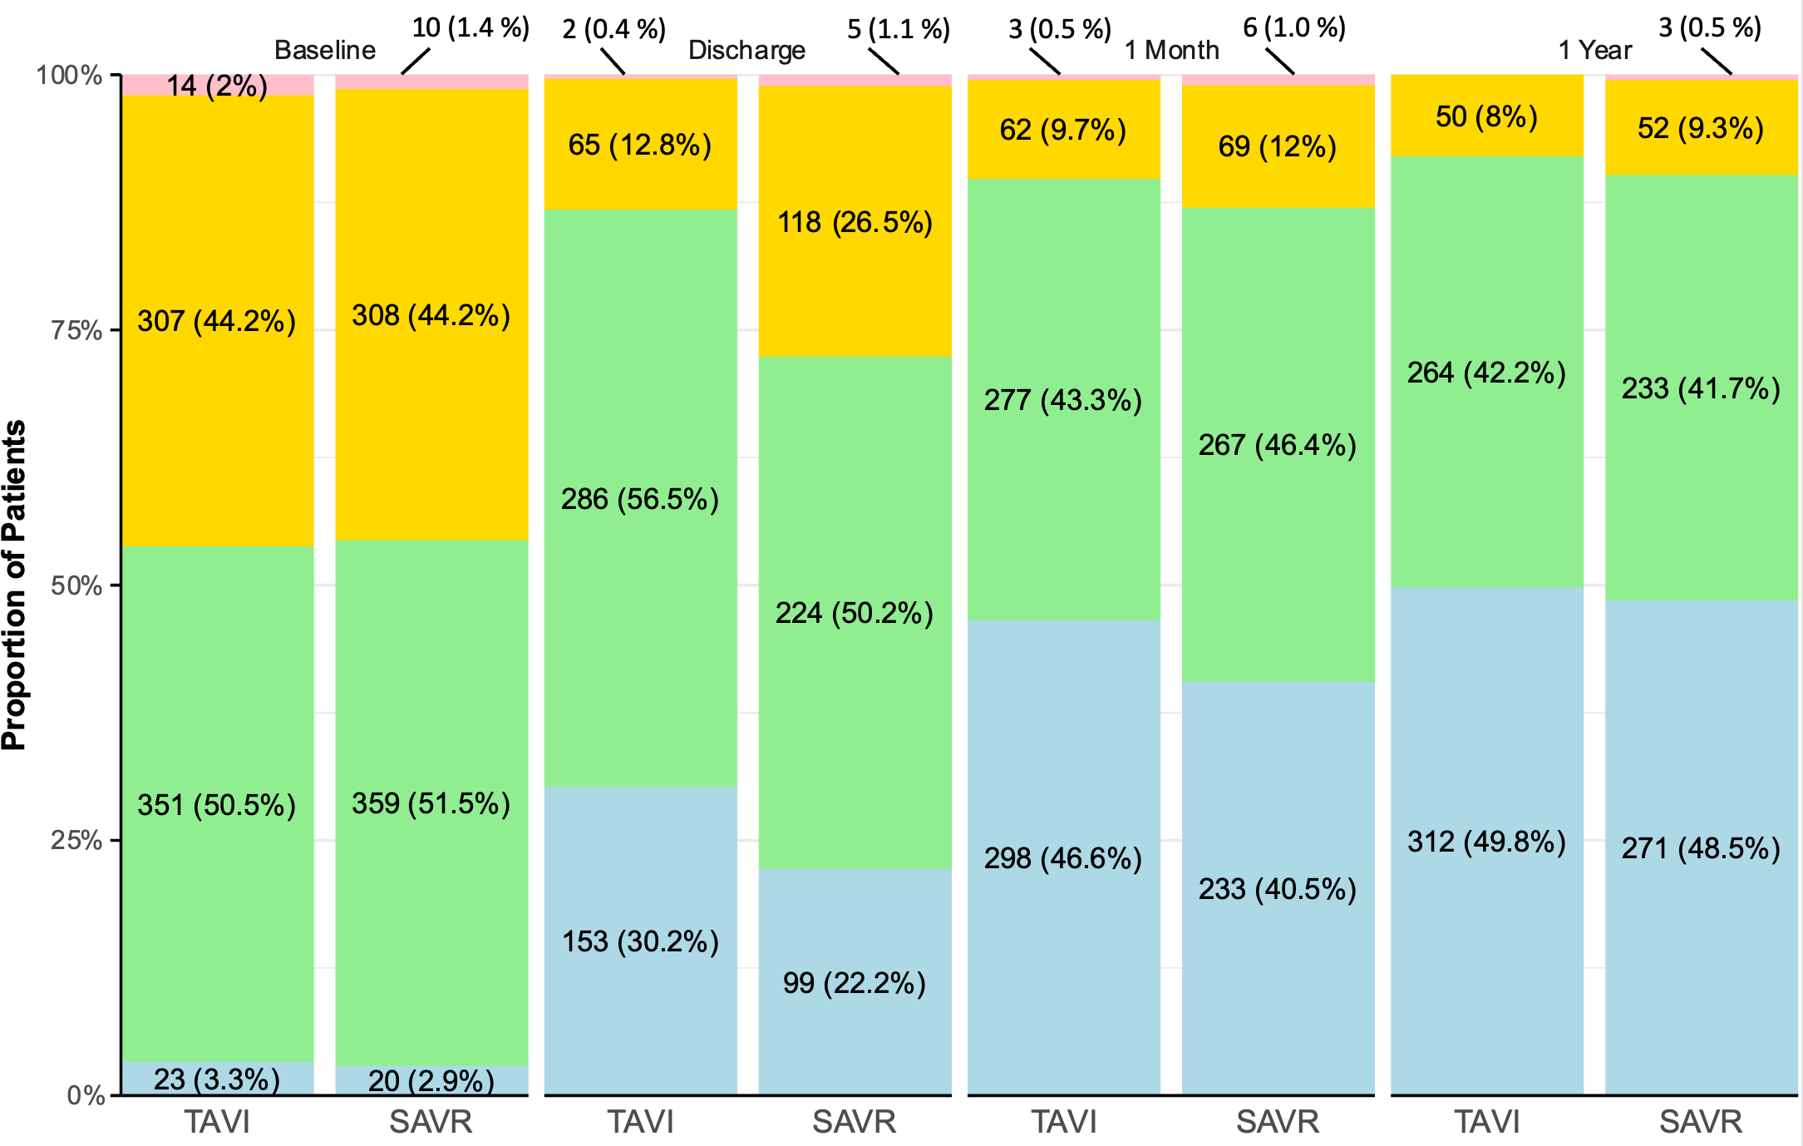
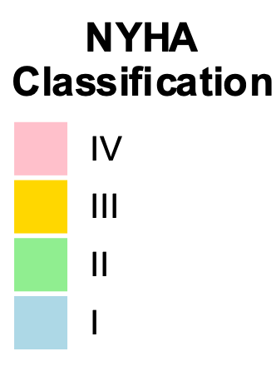
Intention-to-treat population.

Slide 27
Limitations
Analyses limited to 1-year follow-up, primary outcome will be re-evaluated at 5 years (Primary efficacy endpoint, tested for non-inferiority and superiority)
Exclusion of patients with bicuspid AS or concomitant CAD or other VD
Number of crossovers from SAVR to TAVI as part of the ITT design
Potential impact of the Covid-19 pandemic on outcomes
No consecutive all-comers population despite broad inclusion criteria

Slide 28
Conclusion
Among patients with severe aortic stenosis at low or intermediate surgical risk,
TAVI with prosthesis selection based on operator discretion was noninferior to SAVR with respect to the risk of death from any cause or stroke at 1 year.

Slide 29
